Slide 1
Week 8: 9/29-10/3
Monday: Study Guide (due THURSDAY), pass back all graded papers, Grade AGENDA
assign words for tomorrow’s assignment
Tuesday: Prepare Vocabulary Vignettes (Due tomorrow)
Pass out Assignment Reports
Wednesday: Perform Vocabulary Vignettes
***Vignette Script DUE, Grading while students present
Thursday: Test over Words of the Day
***Appetizers and Study Guide DUE
Friday: Free Write/Read FRIDAY

Slide 2
Monday: 9/29
You need: - AGENDA (to be graded)
- Appetizers
Study Guide
Any quizzes or appetizers from this term that you have in your folders
BELLRINGER Question: What is your favorite word of the day we’ve had so far? WHY?
When you finish, READ SILENTLY.

Slide 3
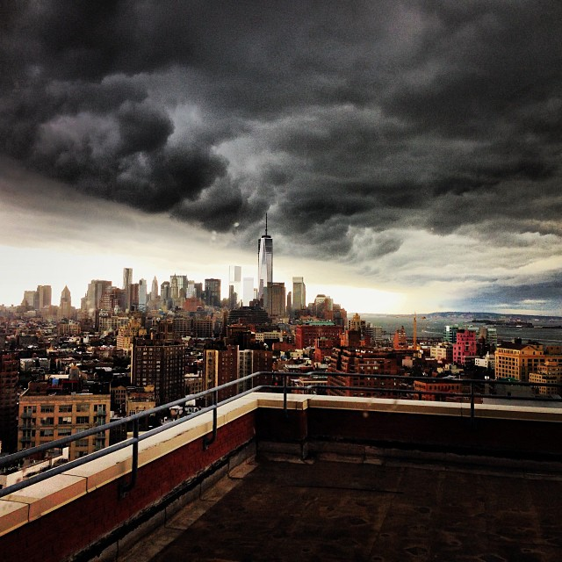
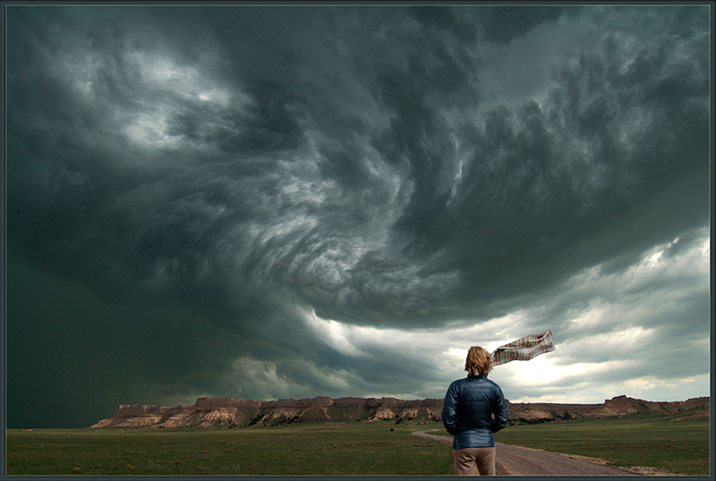
Word of the Day ominous
SYNONYMS: threatening, menacing, fateful, dark, gloomy

Slide 4
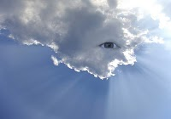
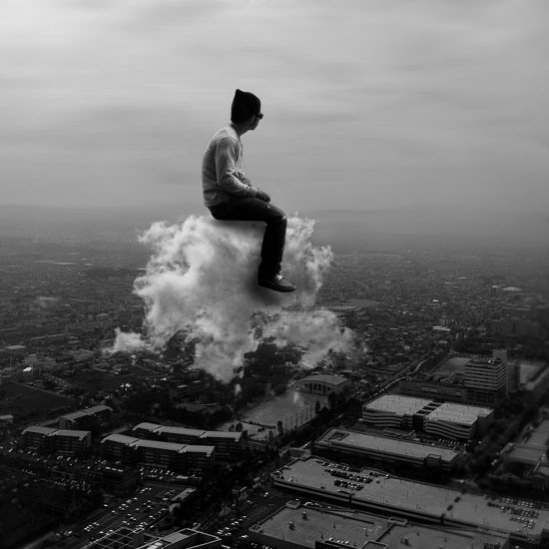
Word of the Day: omniscient
SYNONYMS: all-knowing, all-seeing
https://www.youtube.com/watch?v=MCeyHKcSLTg

Slide 5
STUDY GUIDE: Complete in groups Due before your test on Thursday
Work together with your table to complete the study guide on our Words of the Day.
Be sure you understand the answers you are writing, in order to help yourself study for the test on Thursday
When you finish, read silently

Slide 6
Monday:
I can review my knowledge of vocabulary by completing a study guide.

Slide 7
Tuesday: 9/30
TO-DO:
- AGENDA
Appetizers
BELLRINGER Question: It is imperative to study for your Test on Thursday. What does imperative mean in this sentence?
When you finish, READ SILENTLY.

Slide 8
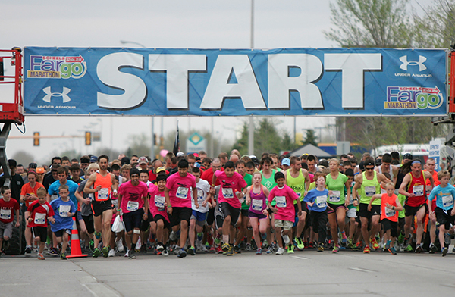
Word of the Day Marathon
SYNONYMS: foot race, endurance run
26.2 miles
https://www.youtube.com/watch?v=dTAAsCNK7RA

Slide 9
Word of the Day Alacrity
SYNONYMS: quickness, efficiently, with speed, eagerness

Slide 10
Vocabulary Vignette
Everyone will be assigned a word
You are responsible for including all those words in your group’s vignette
Be sure that EVERYONE writes down their own script to use tomorrow
VIGNETTES will be performed TOMORROW, so your script is due tomorrow.

Slide 11
Tuesday:
I can comprehend vocabulary by creating a vignette using multiple words.

Slide 12
Wednesday: 10/1
TO-DO:
- AGENDA
Appetizers
Have your Vignette out and ready
BELLRINGER Question: What does it mean if something is juxtaposed?
When you finish, READ SILENTLY.

Slide 13
Vocabulary Vignettes
Be sure your script has your name and vocabulary word on it
Be sure to complete the rubric for each group that performs. (Do not have to include your own.)
Use the skits to have fun, but remember to study while everyone is presenting
REMEMBER: Your study guide and appetizers are DUE TOMORROW before the test.

Slide 14
Wednesday:
I can display my knowledge of vocabulary by performing in a vignette.

Slide 15
Thursday: 10/2
TO-DO:
- AGENDA
Appetizers
Have your Study Guide out ready to turn in
BELLRINGER Question: What does the word tempo mean?
When you finish, READ SILENTLY.

Slide 16
Thursday:
I can demonstrate my knowledge of vocabulary by taking a test.
*When you finish, turn your test over, and read silently.*

Slide 17
Friday: 10/3
Everything off of your desk EXCEPT:
Pencil
Paper
Book
Rules of #FREEWRITEREADFRIDAY
#silent
#readingorwriting
#havefun

Slide 18
