Slide 1
Week 7: 9/22-9/26 A week-long author study on Lois Lowry!!!
Monday: Meet Lois Lowry
(Literature textbook pages 664-667)
Tuesday: Read a short story by Lowry, “Crow Call”
(Lit. Textbook pages 668-675)
Wednesday: Newberry Acceptance Speech
(Lit. Textbook pages 676-677)
Thursday: “Looking Back” – Lois Lowry’s Memoir
(Lit Textbook pages 678-683)
Friday: WOTD QUIZ and
Summary Paragraph about Lois Lowry’s life, writing, and legacy

Slide 2
Monday: 9/22
Clear your desk.
Complete your Appetizer TO-DO list
KEEP YOUR AGENDA OUT TO BE GRADED
Staple together 5 pieces of notebook paper for this week’s reading assignments
BELLRINGER Question: What does it mean to paraphrase?
When you finish, READ SILENTLY.

Slide 3
Word of the Day Amicable
SYNONYMS: friendly, neighborly, peaceful, polite
https://www.youtube.com/watch?v=g1LRG4J8_OU

Slide 4
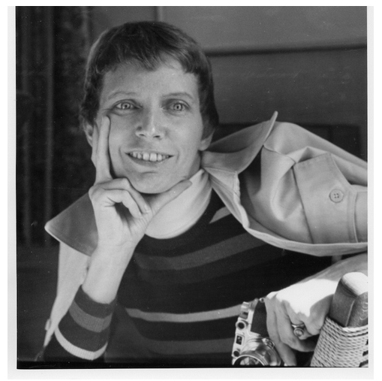
Write on your stapled notebook paper: - Name - Label today’s section title “Meet Lois Lowry” - Write down the page numbers 664-667
DIRECTIONS:
As you read, take at least 10 different notes of important facts on your paper.
When you finish, read silently.

Slide 5
Monday:
I can summarize by taking notes of important facts.

Slide 6
Tuesday: 9/23
Clear your desk.
Complete your Appetizer TO-DO list
Don’t forget your AGENDA
Be sure you have your stapled notes packet out
BELLRINGER Question: What was the most interesting thing you learned about Lois Lowry yesterday?
When you finish, READ SILENTLY.

Slide 7
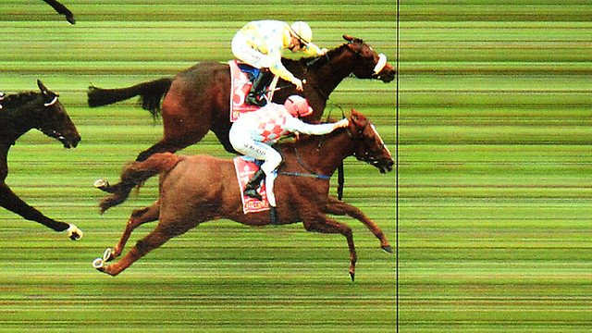
Word of the Day Discern
SYNONYMS: determine, distinguish, detect, foresee, perceive

Slide 8
Read the short story by Lowry called “Crow Call” (Lit. Textbook pages 668-675) When you finish, write 5 sentences summarizing what happened in the story on your notebook paper for this week. (Only include important information.)

Slide 9
Tuesday:
I can summarize a short story.

Slide 10
Wednesday: 9/24
Clear your desk.
Complete your Appetizer TO-DO list
Don’t forget your AGENDA
Be sure you have your stapled notes packet out
BELLRINGER Question: Why do you think the narrator’s father didn’t shoot the crows in the short story “Crow Call”? What does this reveal about him?
When you finish, READ SILENTLY.

Slide 11
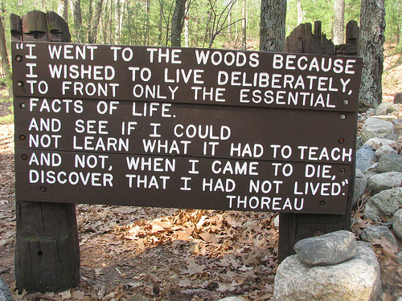
Word of the Day: Deliberate
SYNONYMS: purposeful, careful, thoughtful, intentional

Slide 12
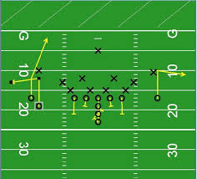
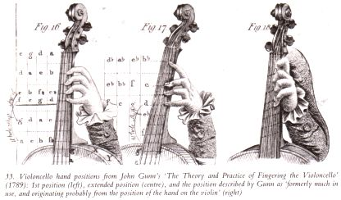
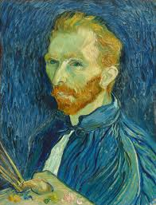
Word of the Day: Deliberate SYNONYMS: purposeful, careful, thoughtful, intentional

Slide 13
Newberry Acceptance Speech (Lit. Textbook pages 676-677)
Follow the directions for the READERS NOTEBOOK while you read. Jot down at least 3 phrases or sentences she says that lead you to understanding her purpose. (Don’t forget to put Lowry’s words in “quotations”)
Complete #1-2 at the end
When you finish, read silently.
https://www.youtube.com/watch?v=eTspwR5dEEk
https://www.youtube.com/watch?v=YYGGs2lxtjY
https://www.youtube.com/watch?v=rwNsBe9hrlc

Slide 14
Wednesday:
I can summarize the purpose of a speech.

Slide 15
Thursday: 9/25
Clear your desk.
Complete your Appetizer TO-DO list
Don’t forget your AGENDA
Be sure you have your stapled notes packet out
BELLRINGER Question: What was the name of one of the books Lois Lowry won a Newberry medal for?
When you finish, READ SILENTLY.

Slide 16
Word of the Day Eradicate
SYNONYMS: abolish, eliminate, extinguish, erase
What would you Eradicate to make a perfect world?
https://www.youtube.com/watch?v=jcsIiqr6Wlw

Slide 17
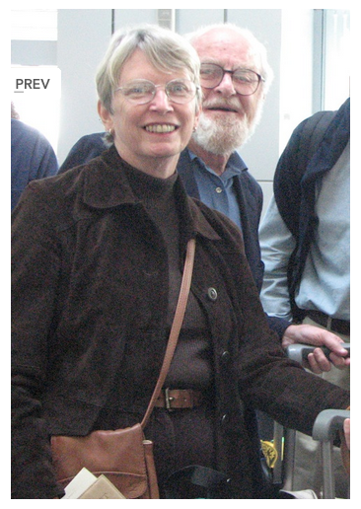
“Looking Back” – Lois Lowry’s Memoir (Lit Textbook pages 678-683)
Take at least 10 notes on your stapled paper from the memoir
When you finish, begin to outline your 3.8 paragraph for tomorrow’s quiz. You are writing a summary about Lois Lowry. Use these 3 points: her writing, her life, and her awards.
You may write out your paragraph to prepare for tomorrow as well.

Slide 18
Thursday:
I can take notes on important details from Lowry’s memoir in order to prepare my own summary.

Slide 19
Friday: 9/26
Everything off of your desk EXCEPT:
Pencil
A piece of paper
Appetizer Packet
Notes from this week
Textbook
Book

Slide 20
I can test my knowledge from this week by taking a quiz.
1. Write a 3.8 summary paragraph about the information you’ve learned this week about Lois Lowry. (Include 3 points about things such as her writing, life, and awards. Be sure to use FACTS, REASONS, EXAMPLES, and DETAILS from your notes this week as well as the 3.8 checklist)
*When you finish, turn your quiz over, and read silently.*
Homework: Be sure your agenda is signed.

