Slide 1
Week 6: 9/15-9/19
Mon: Finish 3.8 on “The Greatest Show on Earth”
Tues: Reading and Annotating
“School’s Lesson Plan: No More Homework”
Wed: Trade Narrative Paragraphs from last week’s quiz
Thurs: Grade Flashbacks, Prepare your 3.8 for quiz
Fri: WOTD QUIZ, 3.8 Summary paragraph

Slide 2
Monday: 9/15
#YOUNEED: - Your AGENDA and handouts from THEHUB
- “The Greatest Show on Earth”
(R.S. packet 2 weeks ago)
- Outline of “The Greatest Show on Earth”
(Last week’s R.S. packet)
Complete your Appetizer TO-DO list
BELLRINGER Question: Describe what we did on the outline for “The Greatest Show on Earth” last week.
When you finish, READ SILENTLY.

Slide 3
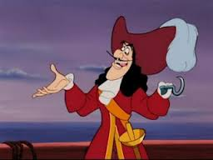
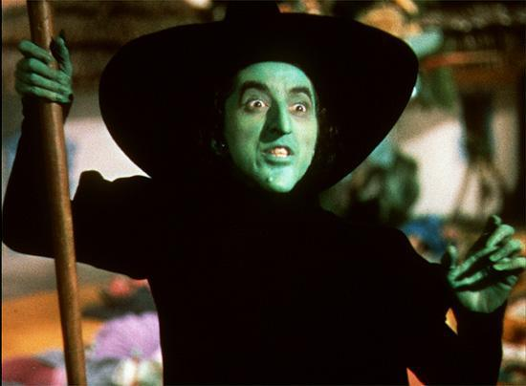
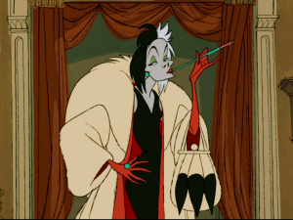
Word of the Day ANTAGONIST
SYNONYMS: adversary,
opponent, enemy, foe

Slide 4
Process the Text by... Writing a Summary Paragraph
Using the information from the chart and the 3.8 summary guidelines, practice writing a summary paragraph of the article from last week.
Determine what your 3 points will be.
Decide what your FREDs will be for those points.
SO WHAT? Write a concluding sentence that EVALUATES.
When you finish, read silently.

Slide 5
Share time!
Trade and Grade with someone in the room.
Read their paper out loud to them.
Tell them something they did well.
Make at least 1 suggestion for improvements.
BE SURE they’ve written a 3.8 paragraph!
When both of you finish, return to your seat and read silently.

Slide 6
MONDAY:
(Don’t forget to rate your target)
I can summarize an article by writing a 3.8 summary paragraph.

Slide 7
Monday: 9/15 7th hour
Agenda – leave it out to be graded.
Appetizers: Follow the to-do list
Learning Target: I can summarize an article by writing an assertion.
BELL RINGER: What does it mean to find the MAIN IDEA of an article?
Read when you finish.

Slide 8
READING PASSAGE
After reading the passage, write an assertion sentence using these three items:
1 2 3 =
Title + VERB + the Main Idea = ASSERTION
FINISH THIS SENTENCE:
“Beverly Cleary” describes...

Slide 9
Tuesday: 9/16
#materials:
Appetizer Packet
Reading Strategy Packet (this week)
AGENDA and a book
Complete your Appetizer TO-DO list
BELLRINGER Question: What is one way you can you figure out the main idea of an entire article?
When you finish, READ SILENTLY.

Slide 10
Word of the Day AEROBIC
SYNONYMS: low impact exercise, work out, warm up
What AEROBICS do you see here?
https://www.youtube.com/watch?v=nfWlot6h_JM

Slide 11
ANNOTATE
To make notes while you read in order to better process the text
Underline, highlight
Circle unknown words and look them up
Summarize paragraphs
make comments or questions in the margins

Slide 12
Process the Text...
As we read “School’s Lesson Plan: No More Homework”:
Circle words you do not understand. Find
their meaning and write it out to the side.
Highlight the ASSERTION (TOPIC SENTENCE) GREEN
Highlight the PROOF (important details) YELLOW
To the right, number 1-6. Write each paragraph’s main idea.
When you finish, read silently.

Slide 13
Tuesday:
(Don’t forget to rate your target)
I can process a text by annotating.

Slide 14
Wednesday: 9/17
Clear your desk except for your agenda, pencil, Appetizers, Reading Strategies Packet, and a book
Complete your Appetizer TO-DO list
BELLRINGER Question: When re-reading through something you’ve just written, what are 2 ways you can improve the writing?
When you finish, READ SILENTLY.

Slide 15
Word of the Day ANAEROBIC
SYNONYMS: weight lifting, endurance, physical conditioning
Anaerobic FAILS...
https://www.youtube.com/watch?v=xcdx045xQDs

Slide 16
PEER EDITING USE THE GRADING CHECKLIST!
Read your paragraph out loud.
Stop to make changes to mistakes as you go.
Have your partner read it out loud a 2nd time.
Stop to make changes to mistakes as you go.
When you finish, switch to your partner’s paper and repeat steps 1-4.
Now, you should both have an improved paragraph. Feel free to rewrite it on another piece of paper if you want to make it a clean copy.
When you both finish, read silently.

Slide 17
Wednesday:
I can improve my writing by rereading and making corrections.

Slide 18
Thursday: 9/18
Clear your desk except for your agenda, pencil, Appetizers, Reading Strategies Packet, and a book
Complete your Appetizer TO-DO list
BELLRINGER Question: What is the main idea of the article “School’s Lesson Plan: No More Homework” ?
When you finish, READ SILENTLY.

Slide 19
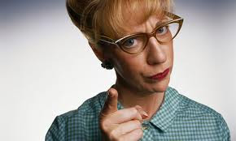
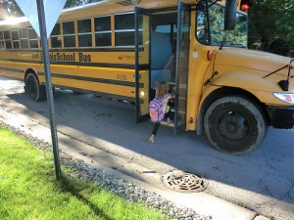
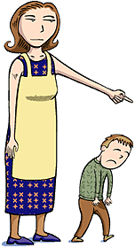
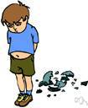
Word of the Day ADMONISH
SYNONYMS: criticize, reprimand, rebuke, scold

Slide 20
FLASHBACKS
TRADE AND GRADE or Grade your own honestly.
Please make sure you have the correct answer and why it is the correct answer

Slide 21
Preparing the 3.8
Use the article and other resources in your Reading Strategy packet to prepare for your summary 3.8 paragraph on your test tomorrow.
Be sure to think of your main 3 points first, and then fill in your FREDs last.
You should be sure your spelling, sentences, and information is all accurate. You will be graded on all of these things in your paragraph. USE THE CHECKLIST to help yourself remember what you need.

Slide 22
Thursday:
I can prepare to write a 3.8 by summarizing information in an article.

Slide 23
Friday: 9/19
Everything off of your desk EXCEPT:
Pencil
Appetizer Packet
Reading Strategies Packet
Book
BELLRINGER Question: What are the four words of the day from this week? (study their meanings as you write them down)

Slide 24
I can test my knowledge from this week by taking a quiz.
*When you finish,
turn your quiz over,
and read silently.*

