Slide 1
Week 5: 9/9-9/13

Slide 2
Monday: 9/9
Please complete your agenda.
Get out your Narrative Folder
Be sure your Draft #1 is stapled to the top of the left side. (the stapler will be coming around)
Work on paragraph 1 of your DPE for this week. DO NOT GO ON TO OTHER DAYS.
When you finish, read silently.
We will catch up on Book Talks after reading time.

Slide 3
Learning Target
I can research significant information to use for my narrative by completing 2 sticky texts to add to Draft #2.

Slide 4
Researching…
What makes a source credible (or reliable)?
What are some important things to observe about a source before reading the actual information?
What details do I need on my source in order to give proper credit to the writer?

Slide 5
TLC: Rules, Expectations, TO-DO
Complete 2 sticky notes of research. Each sticky note should have…
Topic: (what you are researching)
Source: (where you found your info.)
Author: (who wrote that info.)
Quote/Information: (the info you found)
- When you finish, place the sticky notes on your draft #1 in your folder and sit in the center of the room. Read silently or work on homework.

Slide 6
Tuesday 9/10
Have your narrative folder ready for today with your Draft #1.
Take out a separate piece of paper and write your name at the top.
Complete your agenda.
Read your independent reading book silently.
Don’t forget the Book Talk after reading time…

Slide 7
Learning Target
I can practice sequencing a narrative by drawing a timeline in order to evaluate the sequence of my own narrative.

Slide 8
SEQUENCE
On the top of your separate piece of paper, write everything you know about the word sequence. When is it used? How would you define it? Why is it important?
When you finish, read silently.

Slide 9
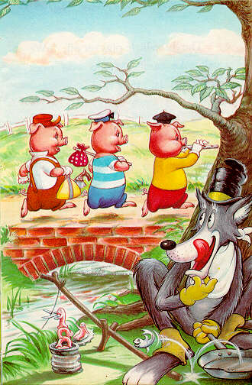
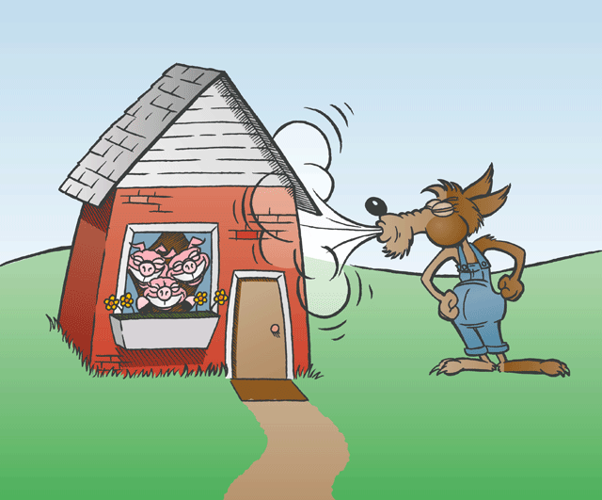
Sequence Partner Challenge
With your partner, draw a quick timeline of The Three Little Pigs from beginning to end on a scratch piece of paper. Be sure to only include important parts and use short fragments, not sentences.

Slide 10
Draft #1 Sequencing
Give your partner your Draft #1 and Paper for today. (Be sure your name is on it.)
Read through their Draft #1.
Create a timeline on their separate paper that models the sequence of their story.
When you both finish, switch back and examine your timeline.
PLEASE SAVE DISCUSSION FOR LATER…

Slide 11
RE-sequencing…
Read through your own draft and highlight the first word in a sentence that might give you clues to a new plot point or event on your timeline.
Now draw a timeline for your story underneath the one your partner drew, that you think is more accurate or detailed.
If you finish, read silently until everyone is done or continue to edit your own Draft #1.

Slide 12
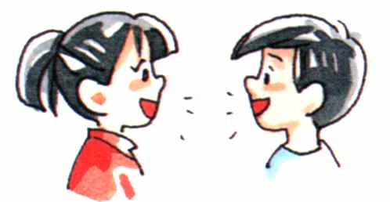
Table Talk
With your partner read through your own personal timeline, then answer the following questions in discussion…
Which part of my plot was most difficult to sequence?
How could I organize my narrative better in order for the sequence to make more sense?
What else could I improve on in general in my story?

Slide 13
Personal Evaluation
On the back or bottom of your separate piece of paper answer the following questions AND describe why you gave that number…
(use a scale of 1-5, 1=weak, 5=strong)
How well was I able to sequence my partner’s story?
How well was my partner able to sequence my story?
How well do I understand the importance of sequence in a narrative?
(Work on your DPE when you finish.)

Slide 14
Wednesday: 9/11
Write on a separate piece of paper…
What are you proud of in your life?
What is most important to you?
If you were to name the most important person in your life, who would it be and why?
http://www.youtube.com/watch?v=PN72xg_Tcj4
http://www.pbs.org/newshour/art/blog/2011/09/preview-of-america-remembers-911-reading-by-poets-billy-collins-nancy-mercado.html
When you finish, be sure to have your narrative folder out. READ SILENTLY.

Slide 15
The Writing Process…
It’s so easy, a kindergartener could do it…
http://www.youtube.com/watch?v=RBKqgOvmJ8w
Writing Process Animated...
http://www.youtube.com/watch?v=V1pnpL8295E
A real author talks on Editing…
http://www.youtube.com/watch?v=4iGfYt8fR4U

Slide 16
Draft #1 Revision
Highlight the first word in every sentence of your draft.
Circle any words that are repeated.
Read your story backwards to your partner one sentence at a time. Stop if your sentence was a run-on or fragment. Decide how to revise it.
When you finish, read each other’s drafts again silently.
Then read silently.

Slide 17
Description
On your separate piece of paper, expand and re-write these sentences using more description and creativity. (Show vs. Tell)
You may expand it into a short story instead of sentences. (There might be prizes involved…)
The student sat down.
The teacher taught.
The bell rang.
The student left.

Slide 18
Draft #2: DUE TOMORROW if you don’t finish today.
For Draft #2, you will not be allowed to look at Draft #1.
You must re-write your story as best as you can. Think back to your timeline from yesterday to help you with the sequence.
Write with as much description as possible.
DOUBLE SPACE and PENCIL ONLY!
If you finish, read silently or work on your DPE.

Slide 19
Thursday: (Early Release)

Slide 20
Friday
Turn in your DPE.
I will pass back your I.N.s today.
Have your narrative folder out and ready to staple in Draft #2. (stapler is coming around)
Read an independent reading book silently.
Don’t forget Book Talks!!!!

