Slide 1
Week 35
5/5-5/9

Slide 2
Monday
FIELD TRIP DAY!

Slide 3
Tuesday
Have your I.N. available in class today and for the next two weeks. (if you don’t have one, staple about 10-15 pages together)
In your I.N., label today’s date and write
Winter 1934

Slide 4
Learning Target
I can make predictions about a certain time period by observing pictures and songs and making inferences based on those observations.

Slide 5
Four Column Chart (top page of the worksheet packet)
On the top of the chart:
Name Observe Reflect Question
When we look at each photo/song, fill in any details of observations, then reflect on the mood/tone of the picture, then ask a question about the picture.

Slide 6
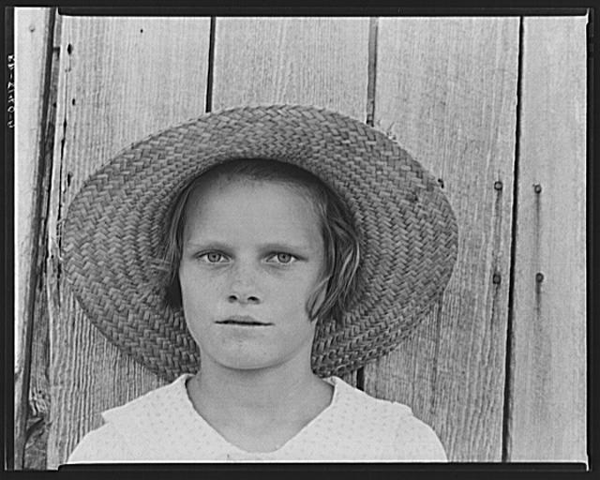

Slide 7
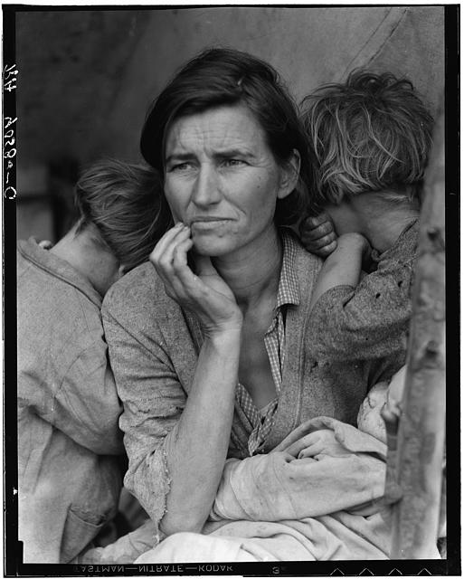

Slide 8
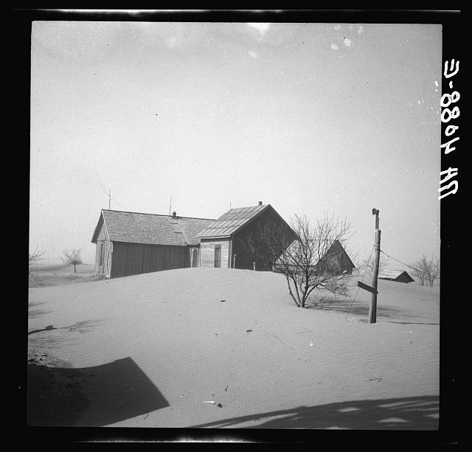

Slide 9
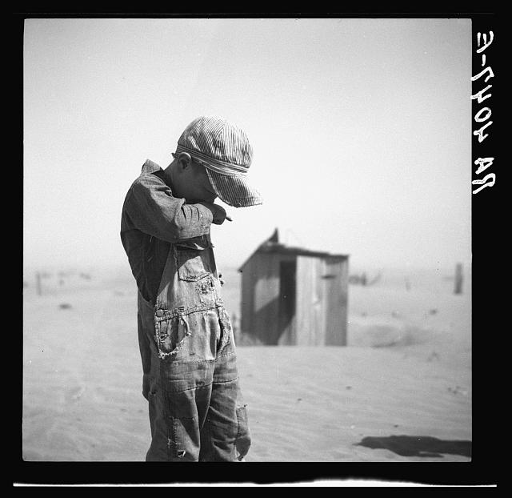

Slide 10
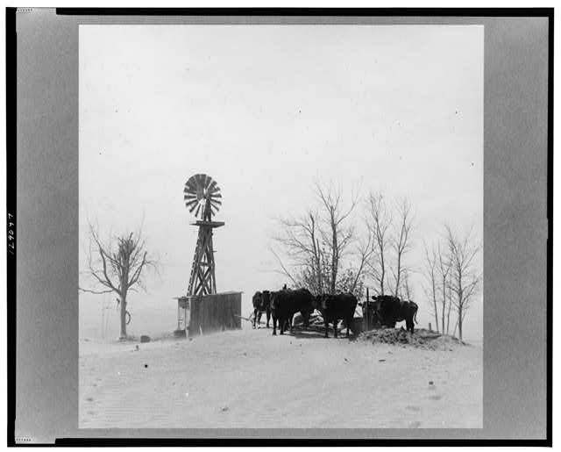

Slide 11
Continue the four column chart, but apply it to the next two songs. “Arizona”
http://memory.loc.gov/cgi-bin/query/S?ammem/toddbib:@FIELD(DOCID+@od1(+4148a1+))
“Dust Bowl Blues”
https://www.youtube.com/watch?v=jQYKJaWuj0Y

Slide 12
I.N.
Speculate as to when and where these photographs may have been taken.
Which image "speaks" to you and why?
If every picture tells a story, what story do these photographs convey?
What questions do these images evoke?

Slide 13
Quote/ Picture Timeline
For each chapter of the book we read, you will pick one important verse.
On each of the 8 squares, you will write the season, year, important quote, and illustrate the quote as best as you can.
These should be done to the best of your ability. Challenge yourself to illustrate the image well.

Slide 14
Out of the Dust
Read “Winter 1934” (pgs. 1-33)
- As we read, write down at least 4 different verses from the novel that you find interesting, poetic, or important. Don’t forget quotes and page numbers. One of these will be used on your picture/quote timeline
When you finish, work on your quote/picture timeline.

Slide 15
Wednesday
Write today’s date and Spring 1934 as your heading for today’s reading journal.
Answer the following question in your I.N.
What is Billie Jo like? Describe her:
Speech:
Actions:
Appearance:
Thoughts:
How others see her:

Slide 16
Learning Target
I can analyze two poems from the text Out of the Dust by completing the FASTR worksheet packet and responding critically to my reading.

Slide 17
Spring 1934
As you read the chapter, write down at least 4 important lines/verses in your I.N. from today’s reading. Choose lines that stand out as significant, interesting, poetic, or important to the story. (don’t forget the quotation marks and page #)
Select one of the lines of poetry in your I.N. to add to your picture/quote timeline after you’ve turned in the worksheet. Work independently until everyone is done. (don’t forget the quotation marks and page #)

Slide 18
Silent Work Time:
Follow and complete all directions on the FASTR worksheet packet. When you finish, answer the question below on a separate piece of paper. (staple it to the back.) ***Compare and Contrast the poems Debts and First Rain. In what ways are the similar and different? How do the people’s feelings towards rain change throughout both? Write at least a paragraph.
Complete the Adjective’s Packet and turn it in.
Finish your Picture/Quote timeline for today.
Read silently an independent reading book.

Slide 19
Thursday
Label your I.N. with today’s date and the section Summer 1934
Answer the following question in a thoughtful paragraph:
What is Billie Jo’s attitude/ feelings towards dust thus far in the novel? (Use evidence to support your answer.) Knowing this, how do you think the title gives clue to a possible ending to her story? Make your predictions based on your current knowledge of the title and text.
When you finish, have your quote/picture timeline ready for today and sit quietly.

Slide 20
Summer 1934
As we read, jot down possible lines to be used in your picture/ quote timeline.
When you finish, work silently on today’s picture/quote.

Slide 21
Learning Target
I can analyze real world restaurant menus in order to prepare for writing my own.

Slide 22
Menu Observation Rotations (please complete in your I.N.)
We will practice understanding descriptive menu writing, by first analyzing real world menus.
Every table will have a different restaurant menu for you to read and analyze.
At each station, read the menu.
Write down at least 3 descriptive words that were used in the menu.
Write down one good idea you could use for your own menus.

Slide 23
Menu Analysis (Answer in your I.N.)
Which menu was the most visually appealing? Why?
Which menu had the most interesting writing that made you want to keep reading? What did they do differently that made it stand out?
If you were to write your own menu, (which you will) what advice would you give to yourself for how to write a good menu that customers would enjoy reading?
List at least 10 interesting/descriptive words that could be used in menu writing.
*work on your picture/quote timeline.

Slide 24
Friday
Label your next I.N. page Autumn 1934
Read Autumn 1934 as a group.
Don’t forget to be looking for interesting or important quotes to put on your timeline!
When you finish work independently on your picture/quote timeline.

Slide 25
Learning Target
I can discuss and analyze what we’ve read so far in Out of the Dust by participating in a Socratic Circle.

Slide 26
Choose 5 & answer with evidence (write them in your I.N. to prepare for the Socratic Circle)
Whose fault is the accident? Should Billie Jo forgive her father for leaving Ma to go drinking in Guymon?
Why does Billie Jo hide her injured hands from her father?
Why does Daddy want to dig a pond now?
How does Mad Dog treat Billie Jo? What would you say to Billie Jo if she were your friend?
Why is the art exhibit so important and so painful for Billie Jo? What does this tell us about her character? What elements of the story does the exhibit bring together?
In what ways is Billie Jo like her father?
Is it right for Miss Freeland to let Buddy Williams and his family stay at school?
Billie begins to mention in her entries that her ma is “haunting her.” What does she mean by that? What do you think she can do about it?

Slide 27
Menu Project
DO NOT LOSE YOUR PACKET about the project. You will turn it in with your final menu!

