Slide 1
Week 33
4/21-4/25

Slide 2
Monday
Turn to page 792 in your yellow textbook.
Answer the QUICKWRITE question in your I.N.
List and define the following words:
Legend
Turbulent - Congregation
Tournament - Integrity
When you finish, read an independent book
You will also need your HOLT WORKBOOK today

Slide 3
HERO PLOT (Take notes in your I.N.)
Hero is born in an obscure place
Hero is of unknown parentage
Hero is threatened as a child
Hero passes a test to prove he is king
Hero is an unlikely person to be king

Slide 4
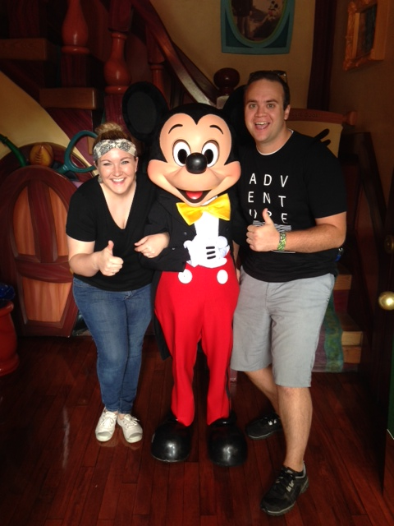

Slide 5
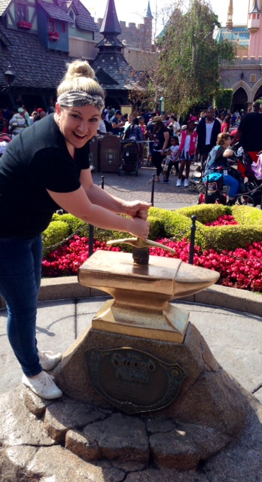
Learning Target
I can identify elements of a hero legend by reading The Sword in the Stone and following the margin directions to annotate and think about the text.

Slide 6
The Sword in the Stone Workbook pages 234-252
As we read, complete the margin directions in your HOLT WORKBOOK

Slide 7
Interesting History to the Story
https://www.youtube.com/watch?v=lZCsBhmjvuQ
https://www.youtube.com/watch?v=Z9RAZhBgSiM

Slide 8
Tuesday
Summarize in at least a paragraph what has happened so far in The Sword in the Stone
Write your paragraph in your I.N.
Read silently when you finish

Slide 9
Learning Target
I can identify elements of a hero legend by reading The Sword in the Stone and following the margin directions to annotate and think about the text.

Slide 10
The Sword in the Stone Workbook pages 234-252
As we read, complete the margin directions in your HOLT WORKBOOK

Slide 11
Holt Workbook
Complete pages 253-254 in your workbook
Tear it out and turn it into THEHUB
Read silently until everyone is finished

Slide 12
Draw the chart below in your I.N., and fill it in for the details of the story:
A Typical Hero’s Story | Arthur’s Story
Born in an obscure place
Unknown parentage
Threatened as a child
Passes a test to prove he is king
Unlikely person to be king

Slide 13
Writing Effective Newspaper Articles
Formula for Success
Copyright © 2012 Gareth Manning

Slide 14
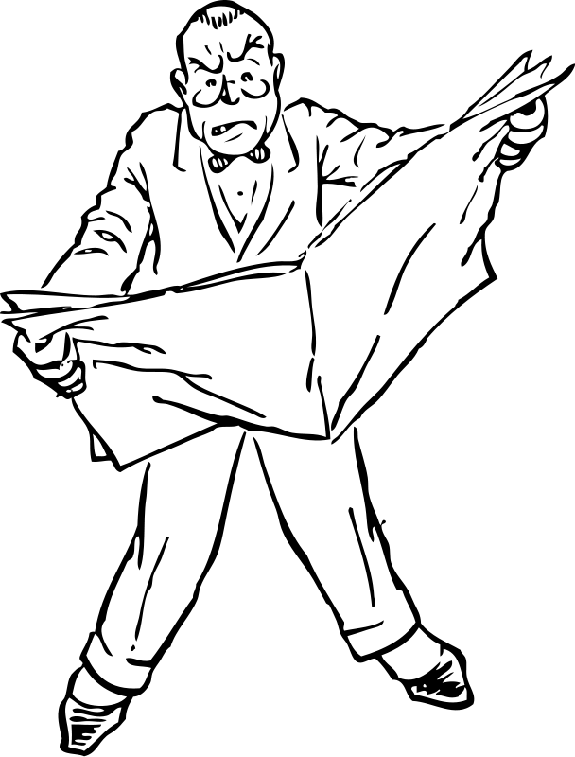
Inverted Pyramid Structure
Most Newsworthy Info
5Ws: Who, What, Where, When, Why, How
Important Information
(in descending order of importance)
Supportive or Background Info
Remember: most news readers skim quickly!
Most important info must be at the start!

Slide 15
A typical newspaper article contains six parts:
Headline: catches reader’s attention
Byline: tells who wrote the story, as well as the date.
Lead paragraph: Contains ALL of the who, what, when, where, why and how in it.
Example: This afternoon handsome school teacher, Gareth Manning, is being thrown a party for being wonderful by his Grade 9 students on Mount Robson using funds raised for their graduation ceremony.

Slide 16
A typical newspaper article contains six parts:
4. Explanation paragraphs: Important facts and quotes not included in lead paragraph, written in order of importance (most to least).
5. Additional Information: Least important information, perhaps about a similar or related event.
6. Concluding Paragraph: Catchy, memorable ending.

Slide 17
Also…
Paragraphs must be short and concise.
Written in the third person.
Be unbiased—just a report on the facts.

Slide 18
Wednesday

Slide 19
Learning Target
I can.

Slide 20
Thursday
Complete the packet on Newspaper Articles with your table partner. Everyone completes their own, but you may work together.
When you finish, turn it into THEHUB.
Read silently

Slide 21
Learning Target
I can practice my knowledge of legends and newspaper elements by completing a study guide to prepare for the test tomorrow.

Slide 22
Study Guide
Complete the various questions and study guide pointers on a separate piece of paper.
This will be due before you take the test tomorrow.
If you finish early, read silently.

Slide 23
Friday
Turn in your Study guide with your name on it.
Have a writing utensil out on your desk.
Everything else needs to be on the floor.

Slide 24
TEST
When you finish with the test, turn it in at THEHUB and read silently

Slide 25
Learning Target
I can take the legend of The Sword in the Stone and turn it into a newspaper article by using the techniques we’ve learned this week.

Slide 26
Fairytales in the News
http://www.literacyshed.com/the-fairy-tale-shed.html
http://www.shol.com/agita/wolfside.htm
http://ericmacknight.com/igcse/2012/02/minor-commits-break-in-at-family-home-news-report/

Slide 27
Newspaper Article
You will turn an event from The Sword in the Stone into a newspaper article.
Don’t forget to include ALL parts of a newspaper article that we’ve learned
You must complete the inverted pyramid 1st as a prewrite
You may also include an illustration
The newspaper article can be hand written neatly or typed.
Take your time, this will be due Tuesday.

