Slide 1
Week 2
PLOT
AZAC #1

Slide 2
Monday: 8-19-13
Have your DPE out with a #2 pencil.
Work on Monday’s paragraph. (The number of errors is in the left margin)
If you finish, begin reading an independent reading book.
**These will be due on Friday. The Friday writing portion must be done as homework this week.

Slide 3
AZAC #1
You may silently work on your AZAC Reading Benchmark test.
REMEMBER:
DO NOT WRITE ON THE TEST BOOK
USE ONLY #2 PENCIL
WORK SILENTLY
If you finish early, please read silently or work on homework.
We will be working on this tomorrow as well, so bring something to work on when you finish or read a book.

Slide 4
Tuesday: 8-20
Begin working on your DPE with a #2 pencil.
Don’t forget the entire packet will be due on Friday. (including the writing portion)
Fill out your agenda.
- Begin reading an independent reading book.

Slide 5
AZAC #1 (Day 2)
You may silently work on your AZAC Reading Benchmark test.
REMEMBER:
DO NOT WRITE ON THE TEST BOOK
USE ONLY #2 PENCIL
WORK SILENTLY
If you finish early, please read silently or work on homework.

Slide 6
Wednesday: 8-21
Have a yellow textbook.
Get out your I.N.
Be sure your agenda is complete.
Please begin reading your independent reading book.

Slide 7
ANCHOR EXTENSION ACTIVITIES
What is an anchor extension?
Who does it?
How do you get to do it?
How does it help my grade?
Where do I get it and turn it in?
***Anchor Extension Signature page is DUE Tomorrow! (10pts.)

Slide 8
Learning Target
I can practice my knowledge of summary and main idea by retelling the story of Duffy’s Jacket.

Slide 9
I.N. page 7: “Duffy’s Jacket”
We will continue our reading from last week on page 6.
Be sure your I.N. page 7 is open to answer the “Retell” questions #1-6

Slide 10
I.N. page 8: Retelling
On page 12 in your textbook, read through the steps to retell a story.
Make two columns in your I.N. page 8. On the left column, rewrite these retelling steps in your own words.
In the right column, actually follow the steps to retell the story of “Duffy’s Jacket”.
If you need to move onto the next page, number it “8A”.

Slide 11
RATE THE RETELL
You and your partner will read aloud your own retell.
Follow the Retelling Rating Sheet on page 13 to rate your partner’s retell.
Be sure to give them positive feedback as well as critical.

Slide 12
IT IS TIME!
TIME TO BRUSH OUR TEETH!
AKA, get out your DPE. ☺

Slide 13
TABLE TALK
What do you know about PLOT?
Brainstorm as many things as you can remember that have to do with plot.
Write all your brainstorms on one piece of paper.
Then try to retell “Duffy’s Jacket” using those parts of plot.

Slide 14
DON’T FORGET…
The anchor extension signature page is due tomorrow!

Slide 15
Thursday: 8-22
Have a yellow textbook.
Get out your I.N.
Be sure your agenda is complete.
Please begin reading your independent reading book.

Slide 16
Learning Target
I can understand elements of plot by piecing together a story and labeling the parts on a diagram.

Slide 17
I.N. 9: Story Scrambled Sentences
Begin cutting your paper’s different sentences out. Move them around on your desk and try to figure out the order of the story.
DO NOT GLUE/TAPE your story to the page until you know you have the correct order.
When you are finished taping it to I.N. 9, read an independent reading book.

Slide 18
I.N. 10: PLOT NOTES
Create a page 10 and title it PLOT NOTES.

Slide 19
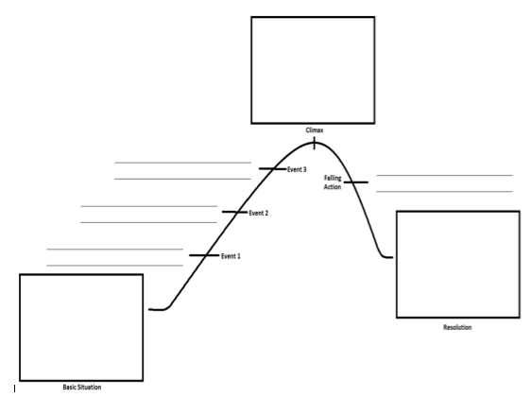
On I.N. page 10, draw this picture WITHOUT THE WORDS, horizontally on your page.

Slide 20
The Following are terms you must have notes for on I.N. page 10:
Plot
Basic Situation
Conflict
Complications
Climax
Resolution
Suspense
Forshadowing

Slide 21
Friday: 8-23
Turn in your DPE.
Begin reading your independent reading book silently.

Slide 22
BOOK TALKS!
Sign Up will be coming around.

Slide 23
Learning Target
I can identify the elements of plot in a children’s book by completing a plot diagram of the story.

Slide 24
Children’s Book Plot
With your partner, take turns reading your book together.
When you finish, begin to discuss the parts of plot in the story.
Complete the diagram by filling in parts of the story that fit the part of plot.
When you finish, turn in your children’s book to me and keep your worksheet at your desk.
Read silently or work on homework.

Slide 25
Coming Soon to an ELA class near you…
http://www.youtube.com/watch?v=vdg9gkmWsEA

