Slide 1
Week 9: 10/13-10/17 Math READING
Monday: Go over new math packet, sticky note wall, Graph intro.
Tuesday: 10 tips article, discussion, data collection
Wednesday: Creating Bar Graphs, Analyzing Peer Graphs, Prewriting for 3.8
Thursday: WOTD, Graphs, 3.8 QUIZ
Friday: NO SCHOOL

Slide 2
Monday: 10/13
You need:
- AGENDA **** START HERE****
Warm-Ups
Bar Graphs Packet
BELLRINGER Question: What do you know about “Bar Graphs” already? Write a complete sentence.
When you finish, READ SILENTLY.

Slide 3
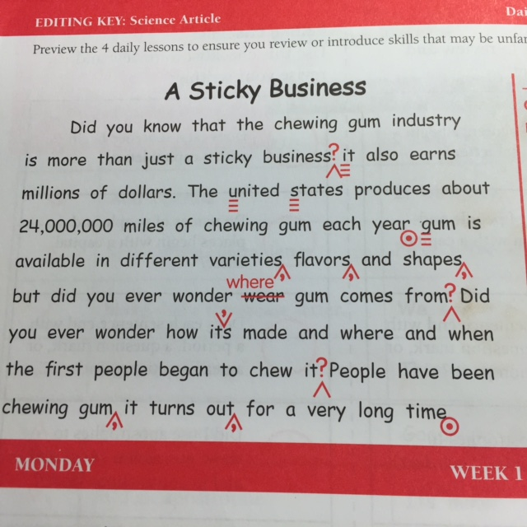
Daily Paragraph Edit DPE Use your editing symbols from the PROOFREADING MARKS Page

Slide 4
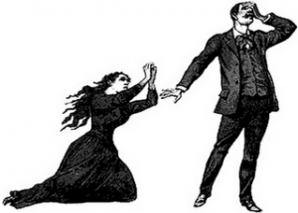
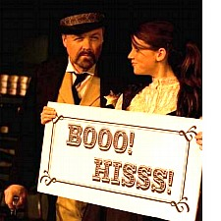
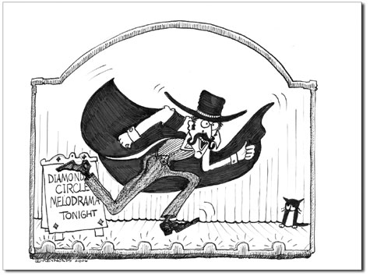
Word of the Day: Melodrama
SYNONYMS: overdramatic, theatrical, exaggerated, cliff-hanger
https://www.youtube.com/watch?v=Gw-W48n06Lw

Slide 5
Why is knowing how to read important in math? - List 3 reasons on your sticky note, post it on the wall, then read silently.

Slide 6
Introduction to Bar Graphs
Read and complete the bar graphs packet with your table group.
Follow all of the directions to discuss as well.
When you get to page 16, stop and read silently or work on Warm-ups you didn’t finish.

Slide 7
Rate the Learning Target
I can understand the purpose of a bar graph.

Slide 8
Tuesday: 10/14
Clear your desk except for:
- AGENDA < Start Here<<<<<<<<<<
Warm-Ups
Bar Graphs Packet
APE for Reading Packet
BELLRINGER Question: What is one part of math that has been difficult for you? Why?
When you finish, READ SILENTLY.
10 minutes
To complete
Warm-Ups

Slide 9
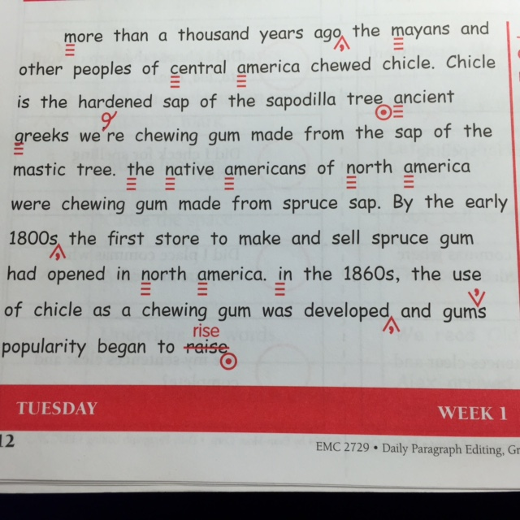
Daily Paragraph Edit DPE

Slide 10
Word of the Day: Assertion
SYNONYMS: declaration, statement, opinion, statement
Topic Sentence or Thesis Statement
Can be one of 3 types:
Narrative, Argumentative, Informative
(APE Writing: A = Assertion P= Proof E= Evaluate)
(APE READING: A= Anticipate P= Process E= Evaluate)

Slide 11
“Top 10 Strategies to Improve your Math Grade”
As you read...
Underline details that are important
Draw an ARROW or an Exclamation mark by details you’d like to discuss with the class that you can relate to.

Slide 12
Listening & Speaking Class Discussion
Which Tip could you use the most in math?
Why?
When your name is called, tell the class which tip # and why.
Put a tally mark by every student’s vote on your article. (If they say they like #2, put a tally beside #2)
Speak loudly; listen loudly.

Slide 13
Rate the Learning Target
I can process what I read by annotating and discussing.

Slide 14
Wednesday: 10/15
You need:
- AGENDA
Warm-Ups
Bar Graphs Packet
Reading Packet
BELLRINGER Question: Which tip was most commonly said yesterday? Why do you think that is?
When you finish, READ SILENTLY.

Slide 15
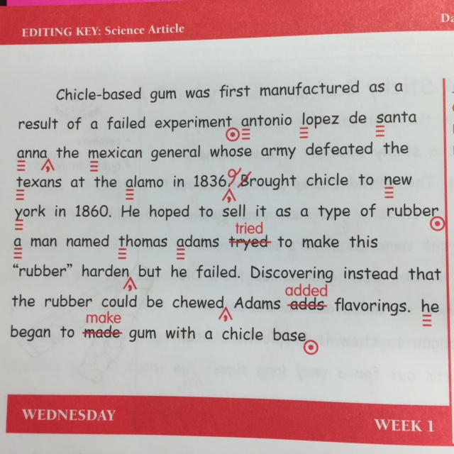
Daily Paragraph Edit DPE

Slide 16
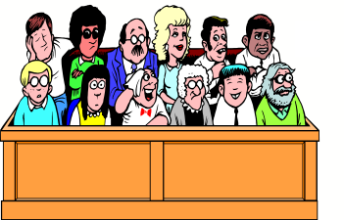
Word of the Day: Evaluate
SYNONYMS:
examine, judge, analyze, assess

Slide 17
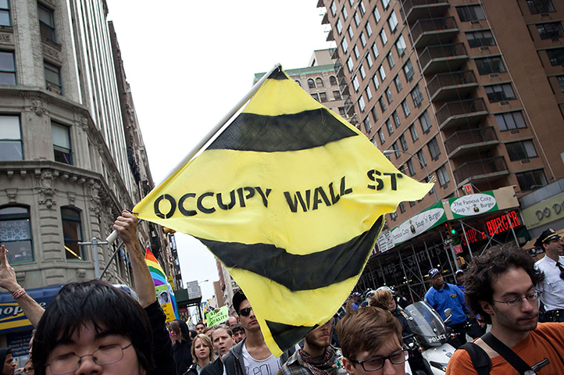
Word of the Day: Radical
SYNONYMS: revolutionary, reformist, extreme, passionate
(Adjective or Noun)

Slide 18
Bar Graph Creation
The X axis (bottom) of your bar graph will be #1-10 representing each tip.
The Y axis (left vertical) of your graph will be a range of numbers depending on the highest number in our data gathering.
Be sure to label the title, the bottom, and the left side.
When you finish, complete the “reading a graph” page on the last page of the packet.

Slide 19
Rate the Learning Target
I can create a bar graph based off of my reading and data from the discussion.

Slide 20
Thursday: 10/16
Clear your desk except
A pencil
Warm-Ups – DUE TODAY
Reading Packet
BELLRINGER Question: What are the words of the day from this week? (Study their meanings while you write them.)
When you finish, READ SILENTLY.

Slide 21
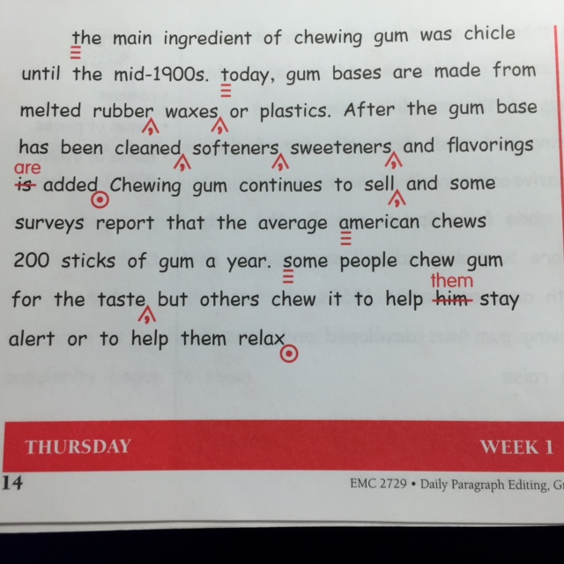
Daily Paragraph Edit DPE

Slide 22
QUIZ
I can test my knowledge from this week by taking a quiz
When you finish, turn it in to THEHUB in your class drawer.
Begin writing your 3.8 paragraph summarizing our 10 strategies article from this week. Use your reading packet, checklist, and rough draft.
When you finish, turn it over and read silently.

Slide 23
MEAN, MEDIAN, MODE, RANGE Rap
https://www.youtube.com/watch?v=1jVZi0cNHls&feature=relmfu

Slide 24
Friday: 10/17
No School.
Teacher Work Day

