Slide 1
Week 5 9/8-9/12
Mon: Notes on Summarizing
Tues: Chart to Summarize
Wed: Writing a 3.8 Summary
Thurs: WOTD QUIZ and 3.8 paragraph
FRI: CONSERVATION DAY

Slide 2
Monday: 9/8
DESK: Reading Strategy packet from LAST WEEK, this week’s packets, agenda, pencil, book.
Have your agenda!!!
Work on Monday’s Appetizers
BELLRINGER Question: What does it mean to summarize information?
When you finish, READ SILENTLY.

Slide 3
Word of the Day Homonym
a word that sounds or is spelled the same as another, but means something different

Slide 4
EVALUATE the Text by... Summarizing
Highlight important ideas in the reading strategy packet as we read.
Put a question mark by anything you don’t understand.
Circle any words you do not know.

Slide 5
I can understand what it means to summarize a text.

Slide 6
Tuesday: 9/9
Clear your desk except for your agenda, pencil, Appetizers, Reading Strategies Packets, and Where the Red Fern Grows.
Complete your Appetizer TO-DO list
BELLRINGER Question: What does it mean to paraphrase? (use the reading strategy packet from yesterday)
When you finish, READ SILENTLY.

Slide 7
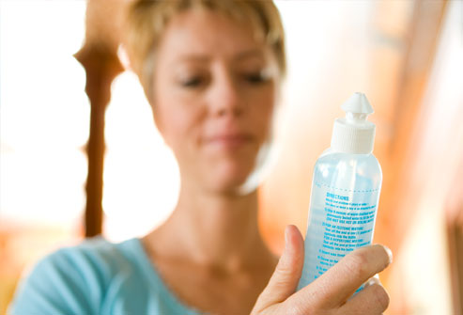
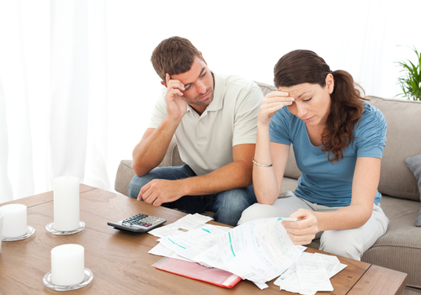
Word of the Day READING IS RELEVANT TO REAL LIFE.
Important, Related, Pertinent, Significant

Slide 8
Process the Text by... Summarizing Important Facts
Complete the chart in your Reading Strategy Packet for the article from last week: “The Greatest Show on Earth”
Write an important fact from EACH paragraph of the article on the left column. (14 total points)
Complete the other information in the chart on the right side.
When you finish, read silently.

Slide 9
I can summarize a text by finding key facts of an article.

Slide 10
Wednesday: 9/10
Clear your desk except for your agenda, pencil, Appetizers, Reading Strategies Packet, and Where the Red Fern Grows.
Complete your Appetizer TO-DO list
BELLRINGER Question: What was the article “The Greatest Show on Earth” mostly about?
When you finish, READ SILENTLY.

Slide 11
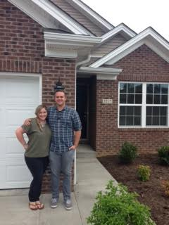
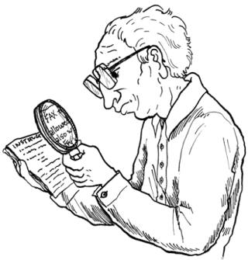
Word of the Day Scrutinize
SYNONYMS: examine,
Inspect, survey,
study

Slide 12
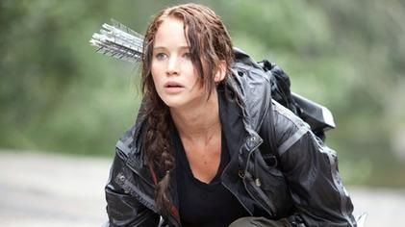
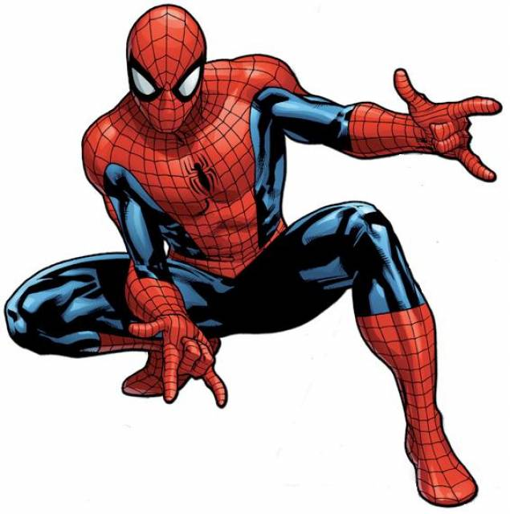
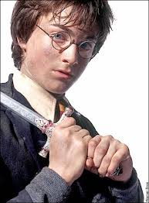
Word of the Day Protagonist
SYNONYMS:
champion, supporter,
advocate, main character

Slide 13
Process the Text by... Writing a Summary Paragraph
Using the information from the chart and the 3.8 summary guidelines, practice writing a summary paragraph of the article from last week.
When you finish, read silently.

Slide 14
I can summarize an article by writing a 3.8 summary paragraph.

Slide 15
Thursday: 9/11
Clear your desk.
You need: a pencil and your agenda
BELLRINGER Question: What do you need to remember to bring tomorrow for Conservation Day?
When you finish, READ SILENTLY.

Slide 16
I can test my knowledge from this week by taking a quiz.
Be sure to follow all the directions to write your paragraph.
Use the checklist to make sure you’ve remembered everything.
RE-read your writing before you finish.
*When you finish, turn your quiz over, and read silently.*

Slide 17
Friday: 9/12
Conservation Day!

