Slide 1
Week 4: 9/1-9/5
Monday – Labor Day, No School
Tuesday – Making Inferences
Wednesday – Figurative Language
Thursday - Analyzing
Friday - QUIZ

Slide 2
Tuesday: 9/2
Clear your desk except for your agenda, pencil, Appetizers, Reading Strategies Packet, and Where the Red Fern Grows.
Complete your Appetizer TO-DO list
BELLRINGER Question: What does it mean to make an inference?
When you finish, READ SILENTLY.

Slide 3
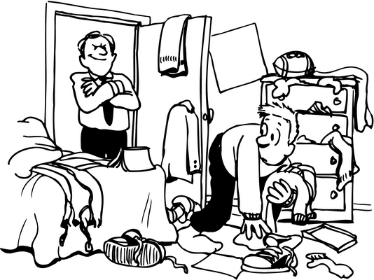
Word of the Day Imperative
SYNONYMS: important, vital
Commanding, authoritative
Clean your
room!
It is
imperative.

Slide 4
Word of the Day Zealous
SYNONYMS: passionate, devoted, enthusiastic, dedicated
https://www.youtube.com/watch?v=RwlhUcSGqgs

Slide 5
Process the Text by... Making Inferences
Read the reading strategies page for this week.
Highlight important ideas or terms.
When you finish, read silently.

Slide 6
Small Groups
Read the article on Barnum and Adams
Stop to write the answer to the margin questions together. You may use a separate piece of paper.
When you finish, read Where the Red Fern Grows or study your words of the day.

Slide 7
I can process a text by making inferences and answering questions as I read.

Slide 8
Wednesday: 9/3
Clear your desk except for your agenda, pencil, Appetizers, Reading Strategies Packet, and Where the Red Fern Grows.
Complete your Appetizer TO-DO list
BELLRINGER Question: What is an example of figurative language?
When you finish, READ SILENTLY.

Slide 9
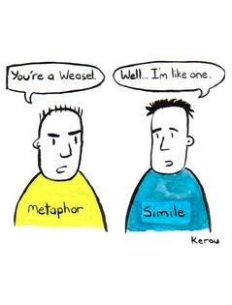
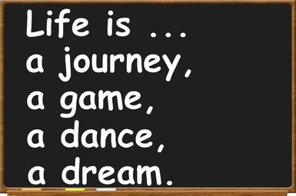
Word of the Day Metaphor
SYNONYMS: comparison, symbol, analogy, image

Slide 10
Process the Text by... Citing Evidence
Find 2 more examples of figurative language in the text.
Write the 2 sentences in the table.
Describe what the two examples really mean.
Then complete “D”
When you finish, read silently.

Slide 11
I can identify figurative language in nonfiction.

Slide 12
Thursday: 9/4
Clear your desk except for your agenda, pencil, Appetizers, Reading Strategies Packet, and Where the Red Fern Grows.
Complete your Appetizer TO-DO list
BELLRINGER Question: How do you think you can understand the meaning of an article?
When you finish, READ SILENTLY.

Slide 13
Word of the Day Volume
SYNONYMS: capacity, size, measure, sound

Slide 14
Flashbacks Grading
Listen for the correct answer
If your answer doesn’t match, CHANGE IT!
Be sure to find out WHY your answer was wrong and ask questions

Slide 15
Process the Text by... Analyzing
At each table...
Read the sentence and determine how it is important to the entire article.
Write your analysis statement on a separate piece of paper.
Be sure to label which station you are at.

Slide 16
I can process a text by analyzing one sentence.

Slide 17
Friday: 8/29
Everything off of your desk EXCEPT:
Pencil
Appetizer Packet
Reading Strategies Packet
Book
BELLRINGER Question: What makes a complete sentence? (Use page #____ in your agenda.)

Slide 18
I can test my knowledge from this week by taking a quiz.
*When you finish, turn your quiz over, and read silently.*

