Slide 1
Week 3: 8/25-8/30
READING
Monday: Text Structures
Tuesday: Map Testing
Wednesday: Compare/Contrast Response
Thursday: Compare/Contrast Analysis
Friday: QUIZ

Slide 2
Monday: 8/25
Clear your desk except for your agenda, pencil, Appetizers, Reading Strategies Packet, and Where the Red Fern Grows.
Complete your Appetizer TO-DO list
BELLRINGER Question: What does A.P.E. for Reading stand for? (look in your Reading Strategies Packet)
When you finish, READ SILENTLY.

Slide 3
Word of the Day
Benevolent
SYNONYMS: kind, compassionate, caring, generous
Who do you know that is benevolent?

Slide 4
Take Cornell Notes over the structures, using your reading strategies packet information.
Process the Text by... Identifying Text Structures
Cause and Effect
Problem – Solution
Chronological
Enumeration
Compare and Contrast
If – Then
Least to Most Important Points
Transitions

Slide 5
I can understand 8 different text structures by taking Cornell notes.

Slide 6
Tuesday: 8/26
We will be going to the lab to do MAP testing

Slide 7
Wednesday: 8/27
Clear your desk except for your agenda, pencil, Appetizers, Reading Strategies Packet, and Where the Red Fern Grows.
Complete your Appetizer TO-DO list
BELLRINGER Question: What are the 8 different text structures?
When you finish, READ SILENTLY.

Slide 8
Word of the Day
Tempo
SYNONYMS: beat, pace, rhythm, count

Slide 9
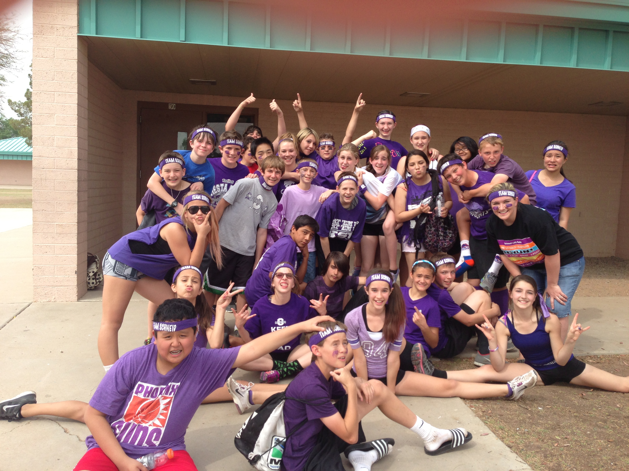
Word of the Day
Vindicate
SYNONYMS: disprove, justify, defend, acquit

Slide 10
Reading Compare/Contrast
Read the short article on Compare/Contrast in your Strategies Packet
Complete the questions and short response
When you finish, read Where the Red Fern Grows Silently

Slide 11
I can comprehend a compare/contrast structure of text by answering questions.

Slide 12
Thursday: 8/28
Clear your desk except for your agenda, pencil, Appetizers, Reading Strategies Packet, and Where the Red Fern Grows.
Complete your Appetizer TO-DO list
BELLRINGER Question: What does Compare and Contrast mean?
When you finish, READ SILENTLY.

Slide 13
Word of the Day
Juxtaposed
SYNONYMS: place side by side,
mix, compare/contrast,

Slide 14
Compare and Contrast
Read the two Pen Pal letters
Fill in the diagrams to compare and contrast them
When you finish, read Where the Red Fern Grows

Slide 15
I can analyze two pen pal letters by comparing and contrasting them.

Slide 16
Friday: 8/29
Everything off of your desk EXCEPT:
Pencil
Appetizer Packet
Reading Strategies Packet
Book
BELLRINGER Question: What is one way you can PROCESS a text? (Use your APE strategies list)

Slide 17
I can test my knowledge from this week by taking a quiz.
*When you finish, turn your quiz over, and read silently.*

