Slide 1
Week 13: 11/10-11/14 Math READING
Monday: Line Graphs
Tuesday: CATCH-UP DAY
Wednesday: Stem and Leaf Plots
Thursday: Circle Graphs
Friday: Read the Sleep article, Short Response

Slide 2
Monday: 11/10
You need:
- AGENDA
Warm-Ups
Math Packet from THEHUB
BELLRINGER Question: What is one Math skill we’ve talked about in class that you are still struggling to understand?
When you finish, READ SILENTLY.

Slide 3
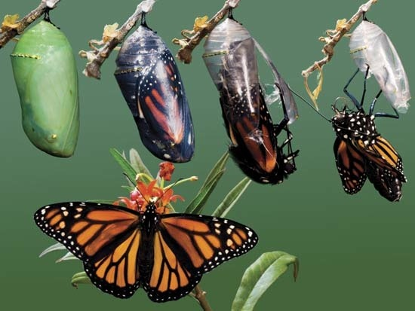
Word of the Day: Metamorphosis
SYNONYMS: transformation, change, conversion, reconstruction
Mrs. Schneider watches her 6th grade students undergo a major metamorphosis throughout their 6th grade year.

Slide 4
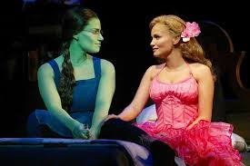
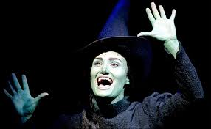
Literacy Strands WICKED
https://www.youtube.com/watch?v=H71FwnEVgmY
Read the paragraph and respond during this song.
Don’t forget to underline, restate, and write in a complete sentence.
https://www.youtube.com/watch?v=3g4ekwTd6Ig

Slide 5
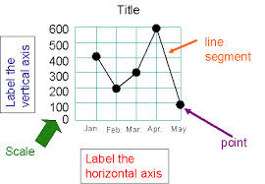
LINE GRAPHS

Slide 6
Line Graphs
Read and complete the worksheets in your math packet on line graphs
Work with your table to group to make sure everyone is understanding.
When you finish, read silently
*** BRING A BOOK TO READ TOMORROW!***

Slide 7
Learning Target
I can read and create a line graph.

Slide 8
Tuesday: 11/11
NO WARM-Ups today.
Please complete this list at a level zero:
Complete and turn in any missing work
Clean out your Reading folder for anything that is not MATH Reading (Recycle is under THEHUB)
Complete the Line Graph Worksheet.
Leave me a note about any of the math concepts you are still struggling with in your hour’s drawer.
Find a book and a spot in the room to read silently.

Slide 9
Wednesday: 11/12
You need:
- AGENDA
Warm-Ups
Math Packet
BELLRINGER Question: Mrs. Schneider’s favorite number is 19. What number is in the ten’s place? What number is in the one’s place?
When you finish, READ SILENTLY.

Slide 10
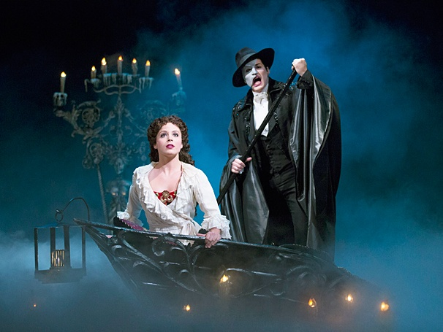
Literacy Strands Phantom of the Opera
Read, underline, and respond during the song.
Don’t forget to restate in a complete sentence.

Slide 11
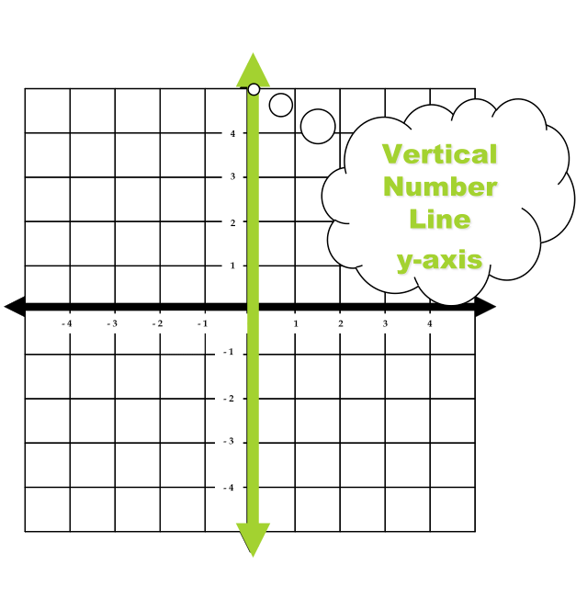
Word of the Day: Vertical
SYNONYMS: upright, standing, Y-AXIS

Slide 12
Stem and Leaf Plot
Read and complete the worksheets in your packet on Stem and Leaf Plots.
When you finish, read silently.

Slide 13
Learning Target
I can read and create a Stem and Leaf Plot

Slide 14
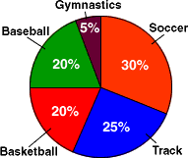
Thursday
You need:
- AGENDA
Warm-Ups
Math Packet
BELLRINGER Question: Looking at the circle graph above, what is the most popular sport? If this was our class, how would it be different?
When you finish, READ SILENTLY.

Slide 15
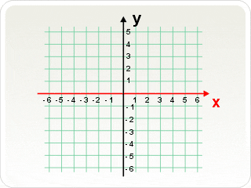
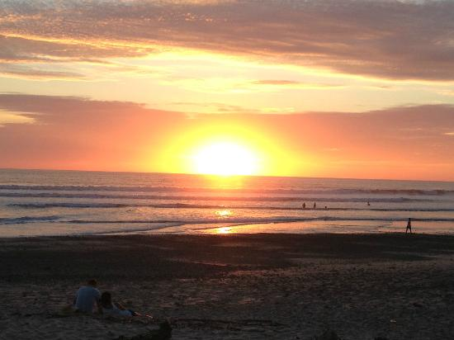
Word of the Day: Horizontal
SYNONYMS: level, flat, plane, X-AXIS

Slide 16
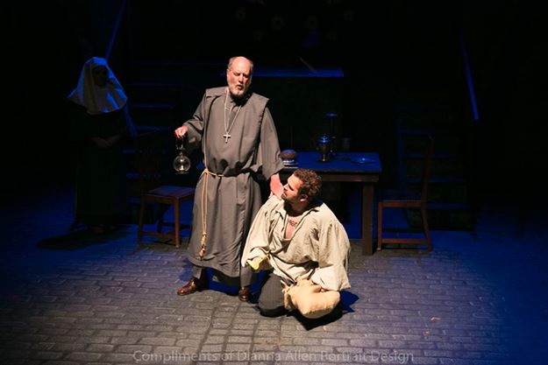
Literacy Strands Les Miserables
Read, underline, and respond during the song.
Don’t forget to restate in a complete sentence.

Slide 17
Circle Graphs
Read and complete the worksheets on Circle Graphs in your Math Packet
When you finish, you may work on other pages that are not finished or read silently

Slide 18
Learning Target
I can read and interpret a circle graph.

Slide 19
Friday: 11/14
Materials:
- AGENDA - (WOTD quiz MONDAY)
Warm-Ups (due MONDAY)
Math Packet (due MONDAY)
BELLRINGER Question: How much sleep did you get last night?
When you finish, READ SILENTLY.

Slide 20
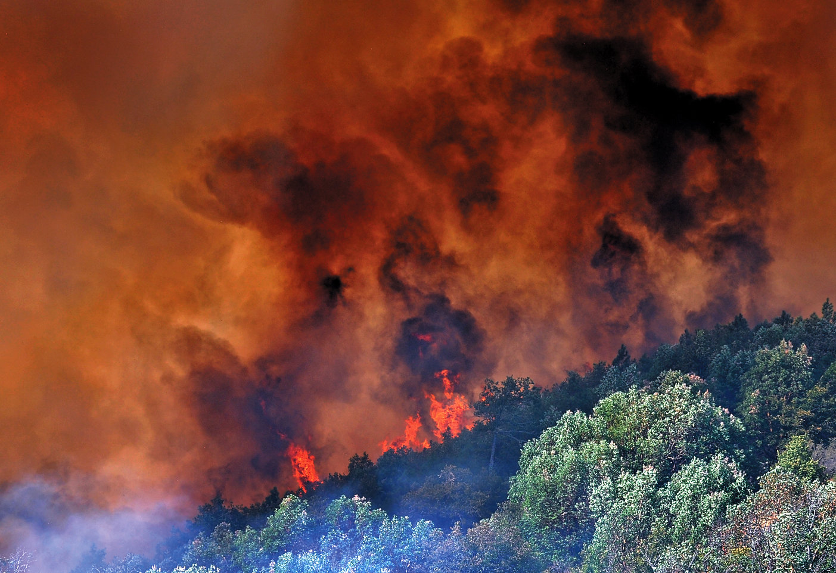
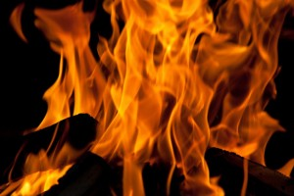
Word of the Day: Conflagration
SYNONYMS: large fire, inferno, firestorm

Slide 21
Literacy Strands: Mary Poppins
1. Read, underline, and respond during the song.
During the video clip, answer this question below your literacy strand:
2. What theme or life lesson is Mary trying
to teach the children besides that a spoonful of sugar helps the medicine go down?
(use a lyric from the song to support your answer)
https://www.youtube.com/watch?v=vLkp_Dx6VdI

Slide 22
Did you get enough sleep?
Read the article as a table group. Take turns on every paragraph and question.
Be sure you examine ALL of the graphs before answering the questions.
Then answers question #1-10
When you finish, you may work on other pages in our math packet you didn’t complete this week or read silently.

Slide 23
EXIT TICKET QUESTION: Short Response Practice
According to this article should schools have a later start time? Why?
3-4 Sentence ANSWER:
Restate and answer
Claim your opinion
Proof/ Support from the text!
(According to Jacqueline Barba... Or According to a High School in Wyoming...)

Slide 24
Learning Target
I can respond to a short answer question using proof.

