Slide 1
Week 12: 11/3-11/7 Math READING
Monday: Grading/Completing Last Week’s Worksheets
Tuesday: NO SCHOOL
Wednesday: Line Plots
Thursday: Histograms
Friday: WOTD QUIZ, Editing Writing, Histogram QUIZ

Slide 2
Monday: 11/3
You need:
- AGENDA
Warm-Ups
BELLRINGER: Describe how to find each of these math terms. Mean, Median, Mode, and Range
When you finish, READ SILENTLY.

Slide 3
Word of the Day: Vague
SYNONYMS: unclear, indefinite, hazy
The teacher’s description of the word didn’t really make sense. It was very vague.
Similar to...
Ambiguous

Slide 4
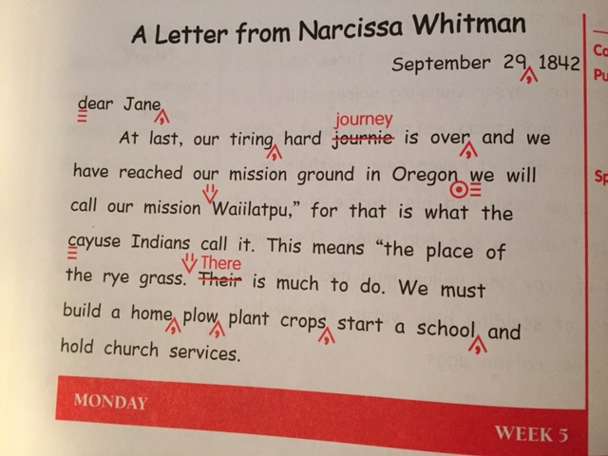
Daily Paragraph Edit DPE Use your editing
symbols from the PROOF-
READING MARKS Page

Slide 5
Grade Your Own Spooky MATH
If you got a 100%, turn it in to THEHUB with a -0 on the top.
Write the correct answer if you got it wrong on your paper.
Make corrections on a separate piece of paper titled “Corrections” and SHOW YOUR WORK.
Staple it to the back and turn it into THEHUB
READ SILENTLY WHEN YOU ARE FINISHED or work on Warm-ups

Slide 6
TEST SCORES Pizza Party
Complete the worksheet from last week about Class A and Class B.
Turn it into THEHUB when you finish.
Read silently while others finish.
This is DUE TODAY before class ends.

Slide 7
Learning Target
I can check my understanding of mean, median, mode, and range by grading my own work.

Slide 8
Wednesday: 11/5
AGENDA and Warm-Ups
(Complete Tuesday and Wednesday Warm-ups)
Bell ringer:
How many pets does your family have?
When you finish, READ SILENTLY.

Slide 9
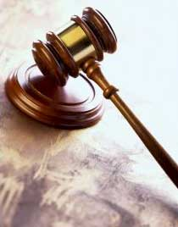
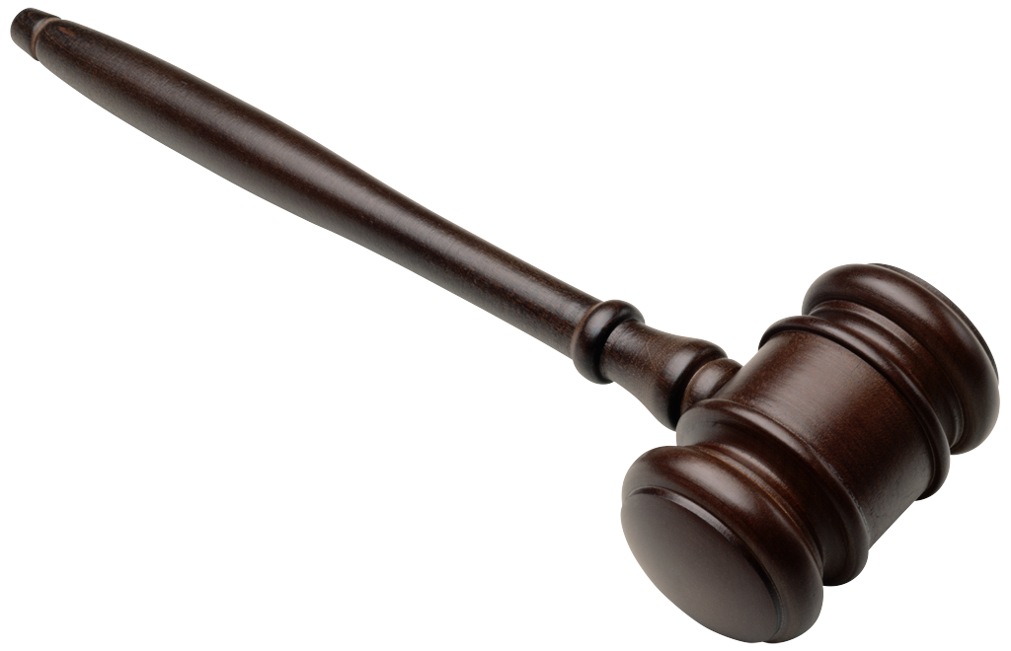
Word of the Day: Justify
SYNONYMS: defend, vindicate, give an explanation for
Justify your answer by SHOWING YOUR WORK in math.
Justify your 3 points by providing a FRED!

Slide 10
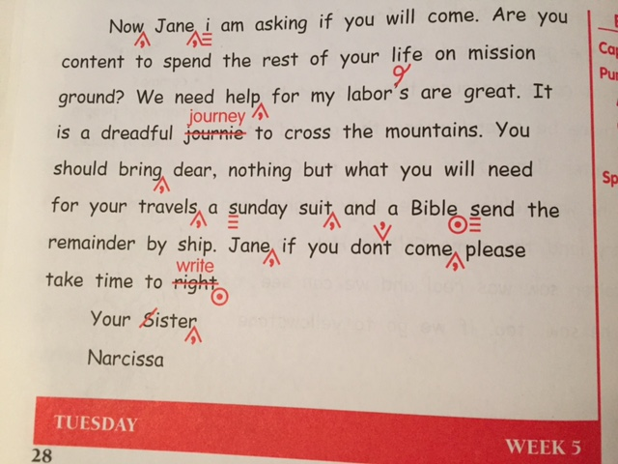
Daily Paragraph Edit DPE Use your editing
symbols from the PROOF-
READING MARKS Page

Slide 11
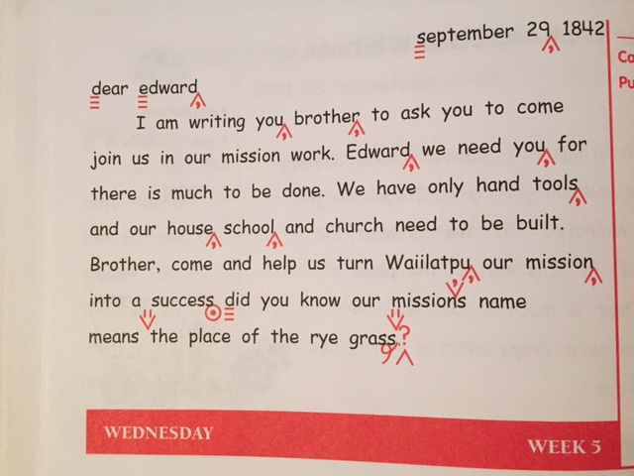
Daily Paragraph Edit DPE Use your editing
symbols from the PROOF-
READING MARKS Page

Slide 12
Line Plot
Read and Complete the 2 pages on Line Plots in your Math Packet for this week.
When you finish, read silently.

Slide 13
Learning Target
I can read and create a line plot.

Slide 14
Thursday: 11/6
Start with your AGENDA and Warm-ups
BELLRINGER: Draw your own example of a BAR GRAPH using the data below: (feel free to use the bottom space on your bell ringer page.
# of Students who’ve read these novels:
The Giver: 12
The Hunger Games: 60
Divergent: 34
The Fault in our Stars: 52
When you finish, READ SILENTLY.

Slide 15
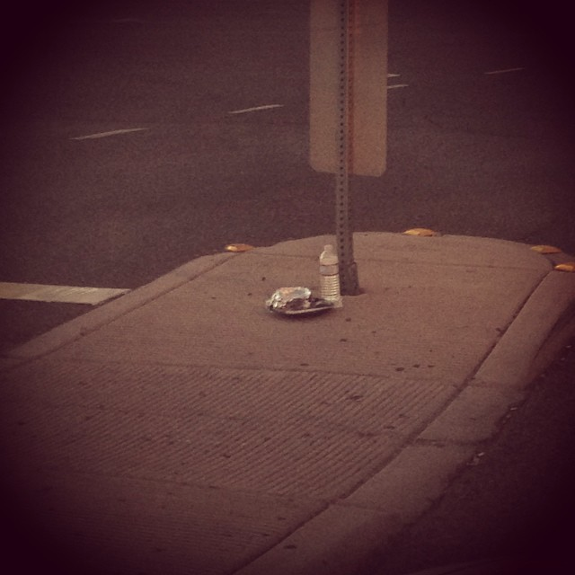
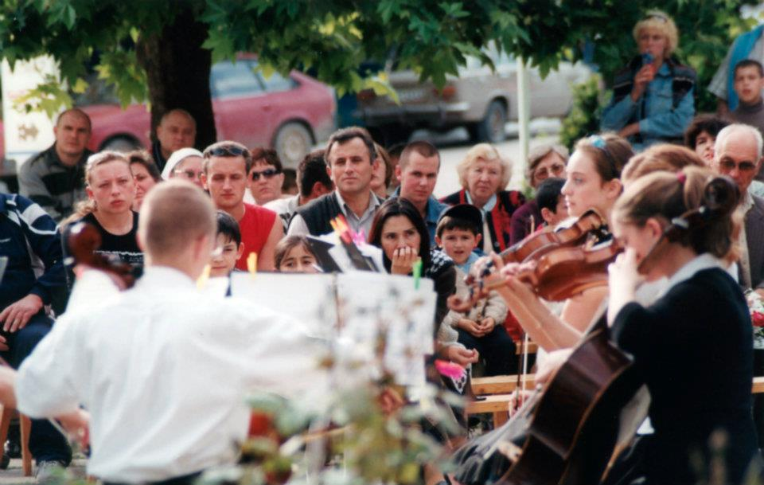
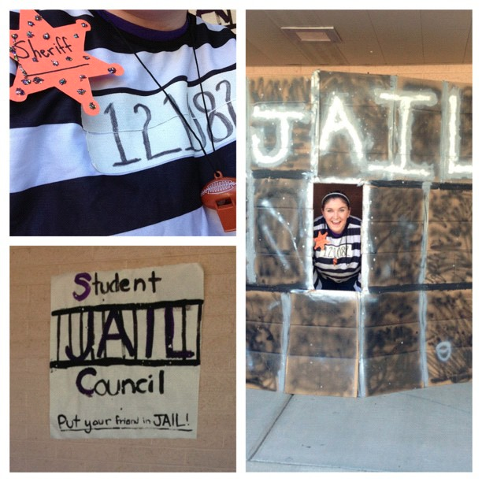
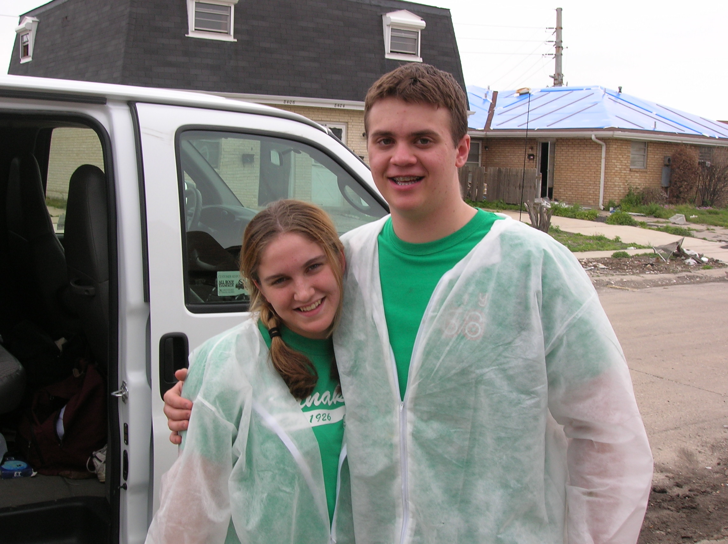
Word of the Day: Philanthropy
SYNONYMS: benevolence, generosity, charity
http://vimeo.com/100249014?utm_content=buffer50586&utm_medium=social&utm_source=facebook.com&utm_campaign=buffer

Slide 16
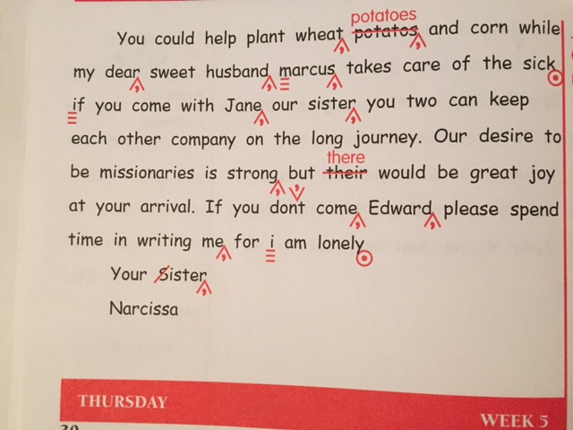
Daily Paragraph Edit DPE Use your editing
symbols from the PROOF-
READING MARKS Page

Slide 17
Histogram
Read and complete the page on Histograms in your math packet
When you finish, you may read silently.

Slide 18
Learning Target
I can read and create a histogram.

Slide 19
Friday: 11/7
Grade your own Warm-Ups!
Use a DIFFERENT COLOR Pen or Marker.
Be sure to write the point totals in the boxes on the pages.
We will go over the Word Problems together.
When you finish, READ SILENTLY.

Slide 20
Learning Target
I can test my knowledge by taking a quiz.
Use the information provided to make corrections, changes, and edits to your writing from last week.
REWRITE your speech after you’ve made corrections.
Turn it in to THEHUB when you finish and read silently.

