Slide 1
Week 11: 10/27-10/31 Math READING
Monday: go over quiz from Friday, Mean Practice, Begin Reading Frankenstein
Tuesday: Letters DUE signed, Table Rotations to Practice for Math QUIZ, Continue Reading Frankenstein, Compare/Contrast
Wednesday: QUIZ over Mean, Median, Mode, and Range
Thursday: Test Score Data Comparison Worksheet
Friday: Grade Warm-ups, WOTD QUIZ writing about Red Ribbon Week, Halloween worksheet due MONDAY

Slide 2
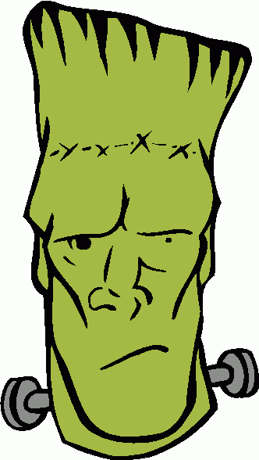
Monday: 10/27
You need:
- AGENDA
Warm-Ups
QUIZ and LETTER HOME on your desk
BELLRINGER Question: Describe what you know about Frankenstein.
When you finish, READ SILENTLY.
FRANK is confused.
“What’s level ZERO?”
Help him out. (He was
actually just born yesterday,
and doesn’t really know.)

Slide 3
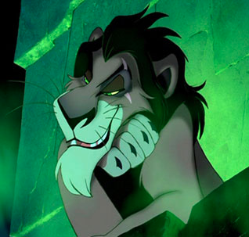
Word of the Day: Dubious
SYNONYMS: suspicious, untrustworthy, shady, unreliable
Someone who is dubious is secretive,
avoids eye contact, and usually doesn’t give straight
answers to questions.
Scar was very dubious to Simba.
Watch this dubious dog!
https://www.youtube.com/watch?v=f0jnFhqDAx0

Slide 4
Daily Paragraph Edit DPE Use your editing
symbols from the PROOF-
READING MARKS Page

Slide 5
Review of Quiz from Friday
Have your quiz out to make corrections and changes as we go over it.

Slide 6
Monday’s Learning Target
I can review what I know about Mean, Median, Mode, and Range

Slide 7
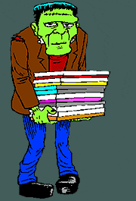
Tuesday: 10/28
You need:
- AGENDA
Warm-Ups
Letters Home on your Desk (if you didn’t turn it in yesterday)
BELLRINGER Question: Describe what you know about Frankenstein and his monster.
When you finish, READ SILENTLY.
FRANK says, “Get out your
materials and get your
learn on!”
Level Zero Students just
might get a treat...

Slide 8
Word of the Day: Ambiguous
SYNONYMS: unclear, vague, arguable, uncertain
Sometimes you might give ambiguous
answers to questions...
How are you? Good.
What’s up? Nothing.
What did you learn at school today? ...
https://www.youtube.com/watch?v=q0NgCcaHfsE
Sometimes book and movie endings leave you with no information! For example, The Giver ends very ambiguously. You don’t really know what happens.

Slide 9
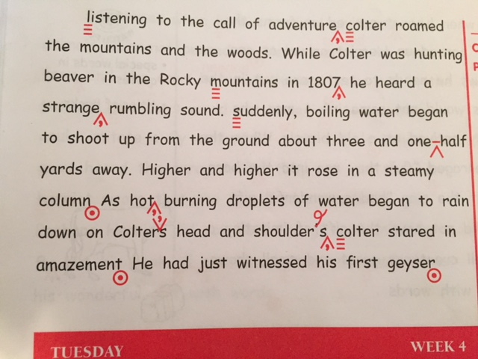
Daily Paragraph Edit DPE Use your editing
symbols from the PROOF-
READING MARKS Page

Slide 10
Find the MEAN, MEDIAN, MODE, and RANGE of the sets of data...
Example: 29, 29, 20, 4, 28
MEAN: 4+20+28+29+29= 110 / 5 = 22
MEDIAN: 28 MODE: 29 RANGE: 29-4 =25
Fold a piece of paper into 4 sections
You will rotate with your group to 7 different tables.
At each table, you will have a certain amount of time to find the mean, median, mode, and range of a set of data.
The table that has all the answers at the end correct and labeled, will win a prize
Don’t forget to label which TABLE # you are at!

Slide 11
Frankenstein
https://www.youtube.com/watch?v=VY-h77CXLQ8
As we read, be thinking about what you’ve previously learned about Frankenstein and how the monster is portrayed in our society now.
PLEASE DO NOT write on the class copies of the story. They are staying in my room to share and save trees ☺

Slide 12
Frankenstein
https://www.youtube.com/watch?v=ZKfWXrZD82g
When we finish reading the selection from Frankenstein: (write on a separate piece of paper)
- Who was Frankenstein? Who is Frankenstein Now? Why do you think people were afraid of his Monster?
- Compare and Contrast the original Frankenstein to the film clip.
*When you finish, you can work on other homework or read silently.

Slide 13
Tuesday’s Learning Target
I can find Mean, Median, Mode, and Range for various sets of data.

Slide 14
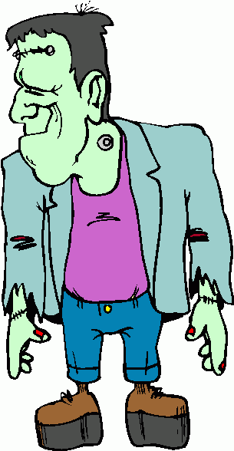
Wednesday: 10/29
You need:
- AGENDA
Warm-Ups
BELLRINGER Question: Why do you think people in our society over time have turned Frankenstein’s monster into a bad character?
When you finish, READ SILENTLY.

Slide 15
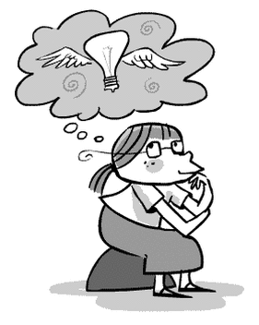
Word of the Day: Hypothesis
SYNONYMS: theory, proposition, educated guess, assumption
Watch to learn what a hypothesis does.
https://www.youtube.com/watch?v=giC6ZYBIeFY

Slide 16
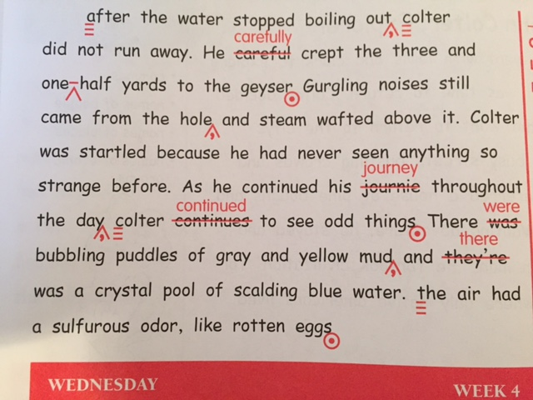
Daily Paragraph Edit DPE Use your editing
symbols from the PROOF-
READING MARKS Page

Slide 17
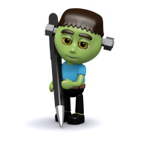
QUIZ
Complete the quiz and turn it into THEHUB
(The Brain Stretch is an extra point)
When you finish, read silently or work on completing your warm-ups

Slide 18
Frankenstein
https://www.youtube.com/watch?v=ZKfWXrZD82g
When we finish reading the selection from Frankenstein: (write on a separate piece of paper)
- Who was Frankenstein? Who is Frankenstein Now? Why do you think people were afraid of his Monster?
- Compare and Contrast the original Frankenstein to the film clip.
*When you finish, you can work on other homework or read silently.

Slide 19
Wednesday’s Learning Target
I can test my knowledge by taking a quiz.

Slide 20
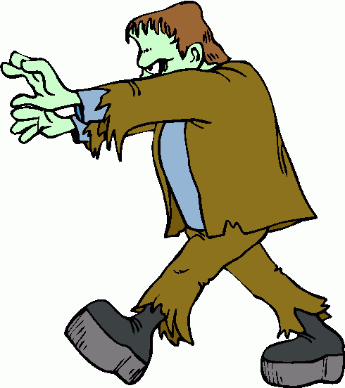
Thursday: 10/30
You need:
- AGENDA
Warm-Ups
BELLRINGER Question: Let’s say a class all failed a test except for one student who got a 100%. Would the mean test score (or average) of the scores represent the students in that class well? Why or why not?
When you finish, READ SILENTLY.
FRANK says, “I’m getting my Warm-Ups!”

Slide 21
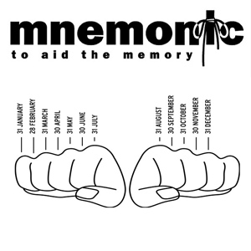
Word of the Day: Mnemonic
Songs, patterns, or ideas that help with memory

Slide 22
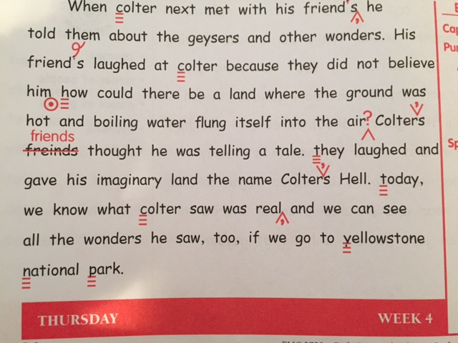
Daily Paragraph Edit DPE Use your editing
symbols from the PROOF-
READING MARKS Page

Slide 23
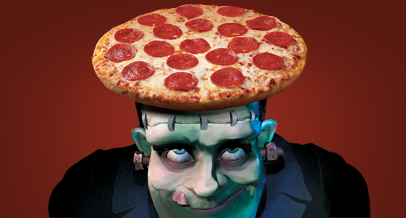
Test Scores MATH-READING
Complete the worksheet with your table group.
Begin by using CUBES
Complete both sides and turn it in to THEHUB.
When you finish, read silently, complete your warm-ups, or study for the W.O.T.D. QUIZ tomorrow.

Slide 24
Thursday’s Learning Target
I can understand how an outlier impacts a set of data.

Slide 25
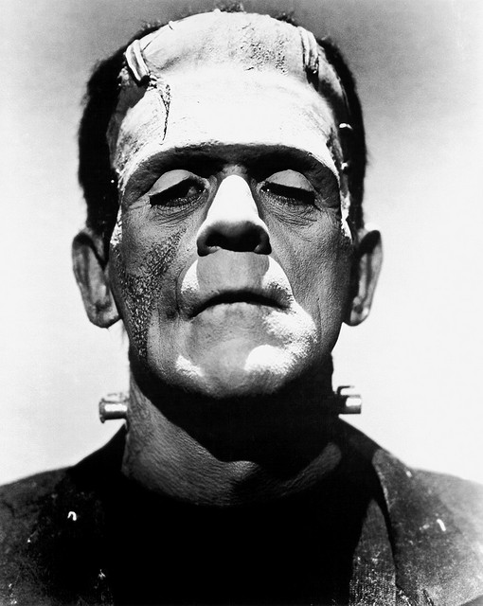
Friday: 10/31 CLEAR YOUR DESK GRADE YOUR OWN Warm-Ups
Use a different color pencil or marker
Complete the point boxes on each page
There are 44 possible points
Put your score in the box on the 1st page.
Examples:
+44/44 +35/44 +42/44
(You can find your percentage by dividing the number you got correct over 44)
FRANK says, “‘SUP?
Grade your own
Warm-up!”

Slide 26
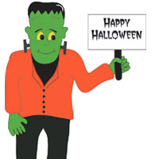
I can test my knowledge by taking a quiz.
When you finish the quiz, turn it in to THEHUB
Take a Halloween Worksheet to your desk
This is DUE MONDAY! You have the rest of the time to complete this in class.
DON’T FORGET C.U.B.E.S. FIRST!!!!!!
The Monster of Frankenstein says, “Trick or Treat?” You decide which you will get today! ☺
PS- The best short stories will be awarded extra credit!

