Slide 1
Week 10: 10/20-10/24 Math READING
Monday: reading a frequency table, Letter Home Intro
Tuesday: Creating a frequency table with dice, Letter Home writing
Wednesday: Mean Median Mode Range, Letter Home work time if time
Thursday: Complete Warm-ups, Prepare 3.8 by reviewing article, Complete Letter Home
(DUE signed by parents by Monday)
Friday: Grade Warm-ups, WOTD QUIZ, Mean Median Mode Range Quiz, 3.8 over math strategies article
(Warm-ups DUE today)

Slide 2
Monday: 10/20
You need:
- AGENDA
Warm-Ups (and 2 other packets from THEHUB)
BELLRINGER Question: What does the word “frequent” mean?
When you finish, READ SILENTLY.

Slide 3
Word of the Day: Adage
SYNONYMS: saying, proverb, motto
Pick 2 famous adages to write down...
Don’t judge a book by it’s cover.
The early bird gets the worm.
Curiosity killed the cat.
Two wrongs don’t make a right.
Stop and smell the roses.
A bird in the hand is worth two in the bush.
Look before you leap.
The best things in life are free.
Practice makes perfect.

Slide 4
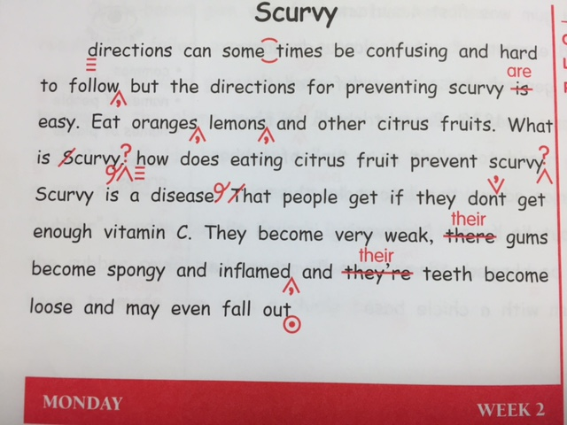
Daily Paragraph Edit DPE Use your editing
symbols from the PROOF-
READING MARKS Page

Slide 5
Frequency Tables
Frequency = the number of time something occurs
Frequency Table = shows the # of items an event, category, or group occurs.
(Watch to copy down an example...)
http://www.onlinemathlearning.com/frequency-table.html

Slide 6
A Letter Home
BRING YOUR SIGNED REPORT CARD back from your PEACE teacher.
DUE next Monday completed and signed by your parent
Use your BEST handwriting and put effort into it.
We will have time each day to work on it in class. You will leave it at school until you are finished, and then I’ll approve it to go home.

Slide 7
Rate the Learning Target
I can understand how a frequency table works.

Slide 8
Tuesday: 10/21
You need:
- AGENDA
Warm-Ups
Math Notes Packet
BELLRINGER Question: What does a frequency table do?
When you finish, READ SILENTLY.

Slide 9
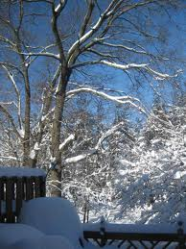
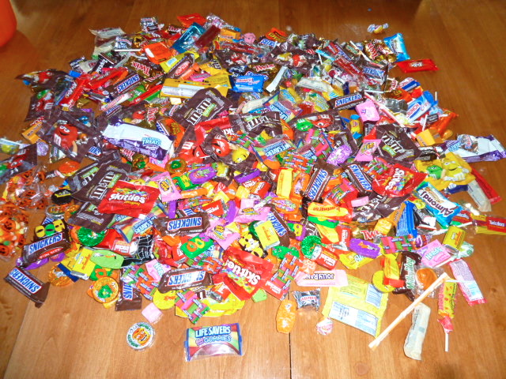
Word of the Day: Accumulate
SYNONYMS: gather, build-up, collect
Snow accumulated on the porch!
After going through the entire
neighborhood, my candy accumulated

Slide 10
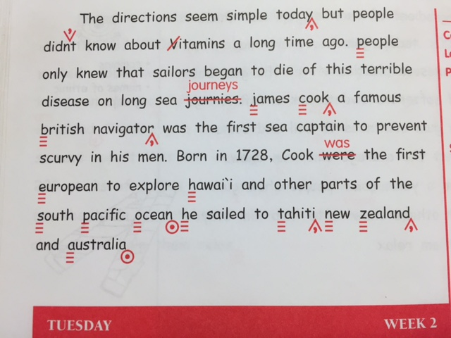
Daily Paragraph Edit DPE Use your editing
symbols from the PROOF-
READING MARKS Page

Slide 11
Roll the Dice
Follow the directions in your notes packet to complete a frequency table
*When you finish, turn in your dice and you will get your letter home to work on

Slide 12
A Letter Home
BRING YOUR SIGNED REPORT CARD back from your PEACE teacher.
DUE next Monday completed and signed by your parent
Use your BEST handwriting and put effort into it.
We will have time each day to work on it in class. You will leave it at school until you are finished, and then I’ll approve it to go home.

Slide 13
Rate the Learning Target
I can create my own frequency table.

Slide 14
Wednesday: 10/22
You need:
- AGENDA
Warm-Ups
Math Notes Packet
BELLRINGER Question: Describe what you know about any of these words: Mean, Median, Mode, Range.
When you finish, READ SILENTLY.

Slide 15
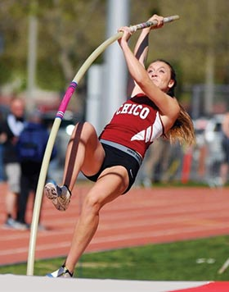
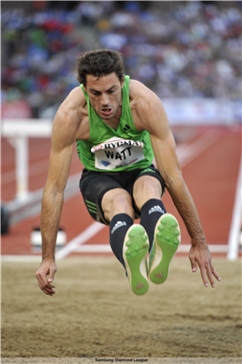
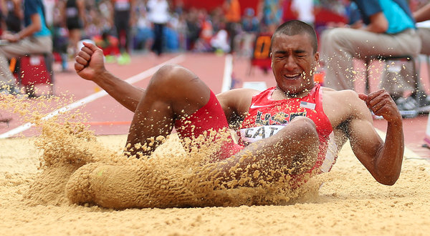
Word of the Day: Decathlon
track and field event, athletic event, 10 events over 2 days

Slide 16
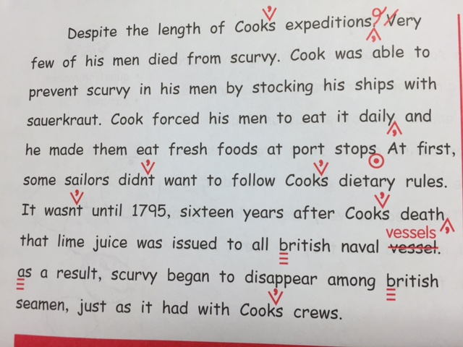
Daily Paragraph Edit DPE Use your editing
symbols from the PROOF-
READING MARKS Page

Slide 17
Mean Median Mode Range
Take notes while we go through the power point on your notes chart

Slide 18
Mean
The mean is the Average of a group of numbers

Slide 19
Mean Example
Here is an example test scores for Ms. Math’s class.
82 93 86 97 82
To find the Mean, first you must add up all of the numbers.
82+93+86+97+82= 433
Now, since there are 5 test scores, we will next divide the sum by 5.
440÷5= 88
The Mean is 88!

Slide 20
Median
The Median is the middle value on the list.
The first step is always to put the numbers in order.

Slide 21
Median Example
First, let’s examine these five test scores.
78 93 86 97 79
We need to put them in order.
78 79 86 93 97
The number in the middle is 86
78 79 86 93 97
In this case, the Median is 86!

Slide 22
Mode
The Mode refers to the number that occurs the most frequently.
It’s easy to remember… the first two numbers are the same! MOde and MOst Frequently!

Slide 23
Mode Example
Here is an list of temperatures for one week.
Mon. Tues. Wed. Thurs. Fri. Sat. Sun.
77° 79° 83° 77° 83° 77° 82°
Again, We will put them in order.
77° 77° 77° 79° 82° 83° 83°
77° is the most frequent number, so the mode= 77°

Slide 24
Range
The range is the difference between the highest and the lowest numbers of the series.
All we have to do is put the numbers in order and subtract!

Slide 25
Range Example
Let’s look at the temperatures again.
77° 77° 77° 79° 82° 83° 83°
The highest number is 83, and the lowest is 77.
All you need to do is subtract!
83-77= 6
In this case, the Range is 6

Slide 26
A Letter Home
BRING YOUR SIGNED REPORT CARD back from your PEACE teacher.
DUE next Monday completed and signed by your parent
Use your BEST handwriting and put effort into it.
We will have time each day to work on it in class. You will leave it at school until you are finished, and then I’ll approve it to go home.

Slide 27
Rate the Learning Target
I can understand how to use Mean, Median, Mode, and Range in a set of data.

Slide 28
Thursday: 10/23
You need:
- AGENDA
Warm-Ups
Article from last week - “10 Strategies to Improve your Math Grade”
BELLRINGER Question: Look back at the article from last week about the “10 strategies to improve your math grade”. What do you think was most helpful? Why?
When you finish, READ SILENTLY.

Slide 29
Word of the Day: Democracy
Government by the people
Self-government

Slide 30
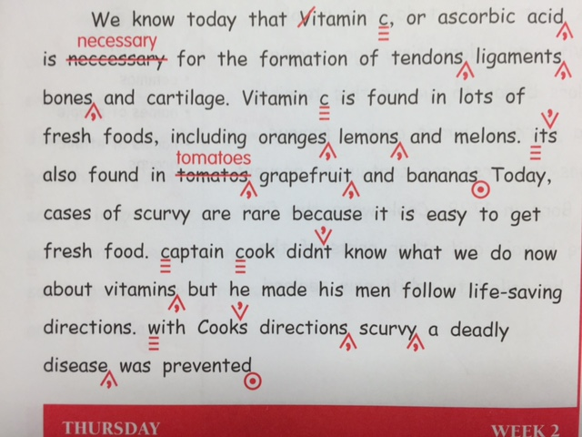
Daily Paragraph Edit DPE Use your editing
symbols from the PROOF-
READING MARKS Page

Slide 31
“10 Strategies to Improve your Math Grade”
Tomorrow you will write a 3.8 over the article from last week
Begin by rereading the parts you underlined/highlighted while reading
Now decide which three main points you’d like to make about the article
Use the Guidelines for writing a 3.8 and map out what you’d like to write tomorrow in an outline form.

Slide 32
Rate the Learning Target
I can prepare my 3.8 by writing an outline.

Slide 33
Friday: 10/24
CLEAR your desk except for:
AGENDA
*Your letter home is due by Monday and must be signed by your parent!
Warm-Ups
When you finish, READ SILENTLY.

Slide 34
GRADE YOUR OWN Warm-Ups
Use a pen or marker that is not what you wrote with in the packet
Write -1 if you miss a question or point
The total points possible is 44
Your total should be at the top and circled.
Examples:
+44/44 +35/44 +42/44
(You can find your percentage by dividing the number you got correct over 44)

Slide 35
A Letter Home
BRING YOUR SIGNED REPORT CARD back from your PEACE teacher.
DUE next Monday completed and signed by your parent
Use your BEST handwriting and put effort into it.
We will have time each day to work on it in class. You will leave it at school until you are finished, and then I’ll approve it to go home.

Slide 36
I can test my knowledge from this week by taking a quiz.
When you finish, begin writing your 3.8 summary over last week’s article. You may use the article, your outline or rough draft, and any guidelines you have to help you.
If you finish, be sure your LETTER HOME is ready to get signed this weekend.
Turn it over and Read silently.

