Slide 1
Week 1
TO-DO:
Notebook/Folder Set Up
DPE Handout Practice
MAIN IDEA
Names/Nombres
Newspaper Articles Main Idea
“Buddies Bare Their Affection for I11 Classmate”
“Duffy’s Jacket”

Slide 2
Monday 8-12-13
Please take this time to complete your agenda for this week. Leave it on your desk for me to check.
Be sure to have your character card out.
Take out your composition notebook and folders you should have.
Turn in any syllabus forms, postcards, or writing assignments, or surveys from last week if you haven’t.
If you do not have an independent reading book, now is the time to check one out from my library. Begin reading silently.
I will come by to check that you have your supplies and a book.

Slide 3
Interactive Notebook (I.N.) CONSTRUCTION
Cut out the Table of Contents and Thinking Stems Page so they will fit in your notebook.
Glue the Table of Contents on your first page front and back.
Next glue the Thinking Stems on the second page front and back.
When you finish, be sure your name is in the cover of your notebook and easy to find.
Please clean up all paper in your row when you finish.

Slide 4
Reading Log
On page 1-2 in your I.N., create a chart that fills the entire page front and back with these categories on the top…
Use a straight edge to draw lines for each column
Fill in the details of your Reading Log in the Table of Contents
Book Title | Author | Date Started | Date Ended | I give this book a… (1-10)

Slide 5
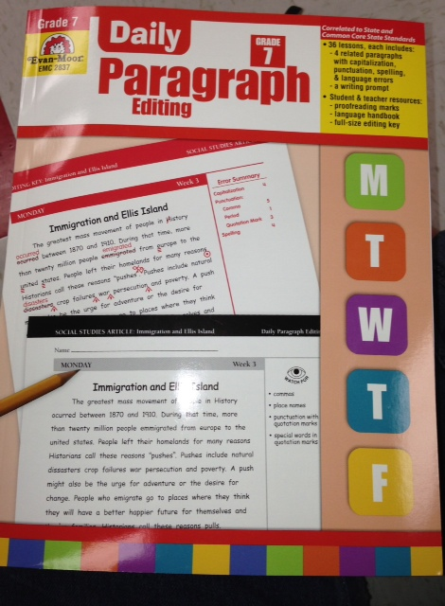
DPE: Daily Paragraph Editing
Please take out the Daily Paragraph Handout you should have from THEHUB.
With the person sitting next to you, brainstorm as many editing symbols as you can.

Slide 6
Editing Marks (please take notes on I.N. page 3)
Fold the page into two columns.
List the following on the entire left side. Leave space.
Delete
Period
Capitalize
Lowercase
Fix Spelling
Add punctuation
Close a space
Underline

Slide 7
Editing Marks (please take notes on I.N. page 3)
In the right column, try to come up with at least two examples of incorrect sentences that need that particular Edit.
For Example: #1 Delete,
I went too to Kansas this summer.
We’ve have gone before too.

Slide 8
Daily Paragraph Edit (or DPE)
Please use what you have learned on Proofreading to silently complete the next paragraph for this week.
Complete this in pencil for today as we practice.
There are 16 errors in total for Monday’s and 22 errors in Tuesday’s.
When you finish, read silently.

Slide 9
WRITING FOLDERS
Front Left Pocket: HOMEWORK such as Daily Paragraph Editing Handout
Front Right Pocket: Completed/Graded Work.
Back right pocket: notebook Paper
Back left pocket: Important Papers
Proofreading Marks Worksheet
6-Trait Rubric
Ready-to-Publish Checklist
Syllabus

Slide 10
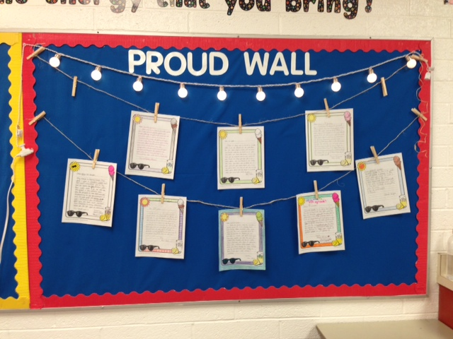
Classroom Feature of the Day: Proud Wall

Slide 11
Learning Target
I can identify the main idea of a text.
Begin taking notes on I.N. page 4, titled, “MAIN IDEA”.
Don’t forget to add it to your Table of Contents.

Slide 12
Main Idea

Slide 13
Main Idea
The main idea identifies the main point or points in a story. It is what the story or passage is mainly about. The main idea in a paragraph is often stated in the first sentence or may be summed up in the final sentence.

Slide 14
Read the paragraph below and identify the main idea.
In the desert of Peru, a country in South America, there are 600 foot long lizards and 900 foot tall birds. They are not real animals, but are drawings in the sand. The Nazca Indians made these drawings about 2,000 years ago.

Slide 15
Read the paragraph below and identify the main idea.
Sam wanted to train Kerry, his puppy. She was 6 months old. The puppy already knew her name and would come when called. Sam wanted to teach her many tricks. When he told his mother about his idea, she suggested that Sam teach the puppy how to sit and shake hands.

Slide 16
The main idea is . . .
Sam trains dogs
Kerry can do many tricks.
Sam hopes to teach Kerry some tricks.

Slide 17
Read the paragraph below and identify the main idea.
Steel is a very important metal which is used for many things. In the United States, the automobile industry uses the most steel. Steel is used in putting up buildings. Cans and containers are made from steel. Steel is used to make farm and factory machines.

Slide 18
The main idea is . . .
The auto industry is the most important.
Steel is used for many purposes.
The United States produces the most steel in the world.

Slide 19
Read the paragraph below and identify the main idea.
Jean finally had money for something she had wanted to buy for a long time. Today after school, Jean would buy her own skateboard. She was pretty good at using skateboards, because she used those of friends to practice. She was looking forward to having her own to use whenever she wanted.

Slide 20
The main idea is . . .
Jean gets a skateboard.
Jean is an expert at skateboarding.
Jean borrows a skateboard.

Slide 21
Read the paragraph below and identify the main idea.
The largest desert in the world is the Sahara. This desert is almost as big as the United States. There are a few plants and animals that live in the Sahara. There are also some people there. These people raise a few crops or animals. They live in tents so they can move around easily.

Slide 22
The main idea is . . .
No one can live in the desert.
The desert is a good place to live.
Few people and animals live on the desert

Slide 23
Read the paragraph below and identify the main idea.
A symbol is a picture or object that stands for something else. For example, the American flag stands for the United States. Uncle Sam is another U.S. symbol. The name comes from the initials U.S. Have you seen the Statue of Liberty? The statue is a symbol for our country and government. The Liberty Bell stands for our freedom. Another symbol, the blad eagle, also stands for freedom.

Slide 24
Read the paragraph below and identify the main idea.
A vegan is a person who eats a special diet of only plant products. Like vegetarians, they do not eat meat, fish or poultry, but a vegan also will not eat eggs, milk, cheese, or butter; products of animals. A vegan diet consists of vegetables, fruits, and grains.

Slide 25
Read the paragraph below and identify the main idea.
Vegans may choose their strict dietm for several reasons. Some don’t like the way farmers treat animals, some change their diet to lower their fat intake, and others are concerned about the enviroment, saying that raising animals is less efficient than farming.

Slide 26
Read the paragraph below and identify the main idea.
The Indians of the South American Andes use llamas for a variety of purposes. The llama is best used as a pack animal because it is sure-footed, strong, and gentle. As members of the camel family, llamas need little water and eat readily available plants. They may be raised for their meat or wool. The Indians use the llamas’ wool for clothing and ropes and make sandals from their hides. Llamas are extremly important animals to these Indians.

Slide 27
Read the paragraph below and identify the main idea.
People find many reasons to like llamas. A llama is used to carrying a load on its back, so it doesn’t mind giving rides to children. They are also hard-working and gentle when they are treated well. Because they are grazers, llamas could be used as “lawn mowers” on golf courses and large estates.

Slide 28
Read the paragraph below and identify the main idea.
No visit to Chicago should be complete without a visit to Skydeck of the Sears Tower. Around one-and-a-half million visitors each year come to Chicago, Illinois, to see the view from the Sears Tower Skydeck. On a clear day, parts of four states can be seen. At night, the view of the city below, ablaze in lights, is breath-taking.

Slide 29
Read the paragraph below and identify the main idea.
The Sears Tower is taller than both the World Trade Center, and the Empire State Building in New York City. The 110-story building reaches 1,454 feet above the ground. Two antenna towers on top bring the building’s height to 1,707 feet.

Slide 30
Read the paragraph below and identify the main idea.
Although they are fascinating today, old time trains were really quite uncomfortable to the passengers of long ago. The seats were rough and bumpy. The cars were open to wind, rain, and sun.

Slide 31
Read the paragraph below and identify the main idea.
A tree is a very useful plant. Paper is made from wood. Medicine is made from bark.. Trees provides shade and beauty. Also, its roots soak up water which might have washed away soil.

Slide 32
Read the paragraph below and identify the main idea.
Did you know that it takes the planet Pluto over 200 years to go around the sun? Our planet, Earth, takes 365 days. Mercury, the smallest planet, only takes 88 days to go around the sun. All of our nine planets in our solar system take a different number of days or years to go around the sun.

Slide 33
Read the paragraph below and identify the main idea.
John Sutter found gold in California in 1848. He wanted to keep his discovery a secret because he wanted all of the gold for himself. But people quickly found out about the gold. By 1849, the news had reached all across America. Many people left their homes to move west in search of gold. That is how the gold rush began.

Slide 34
The Main Idea Is . . .
Very few men become rich from the gold rush.
Miners traveled to California on foot, by boat, and on horses.
The gold rush started after John Sutter discovered gold in California in 1848.

Slide 35
Read the paragraph below and identify the main idea.
Trains carry just about everything. Different kinds of trains carry different things. The locomotive pulls the train. It carries the engineer, or driver. A hopper car carries things like coal, sand, and salt. A flatcar carries large things like telephone poles. The poles must be tied down. Gas is carried in a tanker car. A boxcar can hold many things, from animals to toys.

Slide 36
The Main Idea Is . . .
Boxcars hold many different kinds of things.
Different train cars carry different things.
The locomotive is the most important car.
A train has six different kinds of cars.

Slide 37
Read the paragraph below and identify the main idea.
The ancient Maya Indians lived in central America and Southern Mexico. Today the descendants of the Maya people still live there. During the peak of their civilization, from 250-900 A. D., they lived in the tropical rain forests of the lowlands.

Slide 38
Read the paragraph below and identify the main idea.
The Maya developed the first advanced form of writing called hieroglyphics. Written records of dates and important events were written on pottery, monuments, and palca walls. The Mayan people lived and wrote until the 16th century when they were invaded by the Spanish.

Slide 39
Read the paragraph below and identify the main idea.
With 110 stories, the Sears Tower needs a good elevator service. There are more than 100 elevators in the building. Express elevators can carry passengers to the Skydeck, on the 103rd floor in just over one minute.

Slide 40
Read the paragraph below and identify the main idea.
The famous Battle of Gettysburg was one of the battles fought during the American Civil War. The Civil War had split the U.S. into two sides, the North and the South. The South fought to preserve slavery and the North wanted to abolish slavery. This battle was the turning point in the war.

Slide 41
Read the paragraph below and identify the main idea.
The South approached Gettysburg with 65, 000 troops. The North set up a defensive line with 85, 000 men. The y fought, killing or wounding nearly 28, 000 men from the North. After three days, the South retreated and the North won the battle.

Slide 42
Tuesday 8-13-13
Please take out your agenda, composition notebook, writing folder, and an independent reading book. Double check that you have everything written down for the week.
You should also have a yellow textbook for today. Open it to page 393.
Begin silently reading your own book.
I will pick a student who has followed directions to read in the reading corner if they want.

Slide 43
What’s Main Idea Again? I think I forgot…
TABLE TALK PRACTICE...
Describe what main idea is to your table partner. Pretend they have never heard of the concept before and you have to make them an expert.
Take turns and add to each other’s ideas.
If your partner says what you were going to say, try to say it in a new way.

Slide 44
Learning Target
I can identify details in a text that help me discover the main idea by creating a details “hand”.

Slide 45
Names/Nombres PAGE 393
Review Main Idea before reading...
As we read Names/Nombres be thinking of important details that may lead up to the main idea.

Slide 46
Give me a hand with Main Idea!
On your I.N. page 5 trace your hand.
Go to your table of contents and add page 5. Call it “Main Idea Hand”.
Look back through the short essay we read. With your table partner, decide five important details that could lead to the main idea of the essay. Write those details in your five fingers, then write the main idea in the center of your hand.
Answer question #3 on page 399 on the bottom of your I.N. page 5
When you finish, read silently.

Slide 47
DPE: Daily Paragraph Edit
Begin silently working on your DPE for today.
There are ____ mistakes in today’s paragraph.
Be sure to use the correct editing symbols, otherwise you will not receive credit.

Slide 48
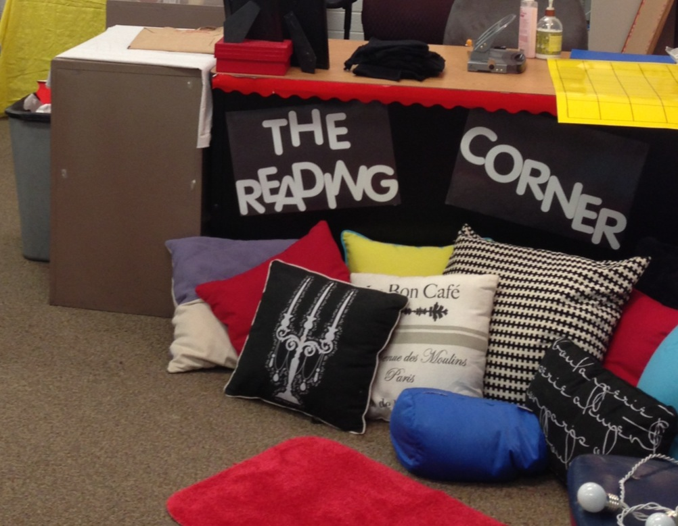
Classroom Feature of the Day: The Reading Corner
When can I sit there?
Who gets to sit there?
Can I ask to sit there?
What should I do there?

Slide 49
Wednesday 8-14-13
Please take out your agenda, I.N., folder, and an independent reading book. Double check that you have everything written down for the week.
Begin silently reading.
I will pick a student who has followed directions to read in the reading corner if they want.

Slide 50
Learning Target
I can identify the main idea of a newspaper article by searching for important details.

Slide 51
Newspaper Articles
You will read 6 newspaper articles with your table partner.
On the last article you read, you will complete the main idea worksheet.
Be sure to be thinking of the main idea on all of the articles, because this will help you later on in class.
Pass your two articles back a row when time is up. Last row bring your article to the front. Take turns fairly reading out loud with your partner.

Slide 52
What was the main idea?
Trade with the table I assigned you. On the back of their worksheet answer the following questions...
Do you agree with their answer for the main idea? Why or why not? (2 sentences)
What details did they leave out of their worksheet about the article?
If you were to write an article about this topic, what would you say differently?
*** Write your name above your answers on the back. When you finish, return the worksheet to its original owner. Turn yours in at THEHUB. Read silently.

Slide 53
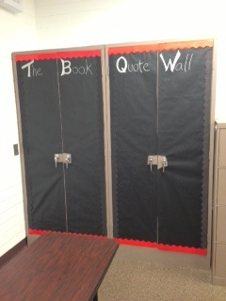
Classroom Feature of the Day: The Book Quote Wall
How can I write on it?
What can I write on it?
When can I write on it?

Slide 54
DPE: Daily Paragraph Edit
Begin silently working on your DPE for today.
There are ____ mistakes in today’s paragraph.
Be sure to use the correct editing symbols, otherwise you will not receive credit.

Slide 55
Thursday 8-15-13
Have your yellow textbook opened to page 543.
Get out your character card, agenda, I.N., and writing folder.
Read your independent reading book silently.

Slide 56
I.N. page 6 “Summary from Main Idea”
After reading page 543, create a chart like the one on the page for the details from “Names/Nombres” in your I.N. page 6. Try to only use half of the page.
Add page six to your table of contents. Title it “Summary from Main Idea”
You may need to look back on your hand from Tuesday to remember. (The essay is on page 393)
*** When you finish your chart, read silently.

Slide 57
Learning Target
I can use what I know about Main Idea to write a summary of a short newspaper article.

Slide 58
I.N. page 6
Read “Buddies Bare Their Affection for I11 Classmate” with your table partner.
Answer questions #1-4 together in your I.N. 6
Then read and complete the constructed response section below independently and on a separate piece of notebook paper. Be sure your summary is at least a paragraph. (5-7 sentences)
Turn it in to THEHUB when you are finished and read silently.

Slide 59
DPE: Daily Paragraph Edit
Begin silently working on your DPE for today.
There are ____ mistakes in today’s paragraph.
Be sure to use the correct editing symbols, otherwise you will not receive credit.

Slide 60
HOMEWORK
If you could make a diagram/chart to describe to someone how to find the main idea of a text, what would it look like?
Create a colorful chart using words and pictures to teach someone how to find main idea.
Your chart must have at least 3 steps to it, but can have more.
DUE TOMORROW

Slide 61
Friday 8-16-13
Have your main idea chart out that is due today. Be sure your name is on it and pass it to the right in your row. End of the rows pass forward.
Open your yellow textbook to page 4.
Be sure your agenda is completed for the week.
Complete the worksheet about your independent reading book.
Turn it in at THEHUB when you are finished.
Read an independent reading book silently.

Slide 62
How do I find the Main Idea?
Homework share time

Slide 63
ANCHOR EXTENSION ACTIVITIES
What is an anchor extension?
Who does it?
How do you get to do it?
How does it help my grade?
Where do I get it and turn it in?
***Anchor Extension Signature page is DUE MONDAY! (10pts.)

Slide 64
Learning Target
I can read and take notes of important story details in “Duffy’s Jacket” by using what I know about finding Main Idea.

Slide 65
I.N. page 7, “Duffy’s Jacket”
While you read “Duffy’s Jacket”, answer the RETELL questions #1-6 that are in the margins of the story. Answer the questions in your I.N. page 7.
While you read, also be thinking of important story points that you would need to remember if you were to retell this story to someone who had not read it.
When you finish read your independent reading book silently.

Slide 66
DPE: Daily Paragraph Edit
Begin silently working on your DPE for today.
Be sure to use all of the proper uses we have talked about this week in creating a paragraph yourself.
Write in pencil to correct your errors.
When you finish, turn it in to THEHUB and read silently.

