Slide 1
Language Arts: Monday 4-22 I.N. 30
Choose one of the following prompts to write on for 5 minutes:
Persuade a friend that one brand of computers is better than another.
Convince your class that exercise is important for good health.
Persuade someone to switch their type of shampoo to a better one.
*have your textbook open to page 234.

Slide 2
Language Arts: Monday 4-22 I.N. 30
(Take notes…)
Generalization: combine what you know with specific information you read to make a judgment.
Faulty Generalization: either is not true or does not apply in all cases.
Persuasive Techniques: ways to add to the appeal of information presented in a persuasive argument.

Slide 3
Language Arts: Monday 4-22 I.N. 30
With the person sitting next to you, or individually, read through the print advertisement on page 235.
Answer questions #1-6 on the back of the worksheet from THE HUB.
Then complete the graphic organizer side of the worksheet. (BE DETAILED and USE COMPLETE SENTENCES)
When you finish, turn it in at THE HUB and read a book silently.

Slide 4
Language Arts: Tuesday 4-23 I.N. 31
How do advertisers get you to buy their products?
Think of the last item you purchased at a store. What made you want to buy it? Did anything influence your decision? Was that item advertised at all?
Is there an object or product you really want right now? Why?

Slide 5
(notes on I.N. page 31) Types of Persuasion

Slide 6
Bandwagon
Convincing people to get on board with something “everyone” is doing
Example:
“Ask your parents for Super Toy so you won’t be the only one of your friends without one.”
“Everyone drinks Super Cola!”

Slide 7
Bandwagon
http://www.youtube.com/watch?v=jvCTaccEk
http://www.youtube.com/watch?v=acMaC08pxGo

Slide 8
Testimonial
Uses the backing of a celebrity or expert.
“I’m Sally Celebrity, and I drink Super Cola before every concert.”
“Super Toothpaste will whiten your teeth quicker than the other brands. I know because I’m a dentist.”

Slide 9
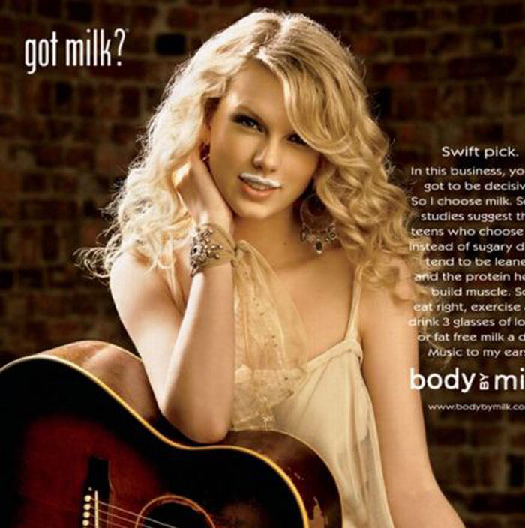
Testimonial

Slide 10
Either/or
Convinces you that you fall into one of two categories, with no in-between.
“Cool people drink Super Cola. Only losers drink anything else.”
“You are either for the new bill raising awareness of hunger, or you think all people should starve.”

Slide 11
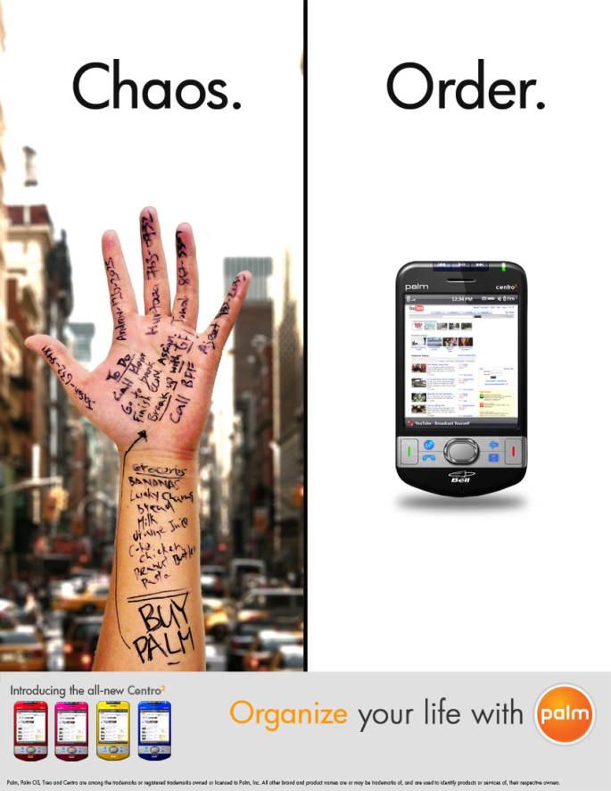
Either/or
http://www.youtube.com/watch?v=dKhv9kZM8gM
http://www.youtube.com/watch?v=Xy_PxLw1B_c

Slide 12
Appeal to Fear
Makes you fear for your health or safety.
“Buy a Super Alarm, or your whole family might be at risk of harm.”
“Buy Super Flu-Prevent, or you might end up in the hospital with the flu.”

Slide 13
Appeal to Fear
http://www.youtube.com/watch?v=VRgNS1P6k6o

Slide 14
Glittering Generalities
use of words that make something sound good without actually saying anything specific/ important.
“Super Cola is the best cola drink there is!”
“Super Shoes are amazing!”

Slide 15
Glittering Generalities
http://www.teachertube.com/viewVideo.php?video_id=137790
http://www.youtube.com/watch?v=nvKyYeJJYwM

Slide 16
Transfer
Associating love, respect, or admiration for someone and transferring it to a product.
If you buy the product, you get the feelings or benefits associated with it.
Example:
A car ad shows a pretty girl in the passenger seat. If you buy the car, you think you get a pretty girl.

Slide 17
Transfer
http://www.youtube.com/watch?v=DCjeSNomXrU
http://www.youtube.com/watch?v=Kaz4vpOr1Dw

Slide 18
Questions
For each example, hold up one, two, three, four or five fingers to show which type of persuasion best fits that example.

Slide 19
“Everyone in Peoria shops at Super Peoria Mart!”
1. Bandwagon
2. Testimonial
3. Either/or
4. Appeal to fear
5. Glittering Generalities

Slide 20
“Super Store is terrific!”
1. Bandwagon
2. Testimonial
3. Either/or
4. Appeal to fear
5. Glittering Generalities

Slide 21
“Hi, I’m Barry Basketball, and I think Super Shoes are a slam dunk!”
1. Bandwagon
2. Testimonial
3. Either/or
4. Appeal to fear
5. Glittering Generalities

Slide 22
“Without Super Lock, it is easy for someone to break into your house.”
1. Bandwagon
2. Testimonial
3. Either/or
4. Appeal to fear
5. Glittering Generalities

Slide 23
Which type is this?
“The next best thing is already here.”
http://www.youtube.com/watch?v=FRkmtbWURwo

Slide 24
Work Cited
http://sps.k12.mo.us

Slide 25
Language Arts: Wednesday 4-24 I.N. 32
What are the 6 types of persuasion we learned about yesterday? List them all and write an example of each next to them.
Think of a commercial that is on TV right now. What type of persuasion is used in it? Describe the commercial and how you know the persuasion technique.

Slide 26
Language Arts: Wednesday 4-24 I.N. 32
Once your table is assigned a type of persuasion, decide on a product you will be selling.
You must use that type of persuasion to create a short 30 second commercial to sell the product.
On one separate piece of paper, write all of your names, the type of persuasion, the product you are selling, and write out an outline or script of your commercial to use when you present. We will present at the end of class.

Slide 27
Language Arts: Thursday 4-25
To help you to study for the spelling test, define each of the spelling words using the dictionaries at your tables and create an acronym. I have done the first word for you. Complete in your I.N. 33
EXAMPLE: (word, definition, acronym)
Madam- Used as a form of polite address for a woman
M: mother
A: a lady
D: dear
A: addressing an adult
M: most women
***When you finish, study, complete homework, or read silently.

Slide 28
Language Arts: Friday 4-26
Take about three minutes to study for the spelling test.
When you finish, turn it in at THE HUB.
Complete the assignment from THE HUB.
If you finish, you may turn it in. Otherwise, it will be due Monday.
Read a book silently.

