Slide 1
RWeek6

Slide 2
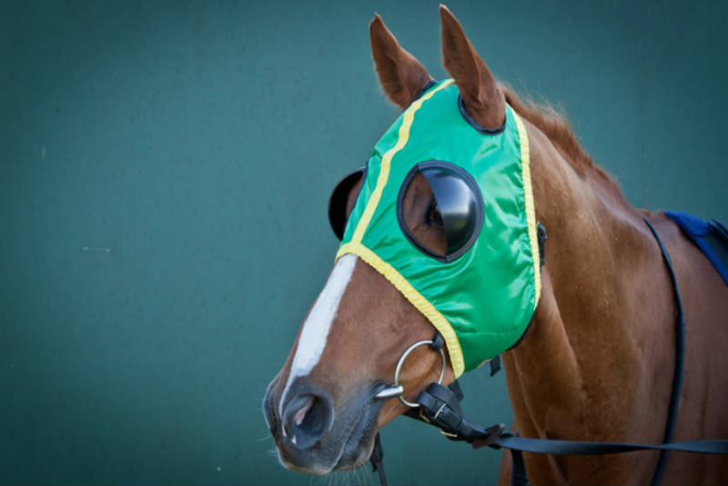
blinkers / blinders
blinders / blinkers – noun – A piece of equipment put on the horse's head to prevent the horse from seeing out the sides so the horse will not spook or jump when they see things out the sides of their eyes.
If a horse does not wear blinders during a race, he might get spooked and throw his jockey, or pull up and stop running.

Slide 3
tack
tack – noun – all the gear that comes with owning and caring for a horse: the bridle, saddle, bit, girths, cinches, saddle pads, lead ropes, halters, whips, stirrup irons and stirrup leathers, horse boots etc.
If you own a horse farm, you spend a lot of time in tack shops trying to buy everything necessary to keep your horse healthy, well groomed, and well equipped.

Slide 4
Grade your Own Article from Yesterday

Slide 5
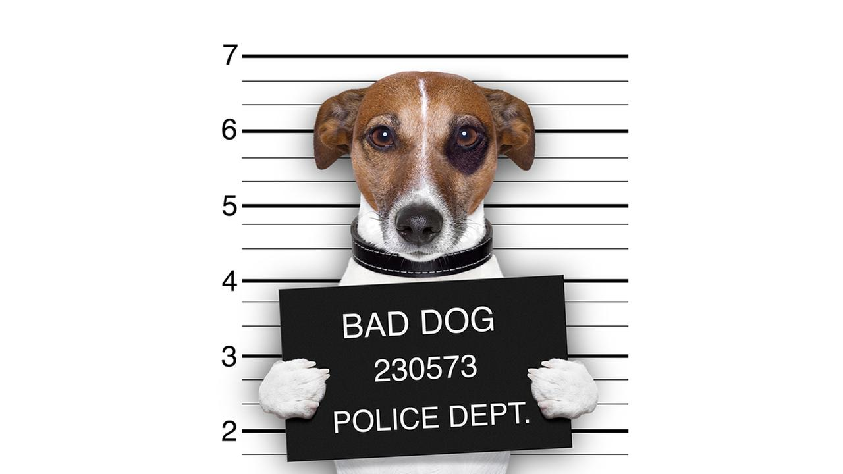
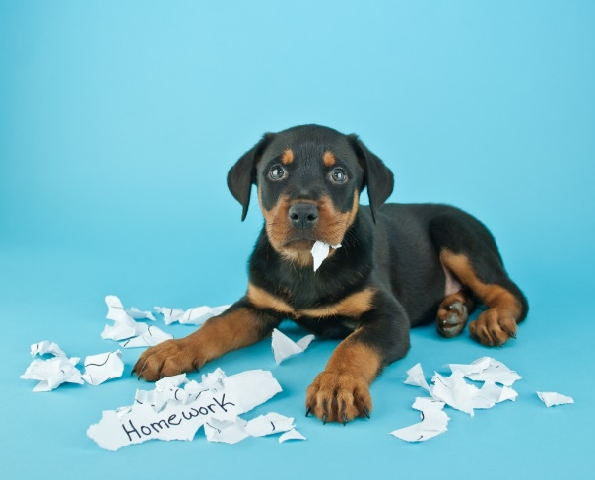
The dog ate its poster. It’s a bad dog.
NAME ____________ 7th hour
ITS
IT’S
When an object or animal shows possession of something.
Used as a pronoun contraction to replace “IT IS”

Slide 6
cadence
cadence – noun – the rhythmic movement making up a horse’s gait.
In some horse competitions, the horse is expected to prance and trot in a specific cadence or rhythm that is set to music.

Slide 7
Read Works online assignments
How to get your assignments
1. Go to digital.readworks.org/student
2. Enter the class code L3LNHW
3. Your default password is 1234

Slide 8
Test Corrections:
Old Answer
New Answer
Why you know it was incorrect
Staple together and turn in to THEHUB
When you finish, create your poster of your Homonym

Slide 9
Homonym Poster Project
DUE TOMORROW

Slide 10
dressage
dressage – noun – A horse competition where the horse must be trained to be poised and to move elegantly and responsively to the rider’s commands.
The dressage competition is a crowd pleaser because the horse and rider need to be in absolute synch with one another, as well as with the music; therefore, it is fun to watch.

Slide 11
August Words of the Day
incentive confidentiality
charitable vandalism
truant
infraction
defiance
arson
forgery
derogatory

Slide 12
September Words of the Day
confidentiality blinkers foal
vandalism tack filly
analysis cadence colt
synthesis dressage polo
equestrian farrier gift-horse
paddock gait Steeplechase
hands halter

