Slide 1
Reading Week 4

Slide 2
Literacy Strand
No Literacy Strand will be accepted unless it has…
Underlined in the text
Capital Letter
Restated the direction
Complete Sentence
Punctuation.

Slide 3
Word of the Day –
Use the word of the day in an original sentence.
Then draw a picture to help you remember what it means.
confidentiality – noun – to keep someone’s name or business private.
You can trust all school teachers and personnel to keep student information confidential to protect everyone’s privacy.

Slide 4
Write an encouragement letter…
Please write a letter of encouragement to offer condolences to the Penn family or Peyton.
Begin by saying, “Dear Penn Family,…”
Express your sympathy by saying “I am sorry for your loss.”
Empathize with them by saying something like, “I can’t imagine the pain you are experiencing, but please know that your community is here for you if you need anything.”
Please use sensitivity when speaking about their circumstances.
If in doubt, just say kind things.

Slide 5
APE for Reading!
Anticipate
Process
Evaluate

Slide 6
Text Structure
Take notes in your notes section or on a separate piece of paper.

Slide 7
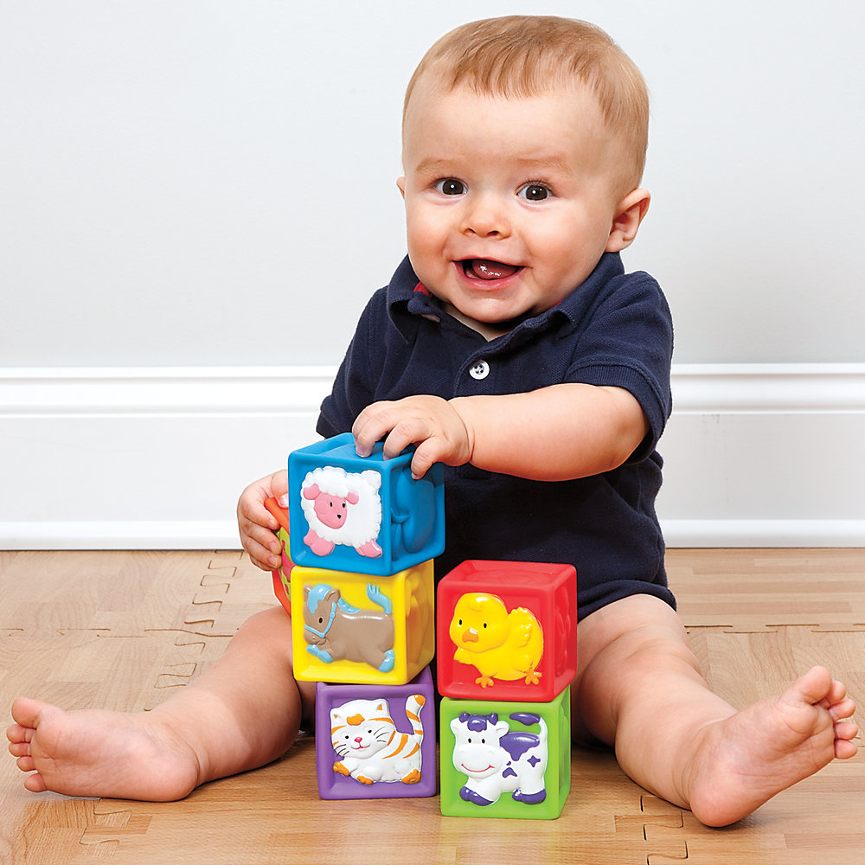
Paragraphs are the building blocks of texts!

Slide 8
WHY?
The purpose of an informational paragraph is to convey the main idea to the reader to help them understand the main idea of an entire text.

Slide 9
Text Structure
Text structure is the way the writer has chosen to organize the information inside an individual paragraph or article.

Slide 10
It can also be..
the order that the author chooses to arrange the paragraphs within a piece of writing.

Slide 11
Types of Text Structures for Paragraphs
Spatial
Also known as descriptive
Used when describing a location, object, living thing.

Slide 12
Example
My room is set up the way I like it. When you walk into my bedroom there is a window facing the door. To the right of that, is a dresser and television, and on the other side of the window is my bed. The walls are covered with various pictures and posters.

Slide 13
Sequential
Used when the paragraph is describing the steps involved in the completion of something

Slide 14
Example
When making a peanut butter and jelly sandwich, first you must get two slices of bread out of the bag. Then, you must open the peanut butter jar and spread peanut butter on one of the slices of the bread. After that, you will need to open the jar of jam and spread jam on the other slice the bread. Finally, you stick the two slices of bread together.
What is the last step in making a peanut butter and jelly sandwich?

Slide 15
Cause and Effect
Used when a writer is trying to explain how one event caused or led to another event happening.

Slide 16
Example
The dodo bird used to roam in large flocks across America. Interestingly, the dodo wasn’t startled by gun shot. Because of this, frontier men would kill entire flocks in one sitting. Unable to sustain these attacks, the dodo was hunted to extinction.
What caused the dodo’s extinction?
This phrase is a clue! It is explaining the cause of the effect in this paragraph.

Slide 17
Problem and Solution
Used when describing a problem or solution to a problem

Slide 18
Example
Thousand of people die each year in car accidents involving drugs or alcohol. Lives could be saved if our town adopts a free public taxi service. By providing such a service, we could prevent intoxicated drivers from endangering themselves or others.
What is the problem in this paragraph?
What is the solution?

Slide 19
Compare and Contrast
Used when an author wants to write about how things are similar and different.

Slide 20
Example
Linux and Windows are both computer operating systems. Computers use them to run programs. Linux is a totally free and open source, so users can improve or otherwise modify the source code. Windows is owned by a specific company, so it costs money to use, and users are prohibited from altering the source code.
How are the two computer systems different?

Slide 21
Chronological Order
When the paragraph is organized around the order in which events happened in time.

Slide 22
Dinosaurs existed about 250 million years ago to 65 million years ago. This era is broken up into three periods known as the Triassic, Jurassic and Cretaceous periods. The Triassic Period lasted for 35 million years from 250-205 million years ago. Planet Earth was a very different place back then. All the continents were united to form one huge land mass known as Pangaea. The Jurassic Period was the second phase. The continents began shifting apart. The time scale for this famous period is from 205 to 138 million years ago. The Cretaceous Period was the last period of the dinosaurs. It spanned a time from 138 million to about 65 million years ago. In this period the continents fully separated. However, Australia and Antarctica were still united.

Slide 23
Practice!
Eating cereal is easy. First, get out your materials. Next, pour your cereal in the bowl. Then add your milk. After that, stick a spoon in your bowl and enjoy!

Slide 24
Sequential

Slide 25
When looking at Mrs. Schneider’s desk, you will notice the coffee cup sitting on the left hand corner. In the middle of the desk are a clipboard, her water bottle, papers and next to the wall is her phone. Mrs. Schneider keeps her candy hidden.

Slide 26
Spatial

Slide 27
No-name papers have plagued teachers for a long time. It is very easy to forget to put your name on your paper. Professor Mario and his colleague Luigi think that teachers should give students a simple reminder before handing in papers. Others think that a more students should check each other’s papers for names.

Slide 28
Problem Solution

Slide 29
There are many theories about why the dinosaurs vanished from the planet. One theory that many people believe is that a gigantic meteorite smashed into the Earth. Scientists believe that the meteorite was very big and that the impact may have produced a large dust cloud that covered the Earth for many years. The dust cloud may have caused plants to not receive sunlight and the large plant eaters, or herbivores, may have died off, followed by the large meat eaters, or carnivores. This theory may or may not be true, but it is one explanation as to why these giant reptiles no longer inhabit the Earth

Slide 30
Cause and Effect

Slide 31
CNN STUDENT NEWS
http://www.cnn.com/studentnews

Slide 32
Word of the Day –
Use the word of the day in an original sentence.
Then draw a picture to help you remember what it means.
vandalism – noun – destroying, mutilating, or defacing property
Vandalism is expensive; anytime we have to re-paint, rebuild, or repair property at our school it costs money – money that could be better spent on books, materials and field trips.

Slide 33
Literacy Strand
No Literacy Strand will be accepted unless it has…
Underlined in the text
Capital Letter
Restated the direction
Complete Sentence
Punctuation.

Slide 34
  GRADE LAST WEEK’S QUIZ
  TOTAL = + ___ / 24
Read the narrative 3.8 paragraph.
  1 point = indenting before the paragraph (put a ☺)
  8 points = 1 for each complete sentence (put a check mark by it)
  3 points = 3 rules mentioned (circle each rule)

Slide 35
CNN STUDENT NEWS
http://www.cnn.com/studentnews

Slide 36
Word of the Day –
Use the word of the day in an original sentence.
Then draw a picture to help you remember what it means.
plagiarism – noun – the practice of taking someone’s ideas, work, words, inventions, or intellectual property and passing it off as one’s own.
When a student “cuts and pastes” words or pictures from a source and does not give credit to that site, the student is stealing someone else’s intellectual property, or plagiarizing.

Slide 37
Literacy Strand
No Literacy Strand will be accepted unless it has…
Underlined in the text
Capital Letter
Restated the direction
Complete Sentence
Punctuation.

Slide 38
CNN STUDENT NEWS
http://www.cnn.com/studentnews

Slide 39
Word of the Day –
Use the word of the day in an original sentence.
Then draw a picture to help you remember what it means.
syllabus – noun – a brief outline, list, or overview of the main topics, or texts to be covered during a class.
Many teachers give students a class syllabus for each 9 weeks so they can anticipate the work they will need to make time to complete.

Slide 40
Literacy Strand
No Literacy Strand will be accepted unless it has…
Underlined in the text
Capital Letter
Restated the direction
Complete Sentence
Punctuation.

Slide 41
CNN STUDENT NEWS
http://www.cnn.com/studentnews

