Slide 1
March Week 1
Monday: Dress Article, Answer the Question!
Tuesday: Read “Drones Put Spying Eyes in the Sky”
Wednesday: Finish “Drones Put Spying Eyes...”
Thursday: After Reading Poster Activity
Friday: Word of the Day Quiz and February Words Quiz

Slide 2
February Words QUIZ ON FRIDAY!
consternation
threshold
plagiarism
tariff
transition
embargo
soliloquy
Denominator
congruent
erosion
text
Negligible

Slide 3
Monday
Complete your Agenda
Copy the Date on your Journal Page
Copy our Learning Target for Today
Robots are used for jobs that are boring, dirty, or even dangerous. What are some jobs that you would give a robot to do? Why?

Slide 4
Word of the Day! chaos
– noun – a state of complete disorder and confusion.
Teachers are disappointed when they enter a classroom and the atmosphere is one of complete chaos.

Slide 5
Literacy Strands
Complete Today’s Literacy Strand
Don’t forget to RESTATE the prompt and use proper capitalization and punctuation.
Work with your group to read out loud and check your answers.

Slide 6
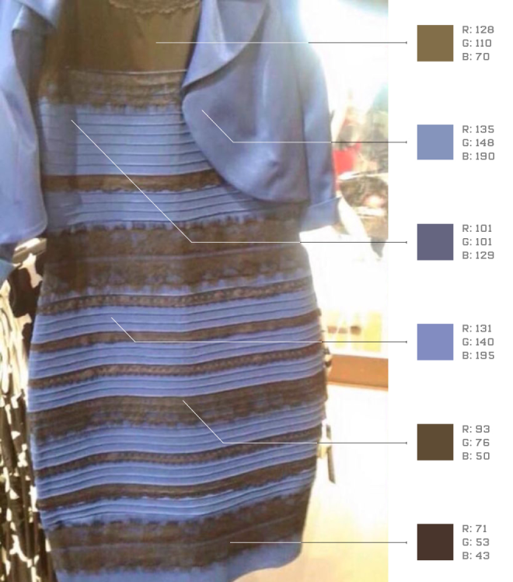
White and Gold or Blue and Black?
Read the article with your group!
https://www.youtube.com/watch?v=H8d5UkHl4cc

Slide 7
Post Reading Question
Explain why many of us see the dress differently. Use evidence from the article to support your answer.
Tell me which color you see! Blue and Black or White and Gold?
When you finish, turn it in to THEHUB and read silently or study February’s words of the day.

Slide 8
Learning Target
I can understand a text by answering one big question.

Slide 9
Tuesday
Complete your Agenda
Copy the Date on your Journal Page
Copy our Learning Target for Today
Describe all the things you can see from a “Birds-eye” view that you can’t see from the ground. What advantages does this view have?

Slide 10
Word of the Day! parasite
– noun – a plant or animal that lives on another, usually larger, host organism in a way that harms or is not an advantage to the host.
People who choose not to “pull their own weight” in the world are often seen as parasites on those who choose to work hard and make good choices.

Slide 11
Literacy Strands
Complete Today’s Literacy Strand
Don’t forget to RESTATE the prompt and use proper capitalization and punctuation.
Work with your group to read out loud and check your answers.

Slide 12
“Drones Put Spying Eyes in the Sky”
Read the article
In your journal, take at least 4 important notes of details from each of the 4 sections in the text. (16 notes total)
When you finish, draw a picture of one of the things described in the article in your journal.
Study February’s Words of the Day!

Slide 13
Learning Target
I can process a text by taking notes of important details.

Slide 14
Wednesday
Complete your Agenda
Copy the Date on your Journal Page
Copy our Learning Target for Today
What is something new you learned about drones in the article we read yesterday?

Slide 15
Word of the Day! hyperbole
– noun – obvious exaggeration used for dramatic effect
“I could eat a million of these” is an example of a type of figurative language called hyperbole.

Slide 16
Literacy Strands
Complete Today’s Literacy Strand
Don’t forget to RESTATE the prompt and use proper capitalization and punctuation.
Work with your group to read out loud and check your answers.

Slide 17
“Drones Put Spying Eyes in the Sky”
Finish reading and taking notes from yesterday if you didn’t already.
Answer the During Reading questions #1-9 on a separate piece of paper as you re-read the article.
When you finish, be sure your name is on your paper, and turn it in to THEHUB.
Read silently or study February’s Words of the Day!

Slide 18
Learning Target
I can process a text by RE-Reading and answering questions.

Slide 19
Thursday
Complete your Agenda
Copy the Date on your Journal Page
Copy our Learning Target for Today
According to you, what is the most useful way to use drones from the article we’ve read this week? Describe why you think that’s the most important.

Slide 20
Word of the Day! personification
– noun – to give human qualities or attributes to something non-human
“The wind whispered my name” is an example of a type of figurative language called personification.

Slide 21
Literacy Strands
Complete Today’s Literacy Strand
Don’t forget to RESTATE the prompt and use proper capitalization and punctuation.
Work with your group to read out loud and check your answers.

Slide 22
You must be finished with questions from yesterday in order to begin.
Drone Poster Details: Your poster must have these things...
Your Name and Class #
Title of the article and The author
A sentence in quotes from the article that will show what your illustration means.
A colorful, quality time spent, picture that illustrates a use of a drone from the article.
If you finish early, study February’s words of the day!

Slide 23
Learning Target
I can display my knowledge of a text by creating a poster.

Slide 24
Friday
Turn in your literacy strands and poster if you haven’t already.
Clear your desk and study your words of the day!

Slide 25
WORD OF THE DAY QUIZ
Follow the directions to complete the 3.8 on the back.
When you finish, look at the list of February words of the day.
On a separate piece of paper, DEFINE AT LEAST 7 of the words from February. Be sure your name is on it and turn everything into THEHUB when you finish.
Read silently.

