Slide 1
Poetry Week 1 - Study Guide Notes Chart DUE THURSDAY - Poetry Reflection Packet DUE FRIDAY

Slide 2
Monday: I.N. 36 Poetry is....
In your notebook, write down as many ends to this sentence as you can think of. Keep writing until I say stop.
http://www.youtube.com/watch?v=qQtmGcdSDAI

Slide 3
Learning Target
I can understand the impact using similes, metaphors, and personification has on the meaning of a poem.

Slide 4
Poetry is about Presentation
http://www.youtube.com/watch?v=LGAMd-tT6fQ
http://www.youtube.com/watch?v=Clm8w8_eOnc
http://www.youtube.com/watch?v=a1yWtFVH-tU

Slide 5
Stick it to your brain....and your notes. I.N. 36
Simile: compare using “like” or “as”
Ex: Bob is hungry as a wolf
Metaphor: compare without using “like” or “as”
Ex: Bob is a hungry wolf
http://www.youtube.com/watch?v=JB0HrNdqJKQ
Personification: giving human qualities or actions to something that is not human.
Ex: The wind whispered her name.

Slide 6
Practice: I.N. 36
Complete each of the following using the figurative language strategy suggested...
Today is like... (simile)
That class... (metaphor)
The pencil... (personification)
(When you finish, begin your homework poetry packet for this week. For each poem, apply the terms we learned in class that day. Write on separate pieces of paper then staple them to the back of the packet.)

Slide 7
Tuesday: I.N. 37
What do you think makes a poem a poem? Write at least three complete sentences to answer your question.
http://www.youtube.com/watch?v=tmayC2AdkNw

Slide 8
Learning Target
I can apply what I’ve learned about Figurative Language and annotate a poem.

Slide 9
Stick it to your brain...and your notes (On your chart)
RHYME: words which end with the same sound
True rhyme: usually at the end of lines
Preach to Teach
Internal rhyme: Rhyme within a line
It is a Bright Night, with the full moon above…
Half Rhyme: slight (not accurate) repeating of sounds
hill to full
Eye Rhyme: Words that LOOK like they rhyme, but don’t
flow to how

Slide 10
Stick it to your brain...and your notes (On your chart)
Repetition: repeating parts of the poem to show importance or make it stand out
Onomatopoeia: a word that sounds what it means
Ex: CRUNCH, BAM, BUZZ
Imagery: Showing a picture of your words by using figurative language or the five senses
“We’re like diamonds in the sky.”
http://www.youtube.com/watch?v=ySqyQAs1XtM
http://www.youtube.com/watch?v=EgwlB-v2pXI

Slide 11
Practice: I.N. 37
Find at least 10 words that rhyme with truth.
Think of a song that uses repetition. What word or phrase is repeated? Why?
Re-write this sentence using imagery:
The sun rose.
What is the point of an Onomatopoeia?

Slide 12
Wednesday:
- Have your notes chart out and filled in for the words that we have learned already.
“Taylor the Latte Boy”: Listen for words that are close together that have similar sounds. Write them down.
http://www.youtube.com/watch?v=zXS0nEOx_20

Slide 13
Learning Target
I can identify figurative language in spoken poetry, and analyze how it deepens the meaning of a poem.

Slide 14
Stick it to your brain...and your notes
Hyperbole: An obvious exaggeration to emphasize something or make it seem important.
Ex: I had a ton of homework(No you didn’t!) ☺
http://www.youtube.com/watch?v=14SEC1vuvoc
Alliteration: The repetition of consonant sounds at the beginning of words close by.
Ex: Summer is a sweaty circus scent.
Assonance: The repetition of vowel sounds in the middle of words close by.
Ex: Talking and walking, to each end of the bend.

Slide 15
Stick it to your brain...and your notes
Figurative Language: writing that steps away from literal meanings in order to accomplish a special effect or deeper understanding.
Irony: Saying the opposite of what you actually mean.
Ex: The directions were as clear as mud.
Paradox: A statement that seems to oppose/contradict itself, yet actually reveals some truth.
Ex: Her silence was deafening.
http://www.youtube.com/watch?v=3K9pd6h9JT0

Slide 16
Slam poetry
http://www.buzzfeed.com/lyapalater/tom-hanks-performs-slam-poetry-about-full-house
http://www.youtube.com/watch?v=mXoQfDk78jk
Sarah Kay “B”
http://www.youtube.com/watch?v=S4Tji76OH6c

Slide 17
Thursday: I.N. 38
Have your notes chart out.
Review all of the terms that we have learned so far.
Practice quizzing each other on what each of them means and give an example of each.

Slide 18
Learning Target
I can analyze a poem (using my knowledge about figurative language) by annotating it, and writing about what I find.

Slide 19
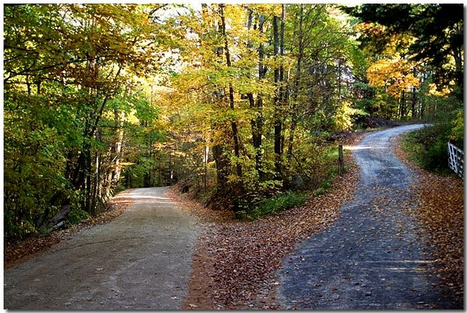
http://9to20.wordpress.com/2012/03/23/art-stop-the-road-not-taken/

Slide 20
“The Road Not Taken” – Robert Frost
Read through the poem once to yourself, read it again and see what figurative language you can find. Mark up your poem in the margins with labels and notes. Try to read it as many times as possible, looking for new things that stand out each time. (use a dictionary if needed)
http://www.youtube.com/watch?v=SnAyr0kWRGE
See Poetry Differently:
http://www.youtube.com/watch?v=eEYIhulK8S0

Slide 21
Friday: Figurative Language Test
http://www.youtube.com/watch?v=2g1Innujn4o
Before the test, have your notes chart out to study for a few minutes.
Also, have your poetry homework packet available for after the test.
When you finish, turn it in at THE HUB and read or sit quietly until everyone is finished.

