Slide 1
Language Arts: Monday 1-7-13
Find your red/yellow newspaper folder you created before break. (Clear out your folder as well)
Once you receive your I.N., turn to the next page we haven’t written on yet.
NUMBER THE PAGE #1 in the top corner and answer the following question…
What are your New Year’s Resolutions? What are some things you want to improve on/ change about your life? What are some things you want to improve on in school? How are you going to accomplish these things?
(When you finish, be sure you have signed up for the Raider Reporter on the back cabinet)

Slide 2
I.N. Updates
If you would like to purchase a new notebook for your I.N. instead of using the same one, now is the time to get one.
NEW TABLE OF CONTENTS!

Slide 3
Language Arts: Tuesday 1-8 I.N. page 2
Glancing at the newspaper articles at your table, what does every article have in common? List at least 5 similar elements from the structure and actual articles.
Draw a line under your bell work when you finish.
Be sure you have your new Table of Contents updated from yesterday and today.
Page 1, New Year’s Resolutions, 1-8
Page 2, Writing News Articles Notes, 1-9

Slide 4
Writing Effective Newspaper Articles
Formula for Success
Copyright © 2012 Gareth Manning

Slide 5
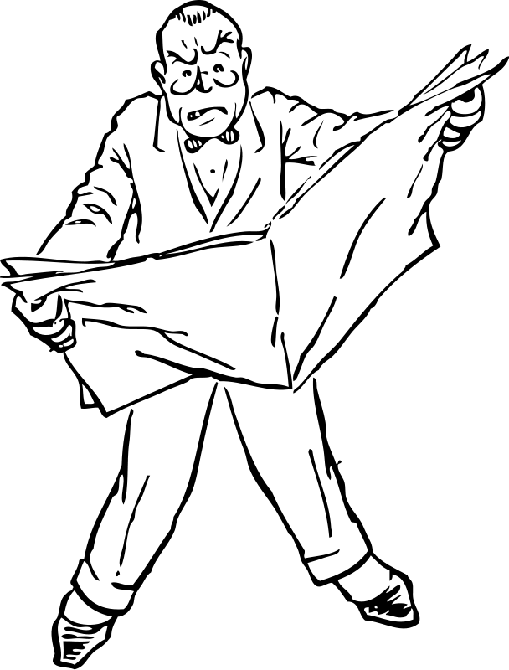
Inverted Pyramid Structure
Remember: most news readers skim quickly!
Most important info must be at the start!

Slide 6
A typical newspaper article contains six parts:
Headline: catches reader’s attention
Byline: tells who wrote the story, as well as the date.
Lead paragraph: Contains ALL of the who, what, when, where, why and how in it.
Example: This afternoon handsome school teacher, Gareth Manning, is being thrown a party for being wonderful by his Grade 9 students on Mount Robson using funds raised for their graduation ceremony.

Slide 7
A typical newspaper article contains six parts:
4. Explanation paragraphs: Important facts and quotes not included in lead paragraph, written in order of importance (most to least).
5. Additional Information: Least important information, perhaps about a similar or related event.
6. Concluding Paragraph: Catchy, memorable ending.

Slide 8
Also…
Paragraphs must be short and concise.
Written in the third person.
Be unbiased—just a report on the facts.

Slide 9
Practice I.N. page 2
Using one of the articles at your table, fill in the 6 elements of a newspaper article. You each have a different article, so this is an independent activity. Begin by reading the article, then complete the following parts in your I.N.
Headline
Byline
Lead Paragraph: 5 W’s and How
Explanation Paragraph: Extra Facts & Quotes
Additional Info.
Concluding Paragraph: catchy ending

Slide 10
Language Arts: Wednesday 1-9 I.N. page 3
What is your Raider Reporter Topic you signed up for? List some ideas of things you could write about.
What is the most interesting thing that has happened or is happening with this topic?
How would you begin a newspaper article that would grab your reader’s attention?
Who is a person you could get a quote from that knows about this topic? (coach, sponsor, etc)

Slide 11
Brainstorm WEB
At your table, you will pass your I.N. to brainstorm ideas for your topic. Draw a web like the one on the board. You must add a NEW IDEA to each topic that you come across.
Move I.N.s in a clockwise direction when the timer goes off. Start by adding one idea to your own web.

Slide 12
Pre-Write/Rough Draft
Complete the Inverted Pyramid Worksheet for your topic.
For your actual newspaper article, use the 6 elements that we learned about Tuesday.
On a separate piece of paper create a three paragraph rough draft of your newspaper article. Don’t forget your Headline and Byline.
You must have at least one quote from a source, facts (no opinions), and follow the guidelines from our notes.
SKIP LINES!
Due Tomorrow: Inverted Pyramid and Rough Draft

Slide 13
Language Arts: Thursday 1-10 I.N. page 4
Have your rough draft out on your desk.
In your I.N. page 4, describe what types of news you hear/read/ watch in your everyday life. Why is it important to be informed of the news? What is the most recent news you read/ heard about?
What are some things you will look for when editing others’ rough drafts?
When you finish, read through your rough draft for any errors.

Slide 14
Editing Rotation
Find any errors, misspelled words, missing elements.
Write one thing they could add in the margin.
Write one thing they did well on the back of the rough draft.
Do they have a quote, facts, and the most important info first?

Slide 15
QUIZ TOMORROW
Put all of your stapled Prewrites and Rough Drafts in a pile in the center of your table. I will collect them.
Tomorrow you will have a quiz over the parts of a newspaper article we learned about this week.
Review with your table your notes.
Make sure your table of contents is up to date for this week.

Slide 16
Language Arts: Friday 1-11
You have two minutes to study for the quiz today.
When you finish, turn it in at THE HUB. Take a Main Idea Worksheet.
This is due at the end of class today.
If you finish that, read a book silently.

