Slide 1
January Week 3
Tuesday: Cheat Sheet Practice with two passages (finish Lit. Strand from last week in 4th, 5th, and 7th)
Wednesday: Reading with Cornell Notes
Thursday: Complete Reading with Cornell Notes and begin prewriting for the 3.8
Friday: WOTD QUIZ and 3.8 over “Journey to Earth’s Center”

Slide 2
Tuesday
Write today’s date on the top of the page.
Copy the Learning Target
Respond to this SCIENCE journal prompt:
Superman can fly. Why can’t we? Where would you go if you could fly?
*When you finish, read silently.

Slide 3
Word of the Day! emancipation
noun; adjective
the state of being free; freedom
President Lincoln wrote and delivered, “The Emancipation Proclamation” in 1863, during the American Civil War, which freed the slaves in The Confederate States of America.

Slide 4
Literacy Strand
Find 1-5 key/clue words in the prompt and circle or underline them.
Read the passage keeping that in mind.
Underline any details that support your answer.
Answer the prompt in a complete sentence.

Slide 5
On the back of your cheat sheet
On a scale of 1-10, how helpful do you think this strategy is for the Reading Test. (10=very helpful) Describe why you rated it that number.
What parts of Reading Full Circle do you think other students might find helpful?
Do you think you will try to use a cheat sheet on the practice test tomorrow? Why or why not?
*When you finish, staple your cheat sheet to the top of your Lit. Strand and turn it in to THEHUB.

Slide 6
MAIN IDEA
Read the questions first!
Create a cheat sheet in your journal for the questions.
Read the passage.
Underline any answers that might help.
Go back and answer the questions using the underlined text.

Slide 7
Learning Target
I can find the main idea of a text.

Slide 8
Wednesday
Write today’s date on the top of the page.
Copy the Learning Target
Respond to this SCIENCE journal prompt:
The sun’s rays can be very helpful in many ways. What are some ways that the sun can be HARMFUL?
*When you finish, read silently.

Slide 9
Word of the Day! inauguration
noun
to recognize a new start or beginning; to formally recognize the start of a new job or position with a ceremony
Robert Frost read his poem, “The Gift Outright” at John F. Kennedy’s presidential inauguration on January 20, 1961.

Slide 10
Literacy Strand
Find 1-5 key/clue words in the prompt and circle or underline them.
Read the passage keeping that in mind.
Underline any details that support your answer.
Answer the prompt in a complete sentence.

Slide 11
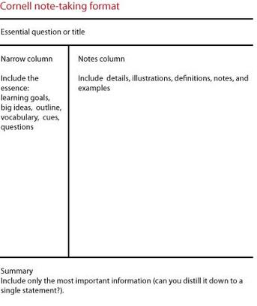
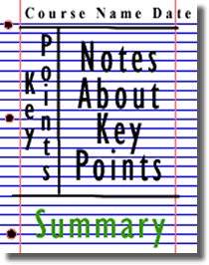
“Journey to Earth’s Center” Read and Take Cornell Notes in your journal

Slide 12
Learning Target
I can process a text by using Cornell Notes.

Slide 13
Thursday
Write today’s date on the top of the page.
Copy the Learning Target
Respond to this SCIENCE journal prompt:
If you were a raindrop, where would you fall? Describe your journey.
*When you finish, read silently.

Slide 14
Word of the Day! timidity
noun
to be shy or or hesitant; lacking confidence.
Timidity is a quality of many 6th graders until they learn the RSMS routine and realize that they can be successful students if they follow the rules and work hard.

Slide 15
Literacy Strand
Find 1-5 key/clue words in the prompt and circle or underline them.
Read the passage keeping that in mind.
Underline any details that support your answer.
Answer the prompt in a complete sentence.

Slide 16
“Journey to Earth’s Center”
Read the article again today.
While you read, complete the outline of details for the article.
When you finish, read silently or you may also prepare for tomorrow by starting your 3.8 pre-write.

Slide 17
Learning Target
I can summarize a text by completing an outline.

Slide 18
Friday
Clear you desk off except for these things:
Reading packet from this week.
Notes Outline from yesterday.
A piece of notebook paper.

Slide 19
Word of the Day QUIZ!
When you finish, turn it over and begin your outline for the 3.8.
Be sure to use the 3.8 summary format!!!!
Your first sentence should include the title of the article “Journey to Earth’s Center”
You should have an outline and a 3.8 paragraph.
When you finish, turn it in to THEHUB and read silently.

Slide 20
Learning Target
I can summarize a text by outlining and writing a 3.8 paragraph.

