Slide 1
January Week 2
Monday: Warm-ups due, WOTD QUIZ and 3.8
Tuesday: Reading Full Circle Notes
Wednesday: Cheat Sheet Practice with article packet
Thursday: Continue Cheat Sheet Practice
Friday: SCHOOL WIDE READING/WRITING SCRIMMAGE

Slide 2
Monday
Have your multiple intelligences worksheets
You need a piece of notebook paper
Grade your own Warm-ups!
Total = 32 points
One point for each item. Literacy strands are worth 2 points. (one for underlining and one for writing a sentence)

Slide 3
QUIZ and 3.8
I can analyze my intelligence by writing a 3.8 paragraph on the following topic...
Describe how Howard Gardner’s Theory of multiple intelligences applies to you as a learner.
In your paragraph, consider these questions:
Which do you think this is your strongest area and why?
How can you use this to help you in the classroom?
How will this understanding help you in the future?
When you finish, turn it in to THEHUB and read silently.

Slide 4
My Analysis of My Strengths
Complete the first page of the Multiple Intelligences Packet
When you finish, study your words of the day or read silently.

Slide 5
Tuesday
On the first page of your composition notebook:
Write today’s date on the top of the page.
Copy the Learning Target
Respond to this SCIENCE journal prompt:
Which of the five senses do you use the most? Describe how and when you use this sense.
*When you finish, work on your literacy strands or ready silently.

Slide 6
sagacious
adjective –
wise; a combination of intelligence and good judgment.
Especially in oriental cultures, older people are respected and revered because society considers them to be sagacious.

Slide 7
sanguine
adjective
cheerfully optimistic; flushed with a healthy, rosy complexion.
After a rigorous workout, people often have a sanguine complexion..

Slide 8
Literacy Strand January 2012 – Cold Facts !!
Monday - Lowest Temperatures - The lowest temperature ever recorded in the United States was -80 °F (-62 °C) on January 23, 1971 at Prospect Creek Camp, located near the Arctic Circle along the Alaska pipeline. This is not much warmer than the -81.4 °F record low for North America that Snag in the Yukon dropped to on February 3, 1947. On that record cold February day, Tanacross Alaska reached -75 °F.
The contiguous US hit its coldest recorded temperature of -70 °F on January 20, 1954 at Rogers Pass, Montana. The pass sits at 5,470 feet elevation in the Rocky Mountains, northwest of Helena.
In one sentence, state the coldest temperature ever recorded in the contiguous U.S. and when this temperature was recorded.
http://www.currentresults.com/Weather-Extremes/US/coldest.php

Slide 9
Literacy Strand – January 2012
Tuesday – Coldest States in the U.S. - Alaska, not surprisingly, outperforms all other US states when it comes to cold weather. After all, Alaska has the advantage of being many miles closer to the north pole than anywhere else in the United States.
In the lower 48 states though, which state is the coldest depends upon the time of year. North Dakota tops the list of coldest states in winter and fall, based on statewide average temperatures. During spring, Maine is coldest, while in summer it’s Wyoming. Some states are among the ten coldest states year round. Consistently cold throughout the year are Maine, Vermont, Montana and Wyoming.
In one sentence, state what state is the coldest in winter and fall.
http://www.currentresults.com/Weather-Extremes/US/coldest.php

Slide 10
Learning Target
I can understand how to use Reading Full Circle while I’m testing.

Slide 11
Reading Full Circle

Slide 12
Reading Full Circle
5.
1.
Read the questions
6.
2.
4.
Refer to the underlined and labeled sections of the text to identify answer.
Write down key/clue words from the question on your scrap paper (cheat sheet)—1-5 words
Underline info in passage that connects with the things written on the cheat sheet and label it with the question number.
3.
Keep cheat sheet visible and begin reading the passage. Read back over cheat sheet after each paragraph.

Slide 13
1. Read the questions
Go ahead, skip the entire passage, and read the questions first.
It will help you when you are reading the passage.

Slide 14
Reading Full Circle
5.
1.
Read the questions
6.
2.
4.
Refer to the underlined and labeled sections of the text to identify answer.
Write down key/clue words from the question on your scrap paper (cheat sheet)—1-5 words
Underline info in passage that connects with the things written on the cheat sheet and label it with the question number.
3.
Keep cheat sheet visible and begin reading the passage. Read back over cheat sheet after each paragraph.

Slide 15
2. Create your cheat sheet
Fold your scrap paper in half.
Write down key/clue words from the question on your scrap paper (cheat sheet)—1-5 words

Slide 16
Reading Full Circle
5.
1.
Read the questions
6.
2.
4.
Refer to the underlined and labeled sections of the text to identify answer.
Write down key/clue words from the question on your scrap paper (cheat sheet)—1-5 words
Underline info in passage that connects with the things written on the cheat sheet and label it with the question number.
3.
Keep cheat sheet visible and begin reading the passage. Read back over cheat sheet after each paragraph.

Slide 17
3. Use your cheat sheet
Keep cheat sheet visible and begin reading the passage.
Read back over cheat sheet after each paragraph.

Slide 18
Reading Full Circle
5.
1.
Read the questions
6.
2.
4.
Refer to the underlined and labeled sections of the text to identify answer.
Write down key/clue words from the question on your scrap paper (cheat sheet)—1-5 words
Underline info in passage that connects with the things written on the cheat sheet and label it with the question number.
3.
Keep cheat sheet visible and begin reading the passage. Read back over cheat sheet after each paragraph.

Slide 19
4. Mark up the passage
You are allowed to write on the passage, so do it.
Underline info in passage that connects with the things written on the cheat sheet and label it with the question number.
Remember to do this after you read each paragraph.

Slide 20
Reading Full Circle
5.
1.
Read the questions
6.
2.
4.
Refer to the underlined and labeled sections of the text to identify answer.
Write down key/clue words from the question on your scrap paper (cheat sheet)—1-5 words
Underline info in passage that connects with the things written on the cheat sheet and label it with the question number.
3.
Keep cheat sheet visible and begin reading the passage. Read back over cheat sheet after each paragraph.

Slide 21
5. Read the questions again
Now that you have more information to answer the questions successfully.
Multiple Choice Reminders
Read question carefully
Read ALL answer choices carefully
Eliminate wrong answers

Slide 22
6. Answer the questions
Refer to the underlined and labeled sections of the text to identify the best answer.

Slide 23
Examples

Slide 24
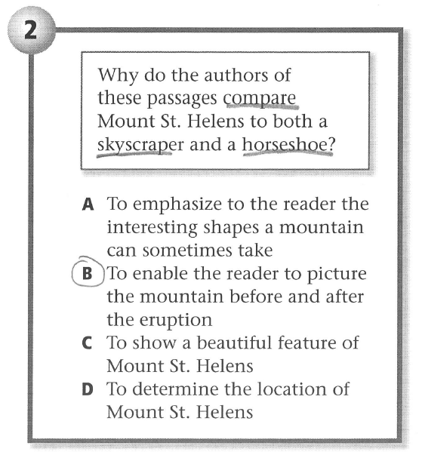
Examples

Slide 25
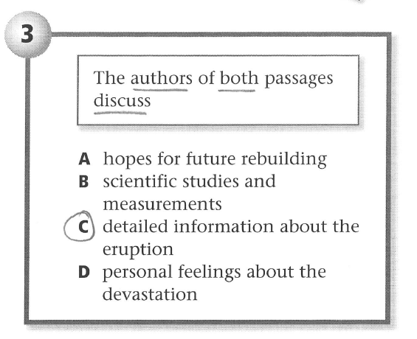
Examples

Slide 26
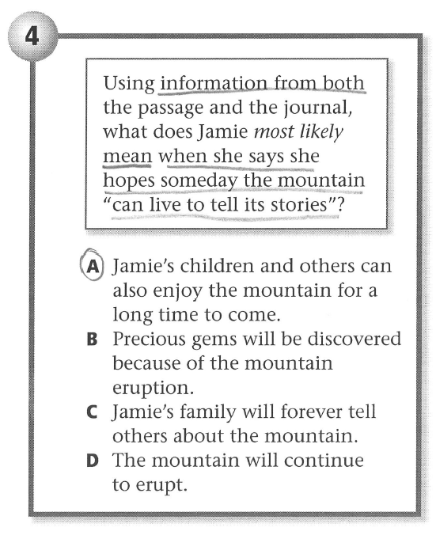
Examples

Slide 27
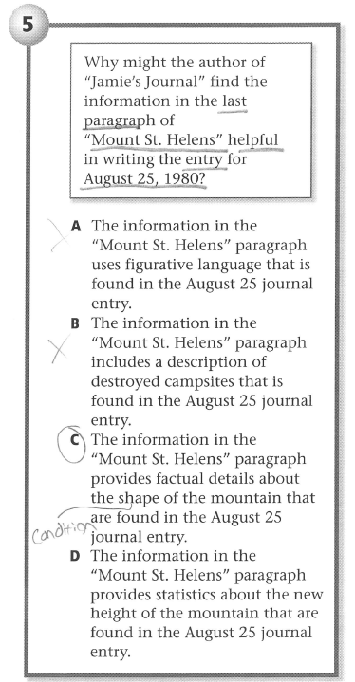
Examples

Slide 28
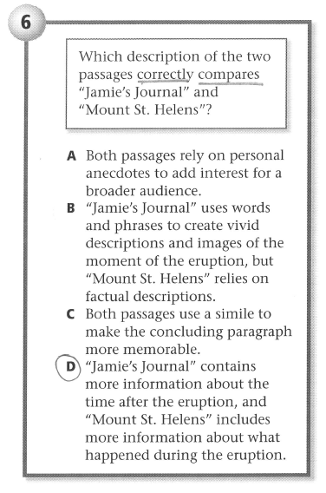
Examples

Slide 29
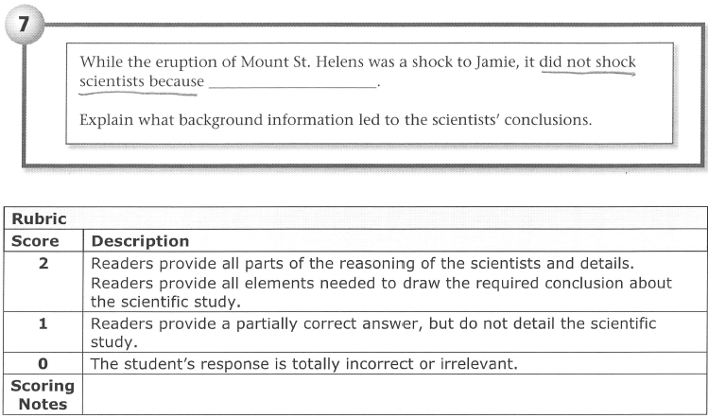

Slide 30
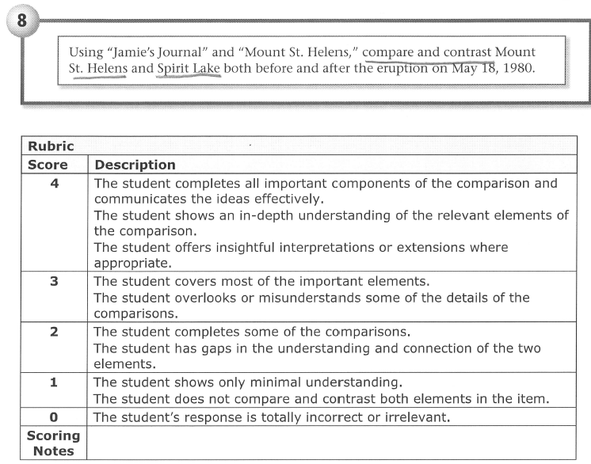

Slide 31
Example Cheat Sheet

Slide 32
REFER TO THE PASSAGE “JAMIE’S JOURNAL”

Slide 33
Practice
Read the questions that are with the articles this week.
In your notebook, write your own numbered cheat sheet.
When you finish, begin reading and answering the questions.

Slide 34
Wednesday
In your composition notebook:
Write Today’s Date
Copy the Learning Target
Respond to this Journal Prompt:
If you were an animal, which would you be and why? (Write at least 5 sentences)
*When you finish, work on your literacy strands or ready silently.

Slide 35
cower
verb
to cringe or move backward defensively in fear.
During scary movies, some young children cower in their seats and cover their eyes with their hands.

Slide 36
Literacy Strand - 2012
Wednesday – Coldest Continent - Antarctica is the world's coldest continent, and the coldest region of that frigid landscape is the Polar Plateau. The plateau stretches across the center of the world's largest ice sheet.
Ice on the Polar Plateau is often three kilometers (1.8 miles) or more thick, making the plateau rise well over 3,000 meters or 10,000 feet in elevation. The high elevation contributes to the plateau's extremely cold year-round weather.
In one sentence, state what the coldest continent is, and explain what contributes to its cold weather.
www.currentresults.com/Weather-Extremes

Slide 37
Learning Target
I can use the Reading Full Circle Strategy.

Slide 38
Thursday
In your composition notebook:
Write Today’s Date
Copy the Learning Target
Respond to this Journal Prompt:
If you had to help write a new science book for your class, what topics would you include in it? Why?
(Write at least 5 sentences.)
*When you finish, work on your literacy strands or ready silently.

Slide 39
tabulate
verb
to arrange information systematically in a table, or in columns and rows.
Microsoft Office has a program that allows teachers to tabulate test results on a spreadsheet.

Slide 40
Literacy Strand – January 2012
Thursday – Coldest Place on Earth – The East Antarctic ice sheet rises several hundred meters above the research stations. Scientists figured they needed to climb higher up the plateau to find the coldest place on earth.
It wasn't until 2005 that scientists reached Dome Argus, better known as Dome A — the highest point on the East Antarctic ice sheet — and started recording temperatures.
The Dome A summit is located at a latitude of 80 degrees South and rises to 4,092 meterss (13,425 feet) above sea level. Measurements made in 2005 revealed that Dome A has an annual mean temperature of -58.3 °C (-72.9 °F), confirming it indeed is the coldest place on earth. Researchers have designated Dome A as the earth's "pole of cold".
In one sentence, state where the coldest place on earth is, and infer why it is the coldest place on earth.
www.currentresults.com/Weather-Extremes

Slide 41
Learning Target
I can process a text by answering questions and annotating.

Slide 42
Friday
Today we will be having a school-wide testing practice for K-PREP Reading and ON-Demand Writing.

