Slide 1
December Week 2: 12/8-12/12 Math READING
Monday: Translations & Reflections on the Coordinate Plane
Tuesday: In-class Study Guide
Wednesday: Open note test over Coordinate Planes
Thursday: Literacy Strands/ WOTD hangman
Friday: WOTD QUIZ/ WOTD Review assignment

Slide 2
Monday: 12/8
TURN IN TEST CORRECTIONS.
You need:
AGENDA
Notebook paper to take notes today
Write the Learning Target and Bellringer
BELLRINGER Question: Vertices is another word to describe an ordered pair. What is an ordered pair?
When you finish, READ SILENTLY.

Slide 3
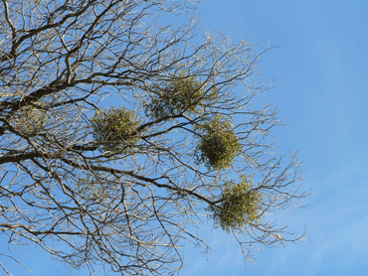
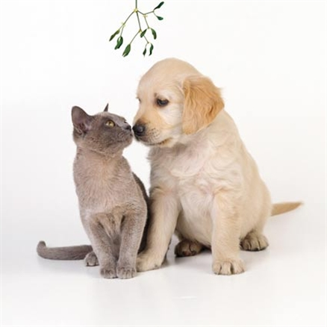
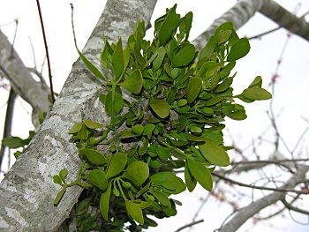
Word of the Day: mistletoe
– noun – an evergreen bush that grows as a parasite on trees such as apple and oak that has leaves in horseshoe-shaped pairs and produces white, poisonous berries in winter

Slide 4
Write a poem or funny letter addressed to mistletoe

Slide 5
Transformations in the Coordinate Plane
Take notes on a separate piece of paper.

Slide 6
I Can...
Translate figures in a coordinate plane
Reflect figures in a coordinate plane
Rotate figures in a coordinate plane

Slide 7
Bellringer
What is a vertex of a figure?

Slide 8
Vertices

Slide 10
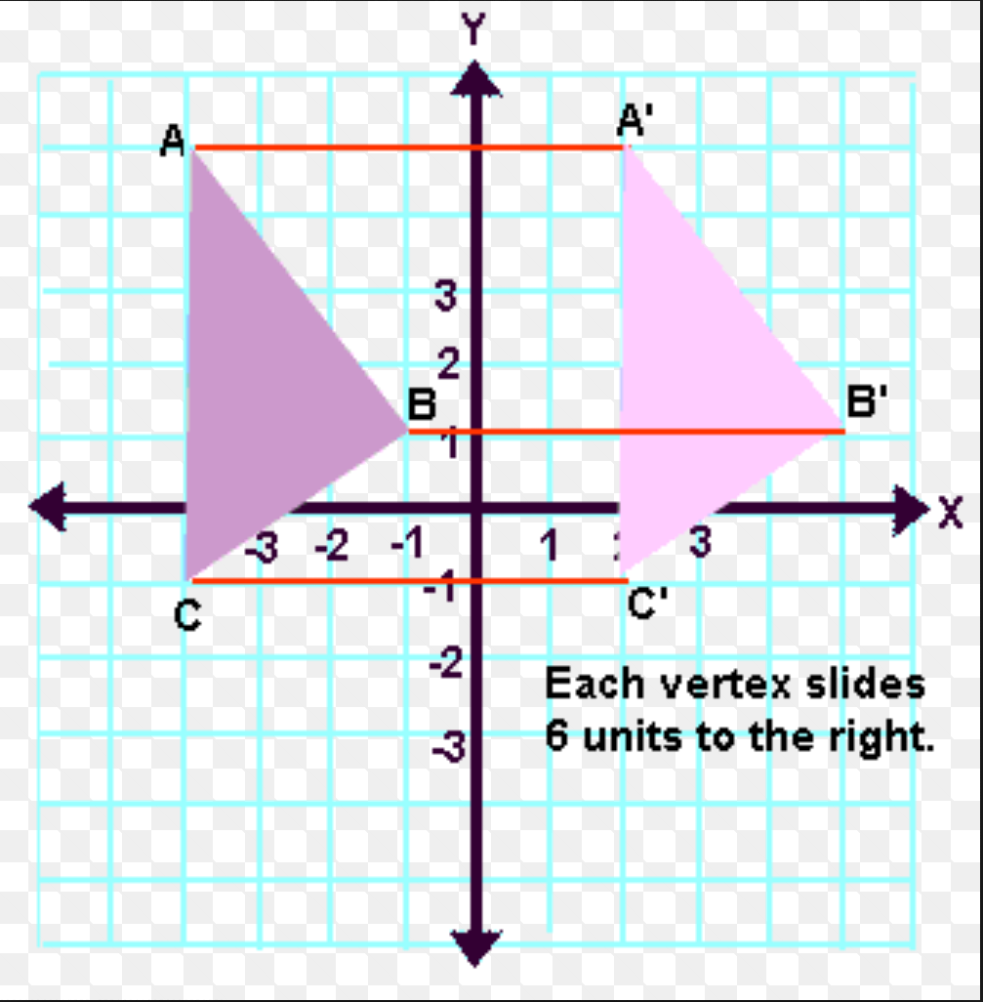
Translating Figures
When you move/slide figures

Slide 11
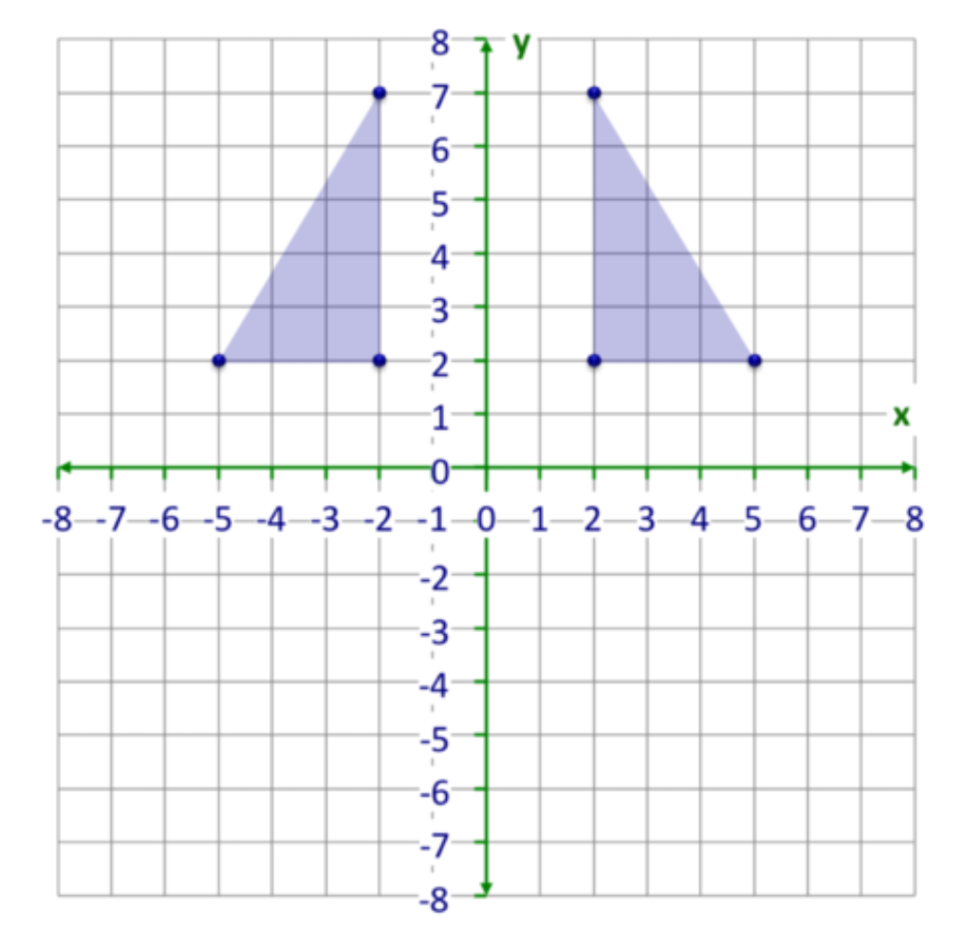
Reflecting Figures
When you reflect/flip figures across the x or y axis

Slide 12
Line of Reflection

Slide 13
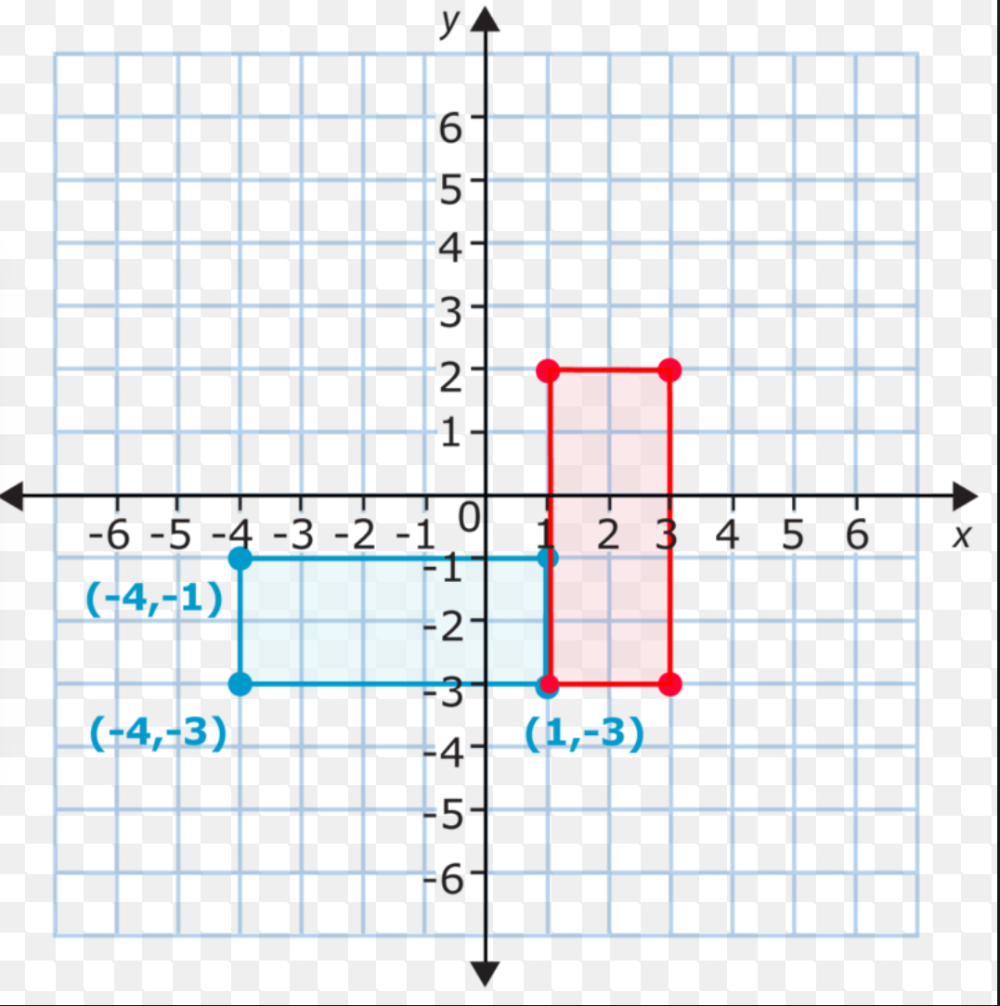
Rotating Figures
When you rotate a figure

Slide 14
Homework
Complete the worksheet on translating.
This is due tomorrow if you don’t finish.

Slide 15
7th hour
Class today is a LEVEL ZERO, unless you are conferencing with Mrs. Schneider or Ms. Wells.
Complete any and all missing work. When you are finished, move on to step 2.
Read silently, write a Christmas Story, or work on work for other classes.

Slide 16
Tuesday: 12/9
On your desk:
- AGENDA
Notes from yesterday
YOUR HOMEWORK
BELLRINGER Question: What is your favorite tradition this time of year?
When you finish, READ SILENTLY.

Slide 17
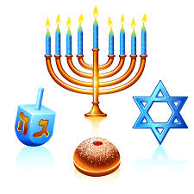
Copy down the Word of the Day: Hanukkah
– noun – a Jewish festival celebrated in December that marks the rededication of the Jewish Temple in Jerusalem in 165 BC.
http://www.history.com/topics/holidays/hanukkah

Slide 18
Grade your own!
Circle any that you got wrong to come back to later and fix.

Slide 19
Create a TEST QUESTION
Look back on your work on Coordinate Planes.
As a group, come up with a test question. Write out the directions. Use a sheet of graph paper if you need to. Be sure to be clear and accurate.
The best test question will be used tomorrow on the actual test.

Slide 20
Study Guide
Your group has five minutes to complete each table’s review question.
The best group will get extra credit on the test tomorrow

Slide 21
Wednesday: 12/10
You need to:
- Complete your agenda
Take out any notes from this week and a pencil
CLEAR YOUR DESK of your binder.
Put your head down and take a nap

Slide 22
Open-Note Test: DO NOT WRITE ON THE TEST!
There will be 3 bonus questions throughout the test. You won’t know which they are. So, the total will be out of 20 in the end.
The questions that have F, G, H, or J as options, please refer to below...
A = F
B = G
C = H
D = J
When you finish, turn it in to Mrs. Schneider.
Read silently or work on EXTRA CREDIT (due Monday)

Slide 23
Thursday: 12/11
You need:
- AGENDA
Notebook paper
BELLRINGER Question: What’s the point of a Christmas tree?
When you finish, READ SILENTLY.

Slide 24
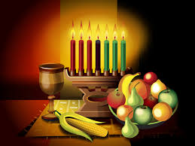
Word of the Day: Kwanzaa
– noun – A seven day cultural and harvest festival celebrated by African Americans from December 26 – January 1st that gives honor and remembrance to the seven great principles of African philosophy and values.
http://www.history.com/topics/holidays/kwanzaa-history

Slide 25
Word of the Day: Messiah
– noun – In the widest religious and literary sense, any redeemer, liberator, or savior; to Christians – Messiah is the name for Jesus Christ, whose coming was prophesied in the Hebrew Bible, and is regarded by Christian as the Savior who was born on Christmas and who has come to redeem and purify the world from sin and suffering.
https://www.youtube.com/watch?v=X4hkwhOiD98

Slide 26
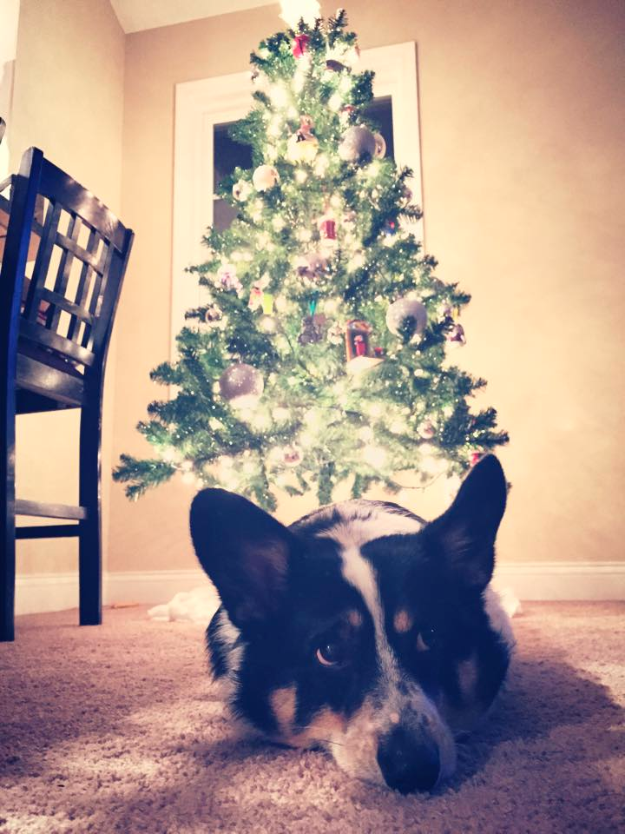
Literacy Strands
Read about the Christmas tree.
Complete each literacy strand to the BEST of your ability.
When you finish, read silently.
http://www.history.com/topics/christmas/history-of-christmas-trees
https://www.youtube.com/watch?v=JQeKdvXliIU

Slide 27
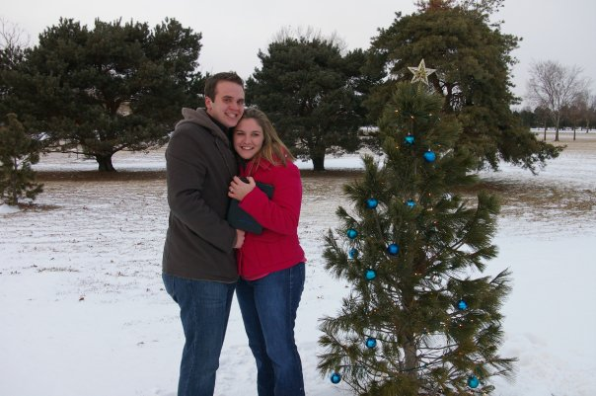

Slide 28
Word of the Day CHERADES! Or HANGMAN!

Slide 29
Friday: 12/12
Clear your desk:
Quiz your neighbor on the words of the day from this week.

Slide 30
Word of the Day QUIZ 3.8
When you finish the quiz, turn it in to THEHUB
Take a separate piece of paper.
Write a 3.8 paragraph about the following:
Describe one holiday tradition your family has. Why is it so important/special to you?
We will share these next week, so do your best!
Turn it into THEHUB when you finish and READ! ☺

