Slide 1
December Week 1: 12/1-12/5 Math READING
Monday: Definitions of terms on pages 295, 404-405
Guided Practice on pages 296, #1-10
Tuesday: pg. 406 #2-26 (Evens) , grading yesterday’s pg. 296
Wednesday: Grading Practice Questions, pg. 407 #49-54
Pg. 408-409, pg. 410 #1-5
Thursday: Grade Yesterday’s practice, pg. 410 #6-12, Go over Warm-ups
Friday: WOTD QUIZ, Coordinate Quiz

Slide 2
Monday: 12/1
HAVE YOUR RED MATH TEXTBOOK WITH YOU.
(If you do not own a red math textbook, please ask for a copied packet.)
Agenda
Warm-ups
You need notebook paper today as well.
BELLRINGER Question: Describe which direction Horizontal and Vertical lines go in.
When you finish, READ SILENTLY.

Slide 3
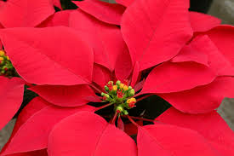
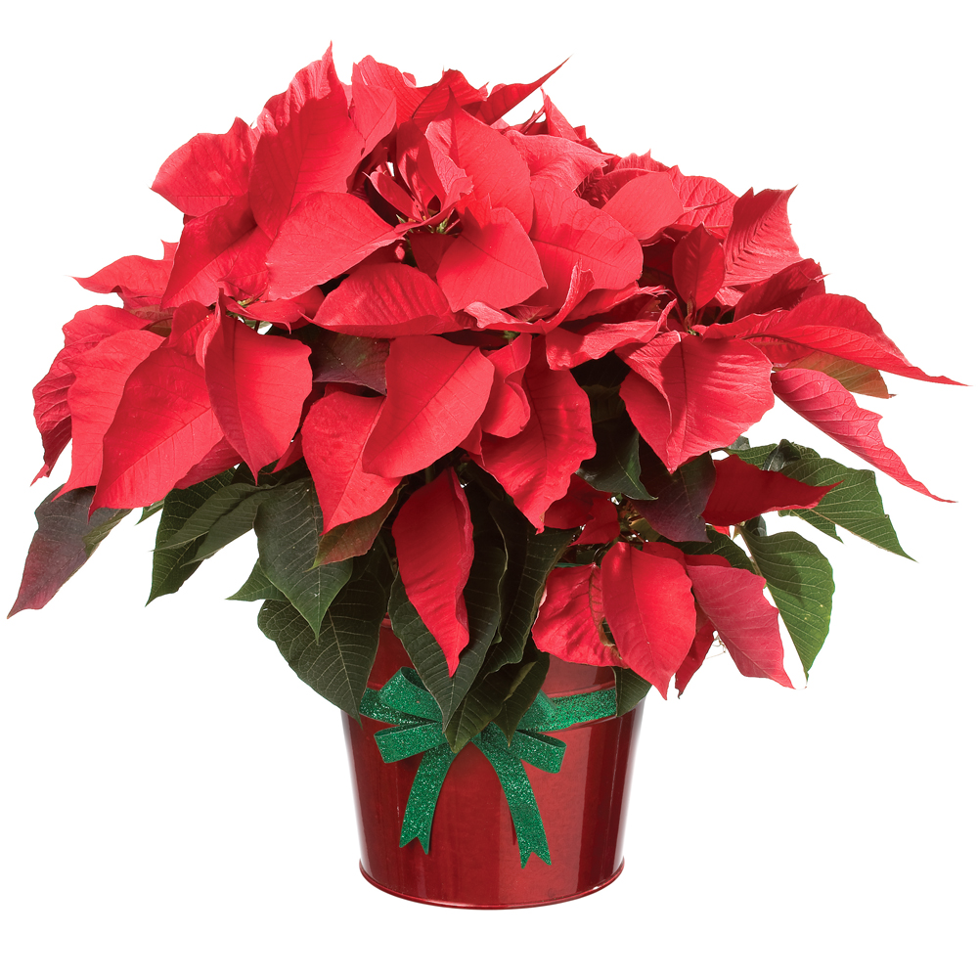
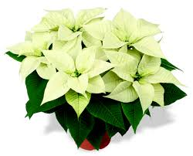
Word of the Day: Poinsettia
A bush native to Mexico and Central America that often has bright red bracts resembling petals; a red flowering plant associated with the Christmas season.

Slide 4
RED MATH TEXTBOOK
Read pages 295, and 404-405

Slide 5
RED MATH TEXTBOOK – pgs. 295,404-405 Define and give an example/picture for each word below on your notebook paper:
Coordinate Grid
Ordered Pair
Coordinate Plane
axes
X-axis
Y-axis
Quadrants
Origin
Coordinates
X- Coordinate
Y-Coordinate
When you finish, work on questions #1-10 on page 296

Slide 6
PRACTICE on your paper questions #1-10 on page 296
Answer all of the questions on your notebook paper
This is homework if you don’t finish.
When you finish, work on warm-ups or read silently.

Slide 7
Monday – Learning Target
I can understand terms about coordinate planes by finding definitions.

Slide 8
Tuesday: 12/2
You need:
- AGENDA
Warm-Ups
BELLRINGER Question: Draw a coordinate grid and graph a point for the ordered pair (2,1) on it.
When you finish, READ SILENTLY.

Slide 9
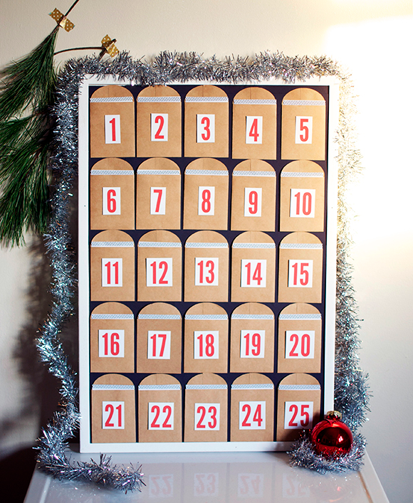
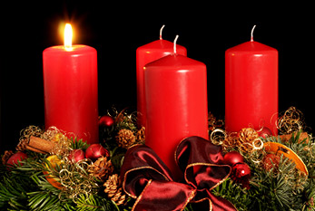
Word of the Day: Advent
The four weeks leading up to Christmas; a time of spiritual preparation for the coming of the Savior; in Christian theology, advent literally means the coming of Jesus Christ.

Slide 10
Grade Your Own
Check your homework from yesterday as we go over it.
Circle any you got wrong

Slide 11
Class Work Time
Complete questions #2-26 on page 406
(Complete ONLY the Even Numbers)
If you finish, read silently.
This is HOMEWORK if you don’t finish.

Slide 12
Tuesday – Learning Target
I can practice coordinate planes by answering questions.

Slide 13
Wednesday: 12/3
You need:
- AGENDA
Warm-Ups
Have your homework out from yesterday
BELLRINGER Question: What are the coordinate numbers on the origin?
When you finish, READ SILENTLY.

Slide 14
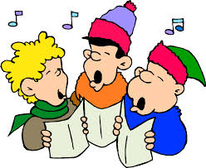
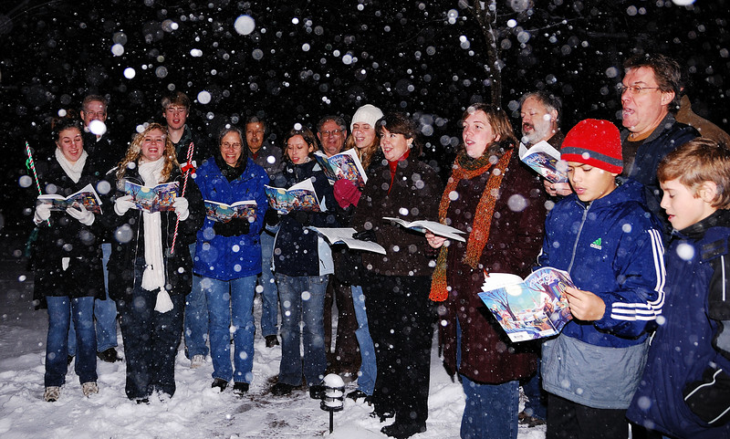
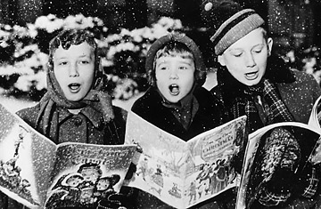
Word of the Day: Carol
a traditional religious folk song or hymn; a religious song sung most often at Christmas time.
https://www.youtube.com/watch?v=Vnt7euRF5Pg

Slide 15
Class Practice Work (Homework if you don’t finish)
Pg. 407 #49-54
Pg. 408-409 (READ)
Pg. 410 #1-5

Slide 16
Wednesday – Learning Target
I can read about how to plot a polygon on a coordinate plane.

Slide 17
Thursday: 12/4
You need:
- AGENDA
Warm-Ups
Work from yesterday
BELLRINGER Question: What is the most complicated thing about coordinate planes so far this week?
When you finish, READ SILENTLY.

Slide 18
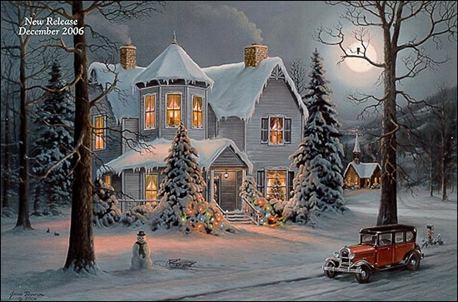
Word of the Day: Yuletide
The Christmas Season; Christmas Time
“Chestnuts roasting by an open fire,
Jack Frost nipping on your nose,
Yuletide carols being sung by a choir,
and folks dressed up like Eskimos”
“The Christmas Song,” written by Mel Tormé.
Pentatonix
https://www.youtube.com/watch?v=XWES7VADHEk
Nat King Cole and Frank Sinatra
https://www.youtube.com/watch?v=1Km2M-nOiM8
Christina Aguilera
https://www.youtube.com/watch?v=Gy9ttAwDonc

Slide 19
It’s a Wonderful Life!
https://www.youtube.com/watch?v=lbwjS9iJ2Sw

Slide 20
Class Practice Work (Homework if you don’t finish)
pg. 410 #6-12
When you finish, be sure your Warm-Ups are ready to turn in tomorrow
Read silently or study words of the day

Slide 21
Thursday – Learning Target
I can practice plotting coordinates.

Slide 22
Friday: 12/5
Turn in your Warm-Ups to your class drawer
Clear your Desk Except a pencil
Put your head down and take a nap.

Slide 23
TEST CORRECTIONS
When you finish your quiz, turn it in to THEHUB
Make corrections for EVERY problem you missed on your test on a separate piece of paper
Write the question number.
Rewrite or describe your original answer.
Write the correct answer. (show your work)
Give a reason why that is the correct answer.
When you finish, read silently.

Slide 24
Friday – Learning Target
I can make corrections on my test to learn from my mistakes.

