Slide 1
April Week 3 4/20-4/24
Mon: Read the play “Forever Free”
Tues: “Abe Lincoln Master Politician”, Review Last Week’s QUIZ
Wed: Civil War Poetry
Thurs: Poem in your Pocket Day!
Fri: WOTD QUIZ and 3.8

Slide 2
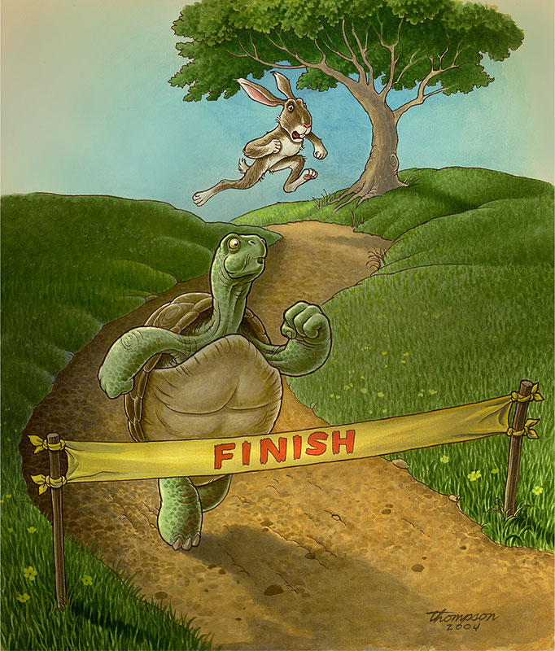
Word of the Day!
Monday
fable – noun – a short story with a moral, especially one in which the characters are animals.

Slide 3
Literacy Strands
Complete Today’s Literacy Strand
Don’t forget to RESTATE the prompt and use proper capitalization and punctuation.
Work with your group to read out loud and check your answers.

Slide 4
PRESIDENT of the DAY!
#13 – Millard Fillmore
#14 – Franklin Pierce

Slide 5
“Forever Free”
Be paying attention to historical events and happenings while we read.

Slide 6
Complete your notes chart for each day as best as you can
This will be graded weekly.
Write down words or concepts you do not understand, so we can look them up together.
http://www.cnn.com/studentnews

Slide 7
Learning Target
I can learn about historical events from a play.

Slide 8
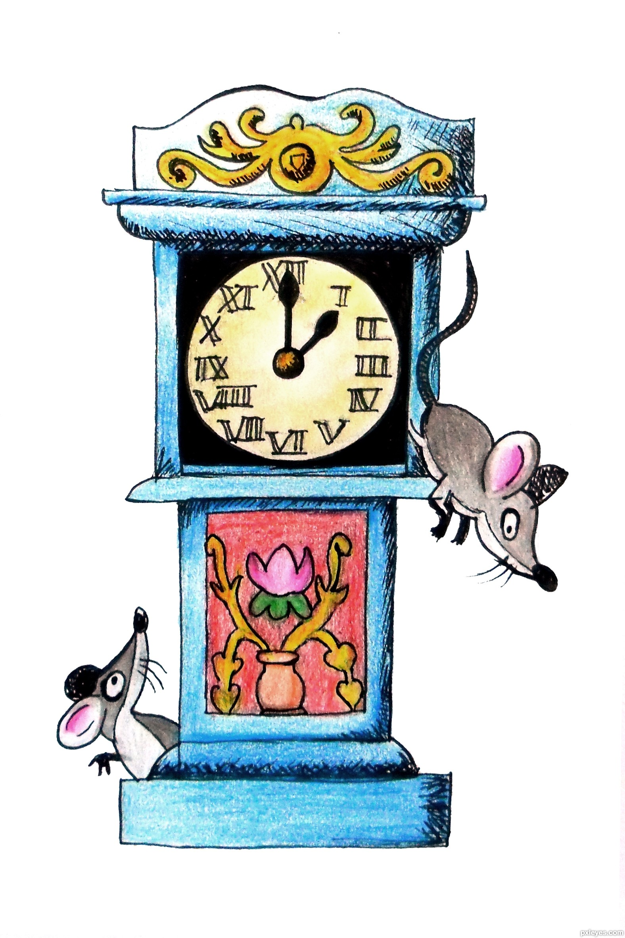
Word of the Day!
Tuesday
limerick – a five-line humorous poem with a predictable pattern of meter and rhyme.
Hickory dickory dock,
the mouse ran up the clock;
the clock struck one
and down he run;
hickory dickory dock.
—Mother Goose

Slide 9
Literacy Strands
Complete Today’s Literacy Strand
Don’t forget to RESTATE the prompt and use proper capitalization and punctuation.
Work with your group to read out loud and check your answers.

Slide 10
PRESIDENT of the DAY!
#15 – James Buchanan
#16 – Abraham Lincoln

Slide 11
Complete your notes chart for each day as best as you can
This will be graded weekly.
Write down words or concepts you do not understand, so we can look them up together.
http://www.cnn.com/studentnews

Slide 12
QUIZ REVIEW
Use the ICE and ABC Strategy to rewrite one Short Answer from your QUIZ last week.
Be sure to make improvements on your vocabulary, grammar, spelling, and complete sentences.
After you rewrite the short answer, write one sentence below about how you improved your answer.

Slide 13
“Abe Lincoln Master Politician”
Read the interview and take notes of any new information you learn about Lincoln

Slide 14
Learning Target
I can use the ICE strategy to improve my short answers.

Slide 15
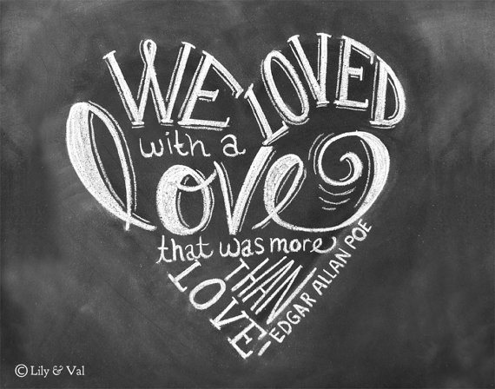
Word of the Day!
Wednesday
ballad – noun – a song or poem that tells a story with a pattern of regular rhyme and meter, and that often has a refrain.
Edgar Allan Poe’s ballad is called
“Annabelle Lee”
https://www.youtube.com/watch?v=rf7aBCrfOQE

Slide 16
Literacy Strands
Complete Today’s Literacy Strand
Don’t forget to RESTATE the prompt and use proper capitalization and punctuation.
Work with your group to read out loud and check your answers.

Slide 17
PRESIDENT of the DAY!
#17 – Andrew Johnson
#18 – Ulysses S. Grant

Slide 18
Complete your notes chart for each day as best as you can
This will be graded weekly.
Write down words or concepts you do not understand, so we can look them up together.
http://www.cnn.com/studentnews

Slide 19
Civil War Poetry
Read the article and take notes on interesting quotes or facts.

Slide 20
Learning Target
I can understand how poetry was a part of the history of the Civil War.

Slide 21
Word of the Day!
Thursday
haiku – noun – a traditional Japanese form of “nature” poetry written with...
3 lines = 17 syllables:
1st – 5 syllables
2nd – 7 syllables
3rd – 5 syllables
He opens the door
And slips behind Lincoln’s seat
Primed pistol in hand.
http://news.utexas.edu/2014/03/25/history-haiku-twitter-hw-brands

Slide 22
Literacy Strands
Complete Today’s Literacy Strand
Don’t forget to RESTATE the prompt and use proper capitalization and punctuation.
Work with your group to read out loud and check your answers.

Slide 23
PRESIDENT of the DAY!
#19 – Rutherford B. Hayes
#20 – James Garfield

Slide 24
Complete your notes chart for each day as best as you can
This will be graded weekly.
Write down words or concepts you do not understand, so we can look them up together.
http://www.cnn.com/studentnews

Slide 25
Poem in your Pocket DAY!
Draw a pocket on a separate piece of paper.
Jot down at least 5 different lines from various poems that you like.
Don’t forget the title and author!

Slide 26
Learning Target
I can read and interpret poetry.

Slide 27
Friday
Clear your desk!

Slide 28
Learning Target
I can test my knowledge by taking a quiz.

Slide 29
Complete your notes chart for each day as best as you can
This will be graded weekly.
Write down words or concepts you do not understand, so we can look them up together.
http://www.cnn.com/studentnews

