Slide 1
April Week 2 4/13-4/17
Mon: Finding the Purpose for Reading Worksheet Pages
Tues: Grade Quizzes from last week and discuss Reading Full Circle, Set Purpose for “Moving Ahead”
Wed: Read “Moving Ahead” and answer questions #1-10
Thurs: Literacy Strands, WOTD QUIZ
Fri: School Wide On-Demand Practice

Slide 2
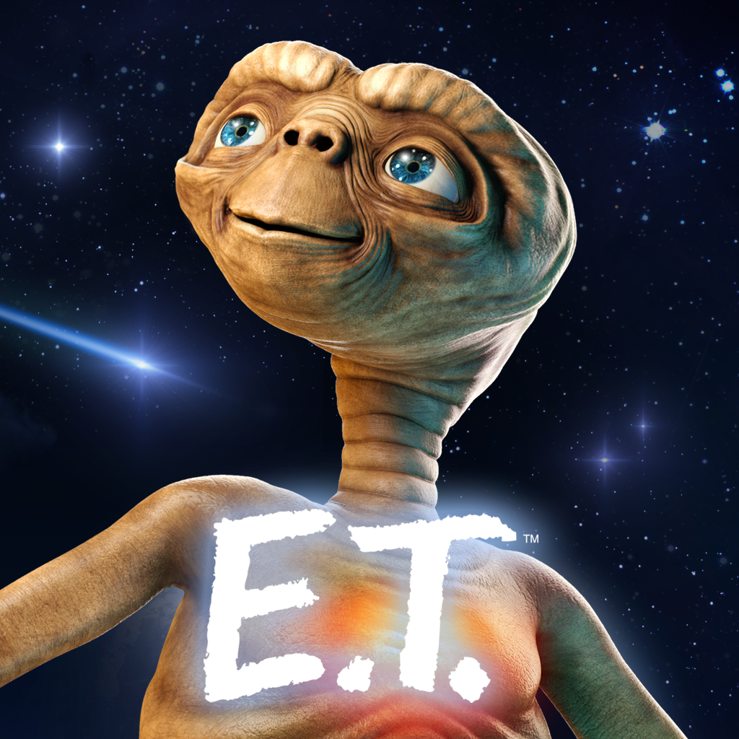
Word of the Day!
Monday
extra-terrestrial – noun or adjective – life that is not common to the earth; alien to life on earth
Director Steven Spielberg created one of the most famous extra-terrestrial creatures in all “moviedom” – “ET”.

Slide 3
PRESIDENT of the DAY!
#5 James Monroe
#6 John Quincy Adams

Slide 4
Set a Purpose for Reading
Read through each page in your CNN STUDENT NEWS Notes packet from last week.
Follow the directions to complete each page.
Stop when you get to the last page.

Slide 5
Complete your notes chart for each day as best as you can
This will be graded weekly.
Write down words or concepts you do not understand, so we can look them up together.
http://www.cnn.com/studentnews

Slide 6
Learning Target
I can set a purpose for reading.

Slide 7
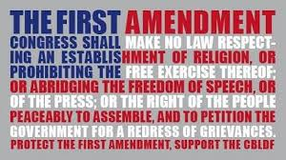
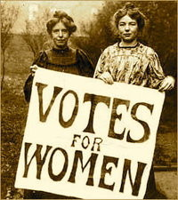
Word of the Day!
Tuesday
amendment – noun – a change or alteration; an addition or alteration to a motion, bill, or constitution.
The 19th Amendment to the constitution was ratified in 1920, finally giving women the right to vote, and ending the suffragist movement.

Slide 8
PRESIDENT of the DAY!
#7 Andrew Jackson
#8 Martin Van Buren

Slide 9
GRADING
CLEAR YOUR DESK except for a different color.
10pts – cheat sheet
5pts – underlining
5pts – writing the number next to your underlining
1pt (total 12)– for each correct answer
5pts (total 20) – correct WOTD answer
TOTAL: _____ / 52

Slide 10
Complete your notes chart for each day as best as you can
This will be graded weekly.
Write down words or concepts you do not understand, so we can look them up together.
http://www.cnn.com/studentnews

Slide 11
Learning Target
I can improve from mistakes I’ve made by grading my own work.

Slide 12
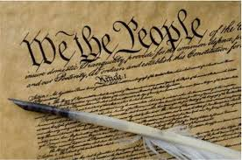
Word of the Day!
Wednesday
1. Preamble – noun – the introduction, preface, prelude, or forward to a piece of writing.
The Preamble of the United State’s Constitution was written by “The Father of the Constitution” James Madison.
2. theme – noun – the life-lesson, or universal meaning of a piece of writing.
A theme of the novel, Where the Red Fern Grows is that love and good memories can help heal the grief associated with death.

Slide 13
PRESIDENT of the DAY!
#9 William Henry Harrison
#10 John Tyler

Slide 14
“Moving Ahead”
Complete the bubbles on the last page of your Reading Packet to Preview and Set a Purpose.
Read the Article
Answer questions #1-10 on a separate piece of paper.
Be sure your name is on the paper before you turn it in to THEHUB.
* You will have time to finish this after your quiz tomorrow if you don’t finish.

Slide 15
Complete your notes chart for each day as best as you can
This will be graded weekly.
Write down words or concepts you do not understand, so we can look them up together.
http://www.cnn.com/studentnews

Slide 16
Learning Target
I can process a text by answering questions while I read.

Slide 17
Thursday
Clear your desk for a QUIZ.

Slide 18
PRESIDENT of the DAY!
#11 James Polk
#12 Zachary Taylor

Slide 19
Literacy Strands
Complete Today’s Literacy Strand
Don’t forget to RESTATE the prompt and use proper capitalization and punctuation.
Work with your group to read out loud and check your answers.

Slide 20
Complete your notes chart for each day as best as you can
This will be graded weekly.
Write down words or concepts you do not understand, so we can look them up together.
http://www.cnn.com/studentnews

Slide 21
Learning Target
I can support my answer by underlining details in my literacy strands.

