Slide 1
AIMS WEEK
Week 32
4/14-4/17

Slide 2
MONDAY: NO TLC TODAY Odd Day (1,3,5)
Schedule:
1st 12:35 – 1:20
2nd 1:20 – 2:05
3rd 2:05 – 2:50

Slide 3
TUESDAY: TLC is open today Odd Day (1,3,5)
Schedule:
4th 12:35 – 1:10
5th 1:10 – 1:45
7th 1:45 – 2:20
8th 2:20 – 2:55

Slide 4
(notes in your I.N.) Types of Persuasion

Slide 5
Bandwagon
Convincing people to get on board with something “everyone” is doing
Example:
“Ask your parents for Super Toy so you won’t be the only one of your friends without one.”
“Everyone drinks Super Cola!”

Slide 6
Bandwagon
http://www.youtube.com/watch?v=jvCTaccEk
http://www.youtube.com/watch?v=acMaC08pxGo

Slide 7
Testimonial
Uses the backing of a celebrity or expert.
“I’m Sally Celebrity, and I drink Super Cola before every concert.”
“Super Toothpaste will whiten your teeth quicker than the other brands. I know because I’m a dentist.”

Slide 8
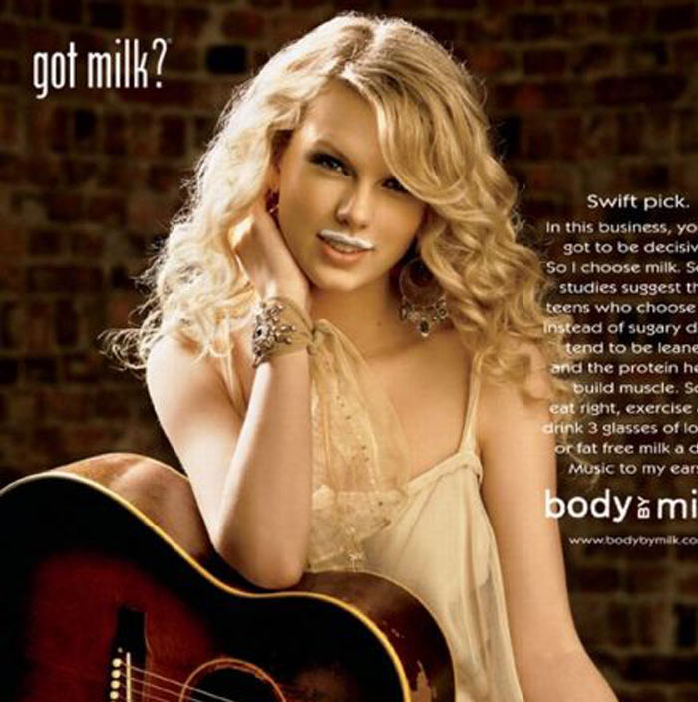
Testimonial

Slide 9
Either/or
Convinces you that you fall into one of two categories, with no in-between.
“Cool people drink Super Cola. Only losers drink anything else.”
“You are either for the new bill raising awareness of hunger, or you think all people should starve.”

Slide 10
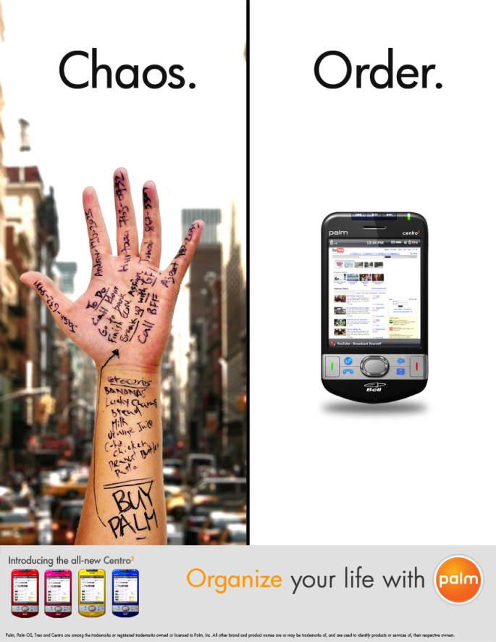
Either/or
http://www.youtube.com/watch?v=dKhv9kZM8gM
http://www.youtube.com/watch?v=Xy_PxLw1B_c

Slide 11
Appeal to Fear
Makes you fear for your health or safety.
“Buy a Super Alarm, or your whole family might be at risk of harm.”
“Buy Super Flu-Prevent, or you might end up in the hospital with the flu.”

Slide 12
Appeal to Fear
http://www.youtube.com/watch?v=VRgNS1P6k6o

Slide 13
Glittering Generalities
use of words that make something sound good without actually saying anything specific/ important.
“Super Cola is the best cola drink there is!”
“Super Shoes are amazing!”

Slide 14
Glittering Generalities
http://www.teachertube.com/viewVideo.php?video_id=137790
http://www.youtube.com/watch?v=nvKyYeJJYwM

Slide 15
Transfer
Associating love, respect, or admiration for someone and transferring it to a product.
If you buy the product, you get the feelings or benefits associated with it.
Example:
A car ad shows a pretty girl in the passenger seat. If you buy the car, you think you get a pretty girl.

Slide 16
Transfer
http://www.youtube.com/watch?v=DCjeSNomXrU
http://www.youtube.com/watch?v=Kaz4vpOr1Dw

Slide 17
Questions
For each example, hold up one, two, three, four or five fingers to show which type of persuasion best fits that example.

Slide 18
“Everyone in Peoria shops at Super Peoria Mart!”
1. Bandwagon
2. Testimonial
3. Either/or
4. Appeal to fear
5. Glittering Generalities

Slide 19
“Super Store is terrific!”
1. Bandwagon
2. Testimonial
3. Either/or
4. Appeal to fear
5. Glittering Generalities

Slide 20
“Hi, I’m Barry Basketball, and I think Super Shoes are a slam dunk!”
1. Bandwagon
2. Testimonial
3. Either/or
4. Appeal to fear
5. Glittering Generalities

Slide 21
“Without Super Lock, it is easy for someone to break into your house.”
1. Bandwagon
2. Testimonial
3. Either/or
4. Appeal to fear
5. Glittering Generalities

Slide 22
Which type is this?
“The next best thing is already here.”
http://www.youtube.com/watch?v=FRkmtbWURwo

Slide 23
Work Cited
http://sps.k12.mo.us

Slide 24
Commercials
Once your table is assigned a type of persuasion, decide on a product you will be selling.
You must use that type of persuasion to create a short 30 second commercial to sell the product.
On one separate piece of paper, write all of your names, the type of persuasion, the product you are selling, and write out an outline or script of your commercial to use when you present. We will present at the end of class.

Slide 25
WEDNESDAY: NO TLC TODAY Even Day (2,4,6)
Schedule:
1st 12:35 – 1:20
2nd 1:20 – 2:05
3rd 2:05 – 2:50

Slide 26
THURSDAY: TLC is open today Even Day (2,4,6)
Schedule:
4th 12:35 – 1:10
5th 1:10 – 1:45
7th 1:45 – 2:20
8th 2:20 – 2:55

Slide 27
Answer in your I.N.
What are the 6 types of persuasion we learned about? List them all and write an example of each next to them.
Think of a commercial that is on TV right now. What type of persuasion is used in it? Describe the commercial and how you know the persuasion technique.
*Read silently until everyone is finished

Slide 28
Green Textbook
Read and complete pages 234-239 by taking notes on important terms and answering any and all margin directions and questions.
Complete this on a separate piece of paper.
Turn it into THEHUB when you are finished
Read silently

Slide 29
The Sword in the Stone

