Slide 1
8 Week Feb 1 ANNE FRANK
Mon: Notes, finish timeline
Tues: ILPs in the computer lab
Wed: ILPs
Thurs: Read Act 1-2, complete worksheet
Fri: Quiz over Act 1

Slide 2
Monday
Fill out your AGENDA!
Bell Ringer Combine these sentences into one without changing the meaning:
Some people cheered for the Falcons.
Some people cheered for the Patriots.
Everyone was shocked at the first overtime ever in Super Bowl history.

Slide 3
Learning Target
I can understand the historical context of a novel.
RI 8.3

Slide 4
The Holocaust
The Diary of Anne Frank

Slide 5
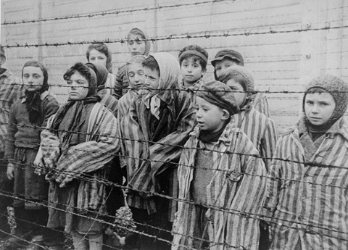
The Holocaust
Period from 1939, when Adolf Hitler became leader of Germany, to 1945 when WWII ended.
Jews were persecuted, which led to 6 million deaths. (1.5 million child deaths).

Slide 6
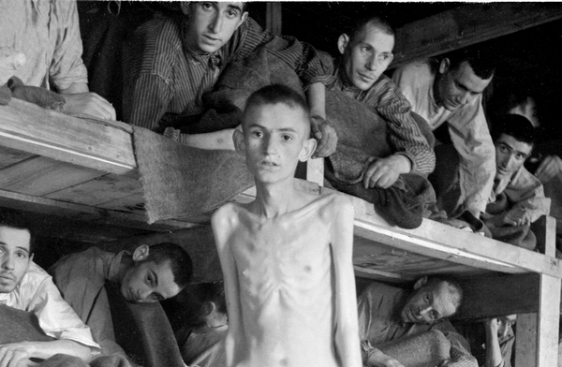
Final Solution
Hitler’s plan to annihilate the entire Jewish population.
Genocide is the total destruction of an ethnic, racial, or religious group.

Slide 7
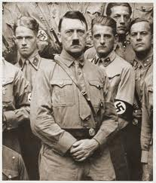
Nazi
Nazi stands for National Socialist German Workers Party.
Hitler was the leader of the Nazis and blamed the Jews for the problems in Germany.
There are many theories for why Hitler hated the Jews.
For example, he thought having a common hatred or common enemy would unite the German people.
During the depression in Germany, Hitler and others were jealous of the prominent jobs that Jewish people held.

Slide 8
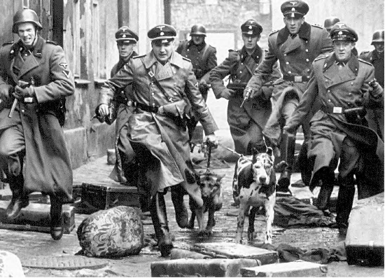
Gestapo
The Gestapo were Hitler’s police and they terrorized, beat, or sent to concentration camps anyone who opposed the Nazi party.

Slide 9
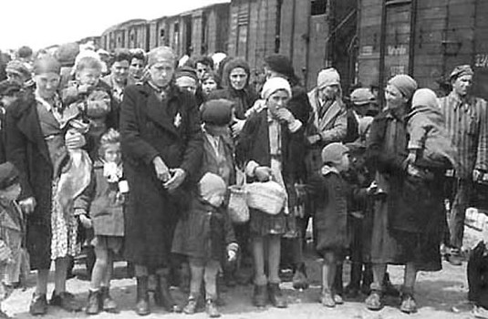
Anti-Semitism
Anti-Semitism is prejudice against Jews.
Once Hitler was in absolute control of Germany he convinced the people that Jews were evil cowards and Germans were hardworking and honest.

Slide 10
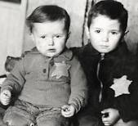
Steps
First, Jews were removed from their jobs and schools. They were forced to wear a yellow star, which labeled them as a Jew. They were banned from certain public places and given a curfew.
Next, Jews were contained to ghettos.
Then, Jews are sent to concentration camps/killing centers.
Finally, WWII ends in 1945, and the camps are liberated, but the damage has already been done.

Slide 11
Historical Notes: add to your notes from yesterday
Take at least 5 notes from each of the videos
(westernscboe, brainpop)
https://www.brainpop.com/socialstudies/worldhistory/holocaust/
https://www.brainpop.com/english/famousauthorsandbooks/annefrank/
https://www.brainpop.com/socialstudies/famoushistoricalfigures/adolfhitler/

Slide 12
“The Girl Who Lived Forever” https://m.youtube.com/watch?v=r6OPtrp6Nds
While you read, create a timeline of important historical events on one side and events from Anne’s life on the other
When you finish reading, complete the short answer in your best sentence writing, using RACE. Turn it in to THEHUB.

Slide 13
Tuesday
Fill out your AGENDA!
Bell Ringer Describe one career you are interested in on your ILP. Why are you interested in that career?
If you finish, you have time to work on your Wordly Wise #2 (DUE FRIDAY)

Slide 14
Wednesday
Fill out your AGENDA!
Bell Ringer Combine these sentences to write a phrase connected to a sentence. (complex sentence)
Anne Frank lived a short life.
Anne Frank made a huge impact on how we remember the Holocaust.
If you finish, you have time to work on your Wordly Wise #2 (DUE FRIDAY)

Slide 15
Thursday
Fill out your AGENDA!
Bell Ringer Read the quote on page 450. Copy part of it on your bell ringer.
Then describe what this tells us about Anne’s character. Do you think you are similar or different from Anne?
If you finish, you have time to work on your Wordly Wise #2 (DUE FRIDAY)

Slide 16
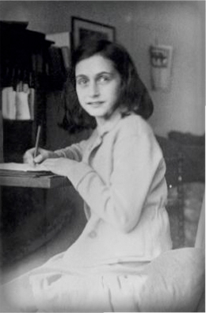
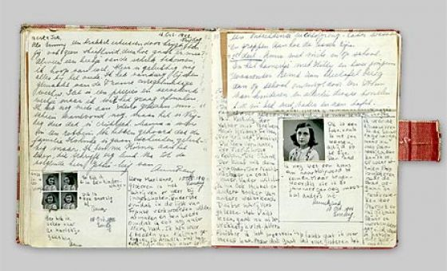
Act 1 Scene 1-2
Complete the worksheet in complete sentences while we read.
QUIZ FRIDAY over Act 1

Slide 17
Friday
Fill out your AGENDA!
Turn in your Wordly Wise #2
Bell Ringer Combine these sentences to write a compound sentence. (two sentences together)
Anne Frank lived during World War 2.
Anne Frank went into hiding while other Jews were being shipped to concentration camps.

Slide 18
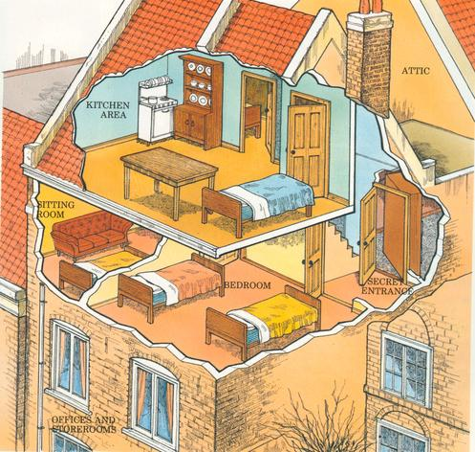
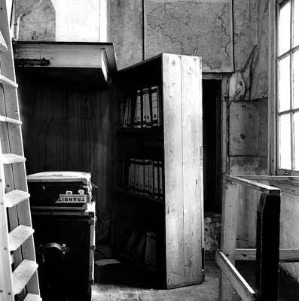
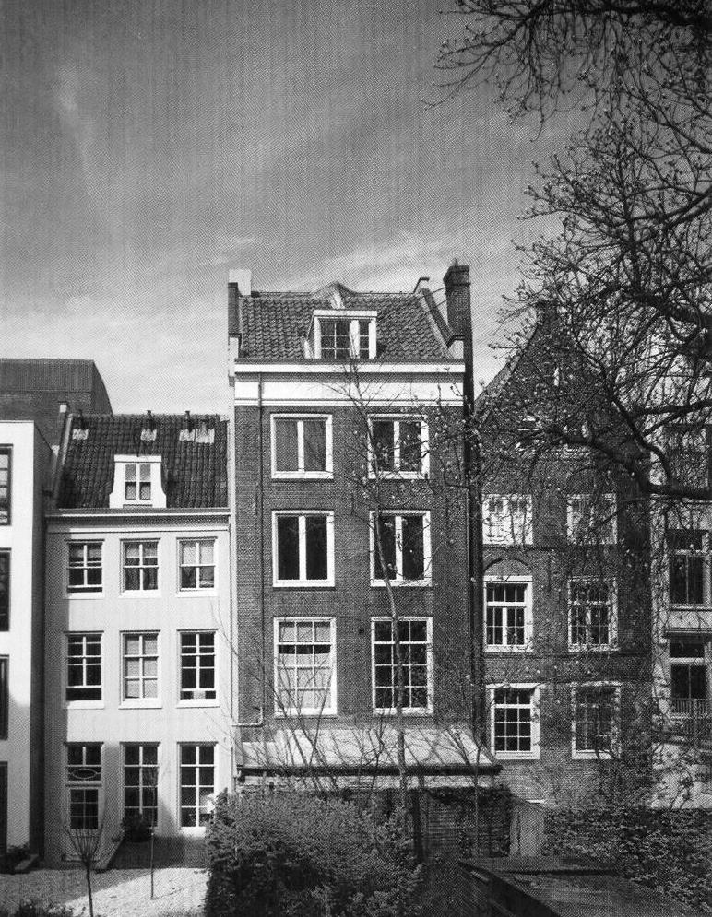
Discussion…
What is Anne experiencing at this point in the play?
What would it feel like to have all the restrictions on your life in hiding? How would you cope with that?

Slide 19
QUIZ over Act 1

