Slide 1
8th Grade Week 3: 8/22-8/26
Mon: Theme Notes, Stop the Sun analysis of theme EXIT TICKET
Tues: Soldier’s Heart Quote Mingle, Read/Annotate, Articles on PTSD
Wed: Connection Chart - Finish Articles on PTSD, NPR and You tube
Thurs: Connection Chart – Guernica, For What it’s Worth
Fri: LIBRARY DAY!

Slide 2
PEACE CLASS NON-NEGOTIABLES
Please complete locker, restroom, library, etc. BEFORE entering
Once you enter you must be in your seat at ALL TIMES.
Please eat breakfast quickly and clean up after yourself.
When announcements come on, EVERYONE LISTENS.
Peace class is PEACEFUL. Please keep your conversations and behavior at a calm and quiet level.

Slide 3
Monday
Copy the Agenda
Flashback: What is theme?
Bell Ringer: Why is it important to understand the theme of a story?

Slide 4
Learning Target
I can determine the theme of a story.
RL 8.2

Slide 5
Notes on Theme https://www.youtube.com/watch?v=p4qME64SkxM
Take notes:
What is theme?
What is theme NOT?
What are the 4 ways to find theme?
A.
B.
C.
D.

Slide 6
“Stop the Sun” page 49 EXIT TICKET:
As you listen to the story again, write at least 3 quotes from the story that help you identify and understand the the theme.

Slide 7
EXIT TICKET:
How does Terry change or what does he go through?
What is the main conflict? Internal and External?
(Man vs Man, Man vs Self, Man vs Society, Man vs Nature?)
How does the title fit the story and give clues for the theme?
Now write a statement that you think could be the theme of “Stop the Sun” on your exit ticket.

Slide 8
Tuesday
Copy the Agenda
Flashback: What are 4 ways to find theme?
Bell Ringer: What does it mean to anticipate a text?

Slide 9
Learning Target
I can cite text evidence to draw connections between texts.
RL 8.1

Slide 10
Quotation Mingle
Find as many different quotes besides your own to better understand the text.
What do you think this text might be about?
What time and place are depicted?
Any guesses as to who wrote this?

Slide 11
Soldier’s Heart

Slide 12
Connection Chart
Underline and mark sentences or phrases that remind you of the story “Stop the Sun”
When we finish reading, add to your chart.

Slide 13
Wednesday
Copy the Agenda
Flashback: What is PTSD?
Bell Ringer: How do you annotate a text?

Slide 14
Learning Target
I can cite text evidence to draw connections between texts.
RL 8.1

Slide 15
Connection Chart
Underline and mark sentences or phrases that remind you of the story “Stop the Sun”
When we finish reading, add to your chart.

Slide 16
PTSD
NPR Radio Broadcast: TAKE CORNELL NOTES http://www.npr.org/2012/08/17/159023437/ptsd-not-just-war-wound-young-people-suffer-too
Youtube Video: Prisoner of her Past
https://www.youtube.com/watch?v=PF3ahUMar1c&feature=relmfu

Slide 17
Thursday
Copy the Agenda
Flashback: What is one thing you’ve learned this week so far about PTSD?
Bell Ringer: How could a painting or song have a theme?

Slide 18
Learning Target
I can cite text evidence to draw connections between texts.
RL 8.1

Slide 19
“For What It’s Worth” – Buffalo Springfield
https://www.youtube.com/watch?v=zGRnw7Y-pVY
Find and annotate:
figurative language
evidence of PTSD
Connections to “Stop the Sun”

Slide 20
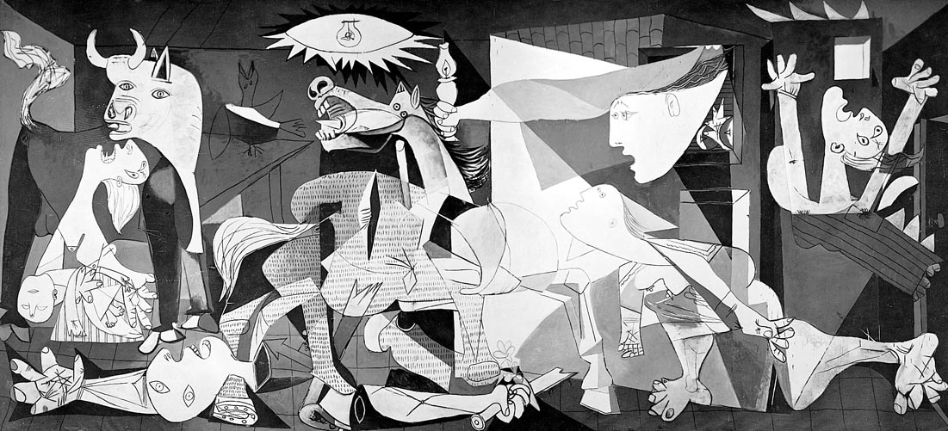
Guernica

Slide 21
Exit Ticket:
After reading several different texts on Post-traumatic Stress Disorder (PTSD), what is it?
Describe your new understanding of how war impacts soldiers and their families.
Why should we be more knowledgeable on this topic?
What action steps should we take as a society?
When you finish, work on your connection chart. DUE TOMORROW!

Slide 22
Friday
Connection Chart DUE TODAY!
LIBRARY DAY!

