Slide 1
8th February Week 3 Anne Frank 2/21-2/24
Mon: NTI
Tues:
Wed:
Thurs:
Fri:

Slide 2
Tuesday
AGENDA!
Turn in all NTI work
Anne Frank Diary Reflection: Open your book to page 488. Answer Question # 4 in your diary. Then describe your faith (if any) and how it has or hasn’t helped you get through difficult times.

Slide 3
Learning Target
I can comprehend character and plot details about a story.
RL 8.2

Slide 4
Wednesday
AGENDA!
Turn in all NTI work
Anne Frank Diary Reflection: How did Act 1 end? Why is this significant or symbolic?

Slide 5
Learning Target
I can comprehend character and plot details about a story.
RL 8.2

Slide 6
Act 1 QUIZ
When you finish, turn it in
Work on any unfinished NTI Work
Read silently.
**** BRING YOUR PROJECT BOOK TOMORROW and a LAPTOP if you are doing the Summit Project

Slide 7
Thursday
AGENDA!
all NTI work DUE TODAY
Anne Frank Diary Reflection: On page 502, Anne writes in her diary that “For myself, life has become much more pleasant.” What is different now about her circumstances that makes her say this? What would cheer you up if you were in hiding for that long?

Slide 8
Learning Target
I can comprehend character and plot details about a story.
RL 8.2

Slide 9
Project Work Time
If you are working on a summit project, get logged on and started.
If you are working on a window project, either read your book or begin working on adapting a timeline.

Slide 10
Friday
AGENDA!
Complete ALL of the Flashback questions for this week if you haven’t already.
Have your project book out and everything else on the floor.

Slide 11
February Week 4 2/27-3/3
Mon:
Tues:
Wed:
Thurs:
Fri: NHD

Slide 12
Monday
AGENDA!
have your green textbook open to page 489
Anne Frank Diary Reflection: How did Act 1 end? Why is this significant or symbolic?

Slide 13
Scene 5 - Page 511
On a separate piece of paper, summarize what happened to the Frank family after they were arrested. (3-5 sentences)
When we watch the videos, take at least 3 notes of facts from each that is NEW information to you.

Slide 14
Tuesday
AGENDA!
Anne Frank Diary Reflection: Some people feel that this play leaves audiences with an unrealistic understanding of the Holocaust and its victims, because the Franks were in such a comfortable hiding location and didn’t get arrested until towards the end of the war. What do you think?

Slide 15
Learning Target
I can compare and contrast two versions of a text to understand how it changes the meaning.
RL 8.5

Slide 16
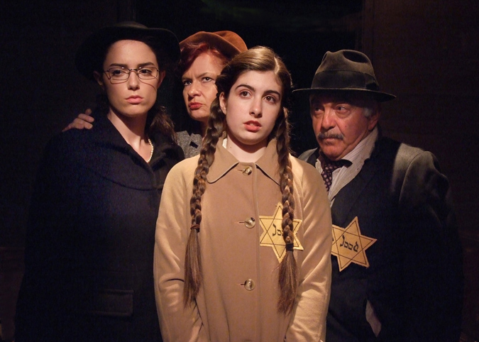
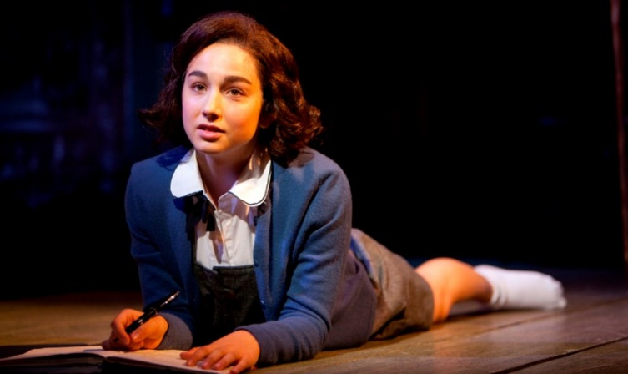
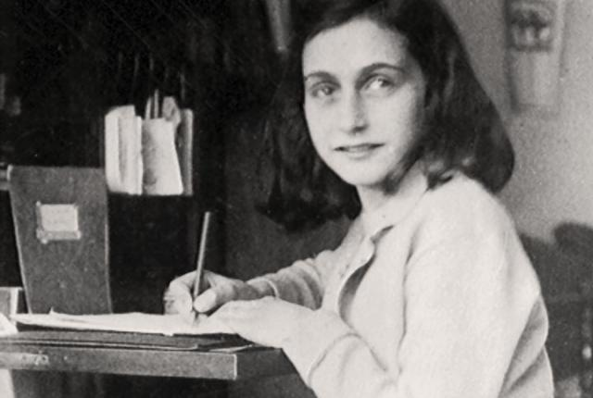
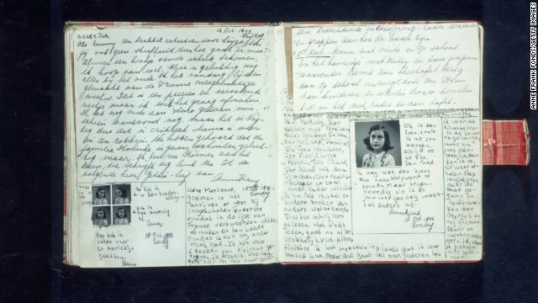
Anne’s Diary vs. Play
Each group will get 4 cards to pass (some may need to share)
7 minutes for each card
Read the diary selection, then read the play version
Complete the questions for each card # on your exit slip
If you finish early, reread your answers or the text

Slide 17
Wednesday
AGENDA!
Anne Frank Diary Reflection: Who is someone you know that has the same optimistic and hopeful mindset as Anne? Describe them.

Slide 18
Reflection Questions
How does Anne’s actual diary provide insight/understanding into her story that the play cannot?
How does turning the diary into a play help us to understand her story even better?

Slide 19
Thursday
AGENDA!
Anne Frank Diary Reflection: What do you have left to complete on your project? What next steps do you need to take today?

Slide 20
Project Work Time
You will get points today for your focus and effort on working on your project.

Slide 21
Thursday
AGENDA!
Anne Frank Diary Reflection: People say Anne Frank’s story lives on because of the legacy she has left in the lines of her diary. What will you remember most about her story?

