Slide 1
8 Week Feb 2 ANNE FRANK
Mon: Miep Gies Article
Tues: Student Voice Info./ Scene 3 Worksheet
Wed: Scene 3
Thurs: Socratic Circle
Fri: Quiz over Act 1

Slide 2
Monday
There will be a substitute teacher
Read the Miep Gies article
Answer the Questions
Work on Wordly Wise

Slide 3
Tuesday
Fill out your AGENDA
Complete the Flashbacks
Anne Frank Reflection: “There are no walls, there are no bolts, no locks that anyone can put on your mind.” Interpret the meaning of this quote in at least 3-5 sentences.

Slide 4
Student Voice Survey

Slide 5
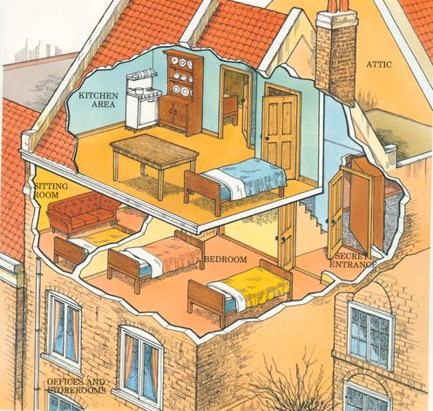
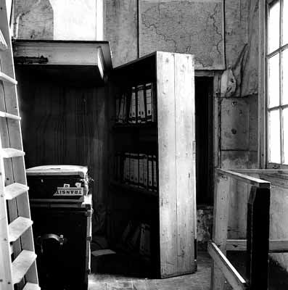
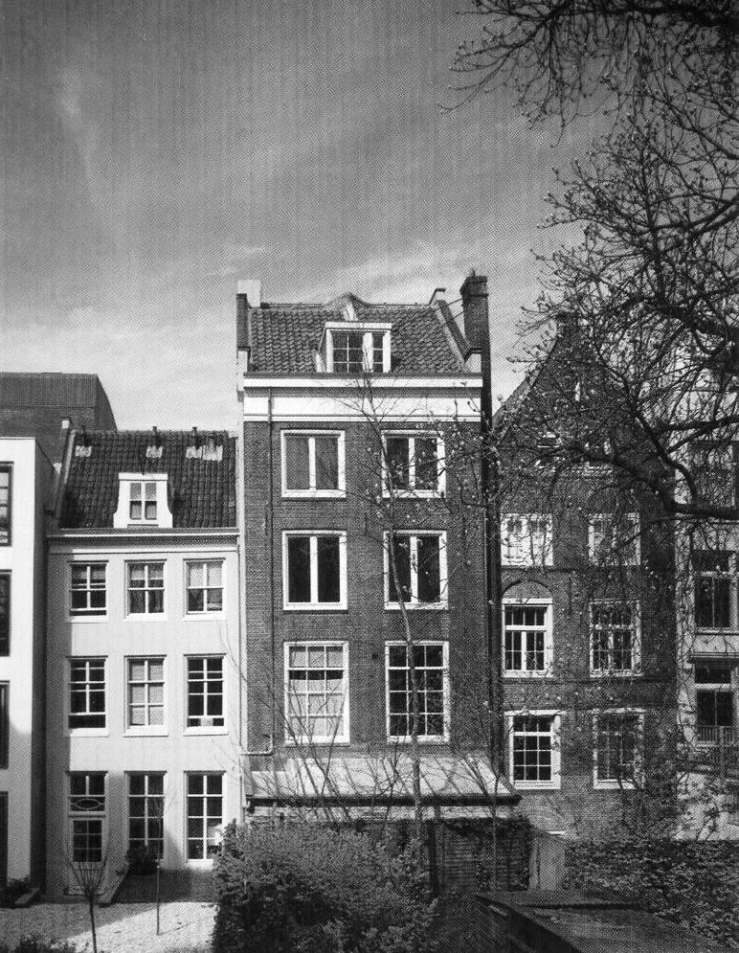
Discussion…
What is Anne experiencing at this point in the play?
What would it feel like to have all the restrictions on your life in hiding? How would you cope with that?

Slide 6
Wednesday
Fill out your AGENDA
Complete the Flashbacks
Anne Frank Reflection: “There are no walls, there are no bolts, no locks that anyone can put on your mind.” Interpret the meaning of this quote in at least 3-5 sentences.

Slide 7
What is the Student Voice Survey?

Slide 8
Learning Target
I can prepare for discussion.
Sp &L 8.1a

Slide 9
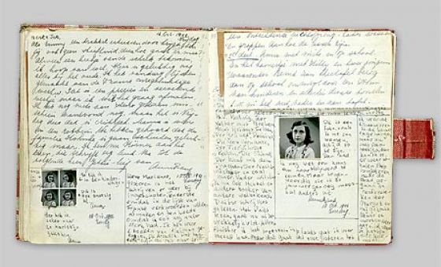
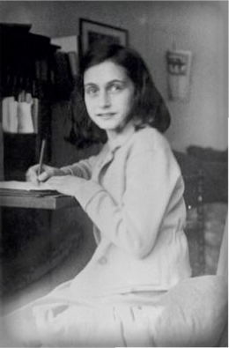
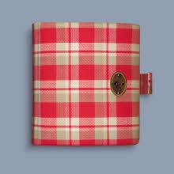
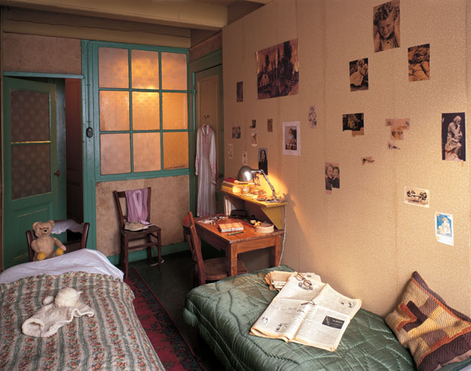
Act 1 Scene 3
While we read this scene, prepare for discussion later by answering the questions.

Slide 10
Thursday
Fill out your AGENDA
Complete the Flashbacks
Anne Frank Diary Reflection: Would you want to burn your yellow star patch like Peter, because it represents discrimination and death? Or would you be hesitant like Anne, because it is part of your faith? Explain your reasoning.

Slide 11
Learning Target
I can understand how an author uses characterization in dialogue.
RL 8.1 and 8.3

Slide 12
Socratic Circle
Every voice is respected
Speak when no one else is speaking, one at a time
Everyone needs to respond at least 1 time for credit

Slide 13
Act 1: Scene 4-5
While we read, complete the worksheet over scene 5 when it comes time.
QUIZ tomorrow over Act 1

Slide 14
Friday
Fill out your AGENDA
Be ready to grade your Reflections
Anne Frank Diary Reflection: How are Anne and Margot different? Give an example. Do you have any siblings who you are different from? (If you are an only child, describe which of your parents you are most like and why.)

Slide 15
GRADE YOUR FLASHBACK
Be sure to write in the correct answer in RED PEN
4 points per day
TOTAL + ___ / 16

Slide 16
Learning Target
I can comprehend character and plot details about a story.
RL 8.2

Slide 17
QUIZ over Act 1
Please DO NOT WRITE ON THE QUIZ, write on a piece of paper
Turn in your test to the pile on the table and answers to THEHUB
Read your project book silently.
*Book Review Due 12/9, Window Due 12/13

