Slide 1
8 Week 1/31-2/3 ANNE FRANK
Mon: NTI DAY 1
Tues: ILPs in the computer lab
Wed: Anticipation Guide/ begin notes
Thurs: Finish Notes, begin reading “The Girl Who Lived Forever”
Fri: Short Answer/ Quiz over notes and “The Girl Who Lived Forever”

Slide 2
Wednesday
Fill out your AGENDA! (NTI work is due tomorrow!)
Bell Ringer: When it comes to reading about WWII, what would you like to learn more about?

Slide 3
Anticipation Guide
Compete the questions IN COMPLETE sentences.
The back two questions need to be at least 3-5 sentences

Slide 4
Learning Target
I can understand the historical context of a novel.
RI 8.3

Slide 5
The Holocaust
The Diary of Anne Frank

Slide 6
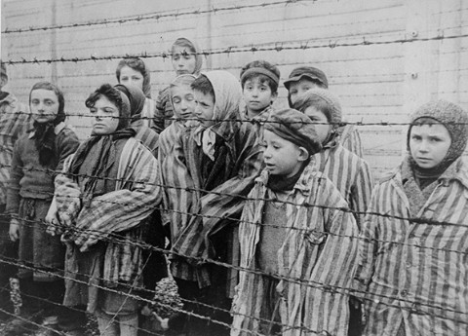
The Holocaust
Period from 1939, when Adolf Hitler became leader of Germany, to 1945 when WWII ended.
Jews were persecuted, which led to 6 million deaths. (1.5 million child deaths).

Slide 7
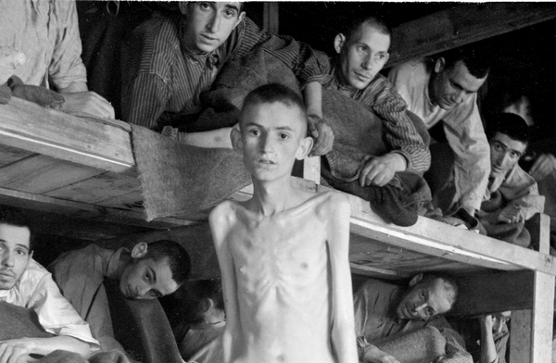
Final Solution
Hitler’s plan to annihilate the entire Jewish population.
Genocide is the total destruction of an ethnic, racial, or religious group.

Slide 8
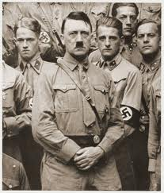
Nazi
Nazi stands for National Socialist German Workers Party.
Hitler was the leader of the Nazis and blamed the Jews for the problems in Germany.
There are many theories for why Hitler hated the Jews.
For example, he thought having a common hatred or common enemy would unite the German people.
During the depression in Germany, Hitler and others were jealous of the prominent jobs that Jewish people held.

Slide 9
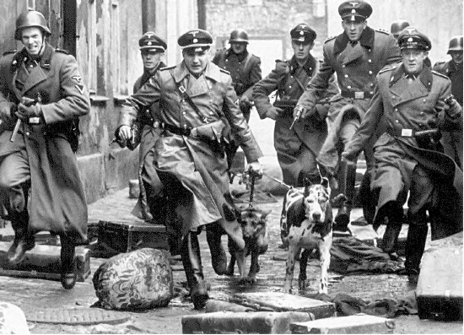
Gestapo
The Gestapo were Hitler’s police and they terrorized, beat, or sent to concentration camps anyone who opposed the Nazi party.

Slide 10
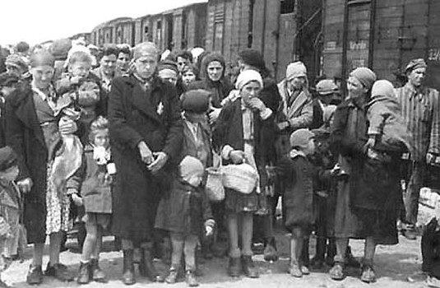
Anti-Semitism
Anti-Semitism is prejudice against Jews.
Once Hitler was in absolute control of Germany he convinced the people that Jews were evil cowards and Germans were hardworking and honest.

Slide 11
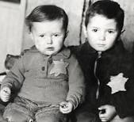
Steps
First, Jews were removed from their jobs and schools. They were forced to wear a yellow star, which labeled them as a Jew. They were banned from certain public places and given a curfew.
Next, Jews were contained to ghettos.
Then, Jews are sent to concentration camps/killing centers.
Finally, WWII ends in 1945, and the camps are liberated, but the damage has already been done.

Slide 12
Thursday
Fill out your AGENDA: NTI WORK IS DUE
Bell Ringer: How does a play version of a text change the story compared to reading a novel? (Explain)

Slide 13
Silent Work Time: use your hand signals to move
Complete the NTI work (if you haven’t already). Please bring that to Mrs. S when you’re done.
Turn in the Theme Anticipation Guide from yesterday (if you took it home to finish).
Complete Wordly Wise #1 (DUE TOMORROW)
Read “The Girl Who Lived Forever” (Quiz Tomorrow over this)
If you finish everything, read silently an independent book.

Slide 14
Learning Target
I can understand the historical context of a novel.
RI 8.3

Slide 15
The Holocaust
The Diary of Anne Frank

Slide 16
The Holocaust
Period from 1939, when Adolf Hitler became leader of Germany, to 1945 when WWII ended.
Jews were persecuted, which led to 6 million deaths. (1.5 million child deaths).

Slide 17
Final Solution
Hitler’s plan to annihilate the entire Jewish population.
Genocide is the total destruction of an ethnic, racial, or religious group.

Slide 18
Nazi
Nazi stands for National Socialist German Workers Party.
Hitler was the leader of the Nazis and blamed the Jews for the problems in Germany.
There are many theories for why Hitler hated the Jews.
For example, he thought having a common hatred or common enemy would unite the German people.
During the depression in Germany, Hitler and others were jealous of the prominent jobs that Jewish people held.

Slide 19
Gestapo
The Gestapo were Hitler’s police and they terrorized, beat, or sent to concentration camps anyone who opposed the Nazi party.

Slide 20
Anti-Semitism
Anti-Semitism is prejudice against Jews.
Once Hitler was in absolute control of Germany he convinced the people that Jews were evil cowards and Germans were hardworking and honest.

Slide 21
Steps
First, Jews were removed from their jobs and schools. They were forced to wear a yellow star, which labeled them as a Jew. They were banned from certain public places and given a curfew.
Next, Jews were contained to ghettos.
Then, Jews are sent to concentration camps/killing centers.
Finally, WWII ends in 1945, and the camps are liberated, but the damage has already been done.

Slide 22
Historical Notes: add to your notes from yesterday
Take at least 5 notes from each of the videos
(westernscboe, brainpop)
https://www.brainpop.com/socialstudies/worldhistory/holocaust/
https://www.brainpop.com/english/famousauthorsandbooks/annefrank/
https://www.brainpop.com/socialstudies/famoushistoricalfigures/adolfhitler/

Slide 23
“The Girl Who Lived Forever” https://m.youtube.com/watch?v=r6OPtrp6Nds
While you read, create a timeline of important historical events on one side and events from Anne’s life on the other
When you finish reading, complete the short answer in your best sentence writing, using RACE. Turn it in to THEHUB.

Slide 24
Friday
Fill out your AGENDA
Be ready to grade your Bell Ringers from this week
Bell Ringer:
Choose 3 of your words from Wordly Wise this week. Create a sentence with all three words in it.

Slide 25
GRADE YOUR Bell Ringers
Be sure to write in the correct answer in RED PEN
4 points per day
TOTAL + ___ / 12

Slide 26
The Holocaust
The Diary of Anne Frank

Slide 27
The Holocaust
Period from 1939, when Adolf Hitler became leader of Germany, to 1945 when WWII ended.
Jews were persecuted, which led to 6 million deaths. (1.5 million child deaths).

Slide 28
Final Solution
Hitler’s plan to annihilate the entire Jewish population.
Genocide is the total destruction of an ethnic, racial, or religious group.

Slide 29
Nazi
Nazi stands for National Socialist German Workers Party.
Hitler was the leader of the Nazis and blamed the Jews for the problems in Germany.
There are many theories for why Hitler hated the Jews.
For example, he thought having a common hatred or common enemy would unite the German people.
During the depression in Germany, Hitler and others were jealous of the prominent jobs that Jewish people held.

Slide 30
Gestapo
The Gestapo were Hitler’s police and they terrorized, beat, or sent to concentration camps anyone who opposed the Nazi party.

Slide 31
Anti-Semitism
Anti-Semitism is prejudice against Jews.
Once Hitler was in absolute control of Germany he convinced the people that Jews were evil cowards and Germans were hardworking and honest.

Slide 32
Steps
First, Jews were removed from their jobs and schools. They were forced to wear a yellow star, which labeled them as a Jew. They were banned from certain public places and given a curfew.
Next, Jews were contained to ghettos.
Then, Jews are sent to concentration camps/killing centers.
Finally, WWII ends in 1945, and the camps are liberated, but the damage has already been done.

Slide 33
Historical Notes: add to your notes from yesterday
Take at least 5 notes from each of the videos
(westernscboe, brainpop)
https://www.brainpop.com/socialstudies/worldhistory/holocaust/
https://www.brainpop.com/english/famousauthorsandbooks/annefrank/
https://www.brainpop.com/socialstudies/famoushistoricalfigures/adolfhitler/

Slide 34
Learning Target
I can answer a short answer question using the RACE format.
RW 8.2b

Slide 35
Short Answer Help
REMEMBER to RACE!
R = Restate the question
A = Answer the question
C = Cite evidence to support your answer
E = Explain your evidence

Slide 36
QUIZ
When you finish reading, complete the short answer in your best sentence writing, using RACE. Turn it in to THEHUB.
Create a timeline of events from Anne Frank’s life, but also world war events.
When you finish, begin Wordly Wise Lesson 2 (Due NEXT FRIDAY)

Slide 37
QUIZ over Act 1
Please DO NOT WRITE ON THE QUIZ, write on a piece of paper
Turn in your test to the pile on the table and answers to THEHUB
Read your project book silently.
*Book Review Due 12/9, Window Due 12/13

