Slide 1
8th MARCH Week 2 Anne Frank 3/6-3/10
Mon: Diary Passages
Tues: Diary Passages/ Picture Folders
Wed: Picture Folders
Thurs: On-Demand 40 minute Practice
Fri: District Common Assessment

Slide 2
Monday (Reminder: All Assignments DUE FRIDAY for 3rd Term)
Complete the Agenda
BELL RINGER: Turn to page 507. At the end of Scene 3, Anne says, “I have often been downcast myself…but never in despair. I can shake off everything if I write.”
What is the one thing for you in life that allows you to “shake off everything” like Anne?

Slide 3
Learning Target
I can compare and contrast two versions of a text to understand how it changes the meaning.
RL 8.5

Slide 4
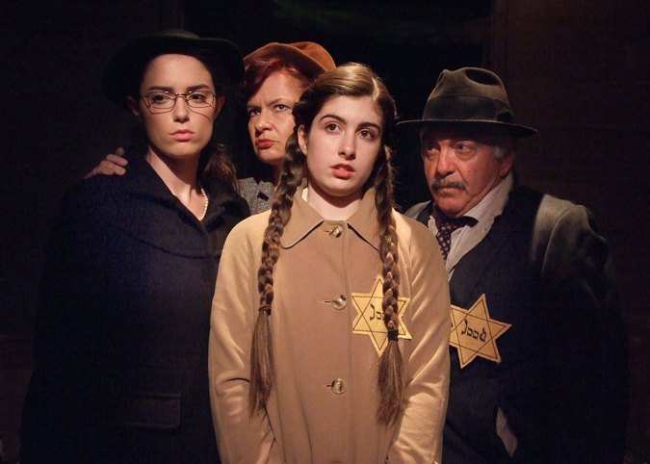
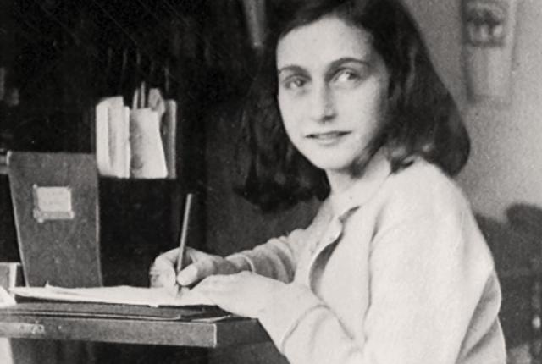
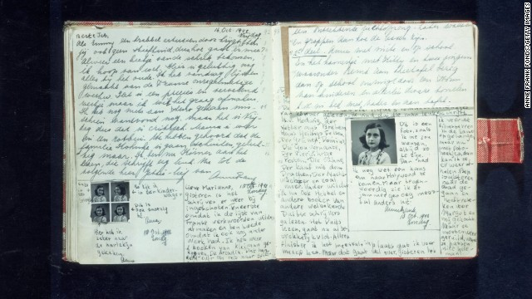
Anne’s Diary vs. Play
Each group will get 4 cards to pass (some may need to share)
7 minutes for each card
Read the diary selection, then read the play version
Complete the questions for each card # on your exit slip
If you finish early, reread your answers or the text

Slide 5
Reflection Questions
How does Anne’s actual diary provide insight/understanding into her story that the play cannot?
How does turning the diary into a play help us to understand her story even better?

Slide 6
Tuesday (Reminder: All Assignments DUE FRIDAY for 3rd Term)
Complete the Agenda
BELL RINGER: Who is someone you know that has the same optimistic and hopeful mindset as Anne? Describe them.

Slide 7
Learning Target
I can make inferences about photography to better understand a historical time period.
RI 8.7

Slide 8
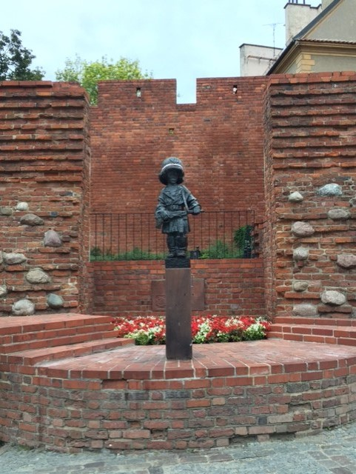
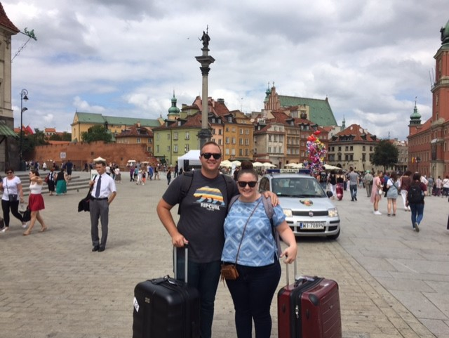

Slide 9
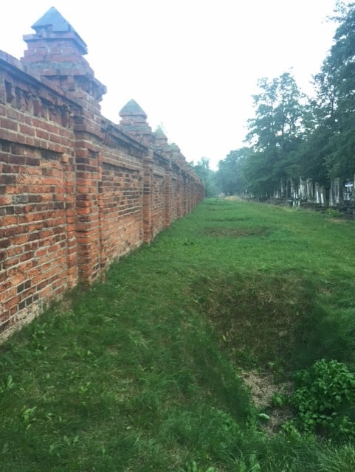
I SEE | I THINK | I WONDER | I LEARNED
What do you literally see in the picture? | What inferences or conclusions can you make about it? | What questions could you ask?

Slide 10
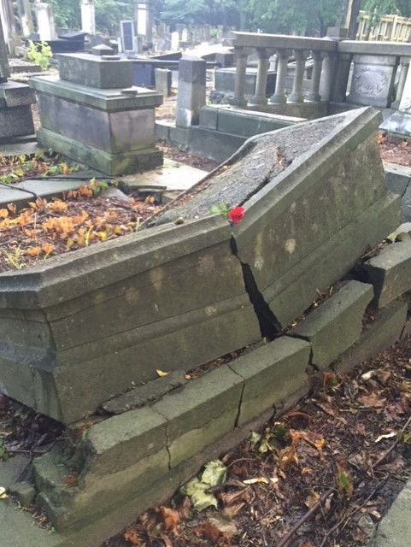
I SEE | I THINK | I WONDER | I LEARNED
What do you literally see in the picture? | What inferences or conclusions can you make about it? | What questions could you ask?

Slide 11
Photo Folder Swap
First 3 minutes - complete the first 3 boxes.
Be sure to pass around the folder for everyone.
DO NOT OPEN the folder until the timer goes off.
Final 4 minutes – Read the inside info out loud.
Then write down what you’ve learned.

Slide 12
Wednesday (Reminder: All Assignments DUE FRIDAY for 3rd Term)
Complete the Agenda
BELL RINGER: There’s an old saying that says “a picture says a thousand words”. How is this true?

Slide 13
Learning Target
I can make inferences about photography to better understand a historical time period.
RI 8.7

Slide 14
Photo Folder Swap
First 3 minutes - complete the first 3 boxes.
Be sure to pass around the folder for everyone.
DO NOT OPEN the folder until the timer goes off.
Final 4 minutes – Read the inside info out loud.
Then write down what you’ve learned.

Slide 15
Thursday
40 minute On-Demand Practice

Slide 16
Friday
District Common Assessment

