Slide 1
7th Grade Week 3: 8/22-8/26
Mon: “Rikki-Tikki-Tavi”, Point of View Notes, Quote Analysis Assignment
Tues: RTT, Conflict Exit Ticket
Wed: RTT, Types of Conflict Notes
Thurs: Quote Analysis Work Day
Fri: LIBRARY DAY

Slide 2
Monday
Copy the Agenda
Flashback: What is the climax of a story?
Bell Ringer: What are 3 different types of Point of View?

Slide 3
Cornell NOTES
LEFT Column = BIG IDEAS/Terms
RIGHT Column = Details about the big idea or term

Slide 4
Point of View – the perspective a story is told from
1st Person – “I”, we know only that characters thoughts
2nd Person – “You”, puts the reader in the story
3rd Person – Omniscient (all-knowing), He, she, they, can see everything
3rd Person LIMITED – focuses on one person’s experience/thoughts, still from outside that character’s mind

Slide 5
Learning Target
I can analyze the point of view in a story.
RL 7.6

Slide 6
http://www.youtube.com/watch?v=vdg9gkmWsEA

Slide 7
“Rikki-Tikki-Tavi” by Rudyard Kipling page 121

Slide 8
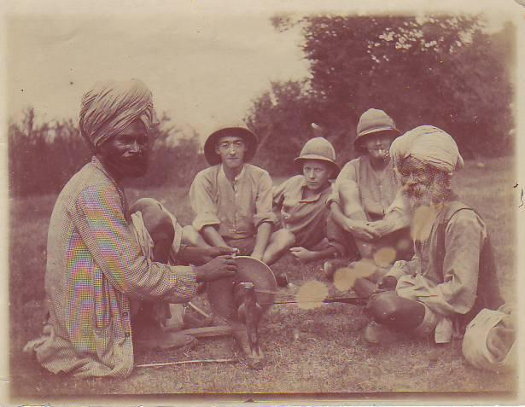
British ruled India

Slide 9
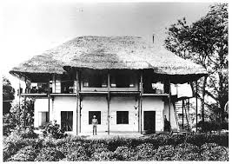
Bungalow

Slide 10
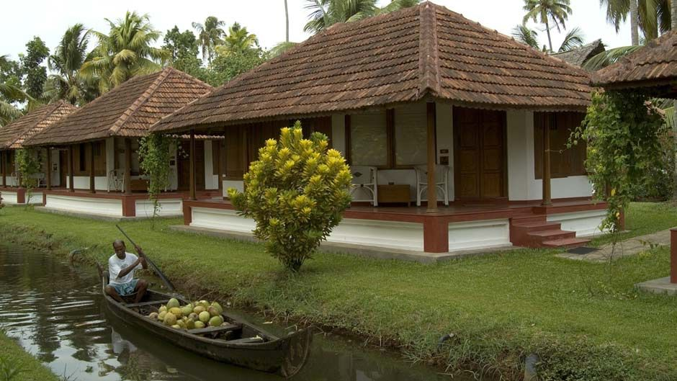
Bungalow

Slide 11
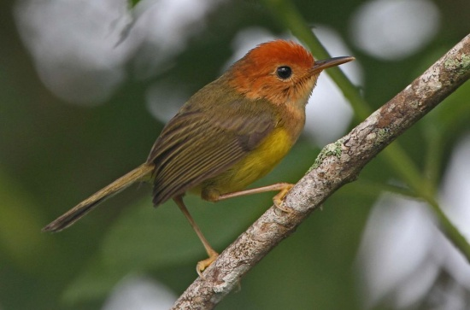
Darzee – A tailorbird

Slide 12
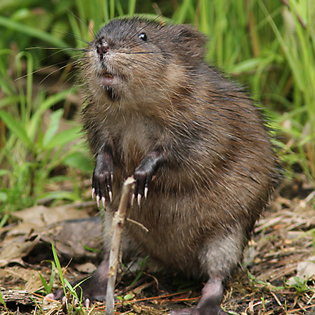
Chuchundra – The Muskrat

Slide 13
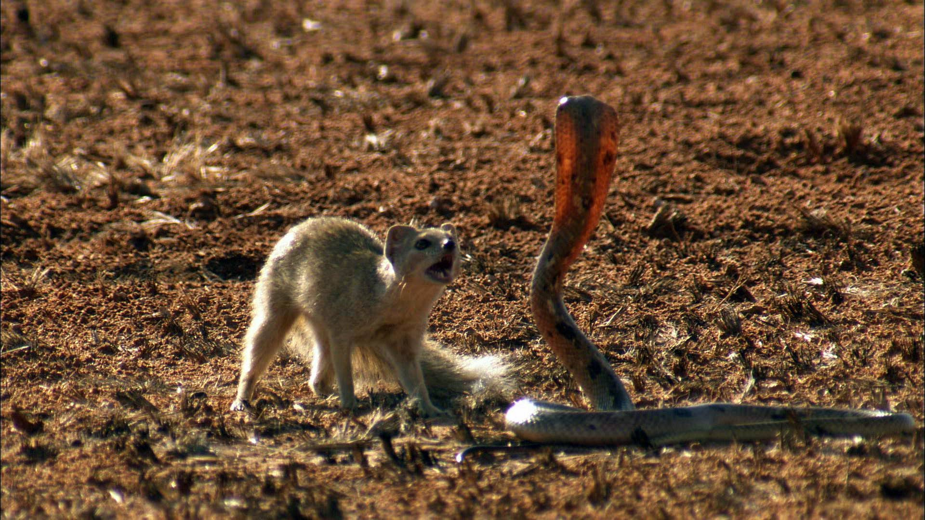
Mongoose vs. Cobra

Slide 14
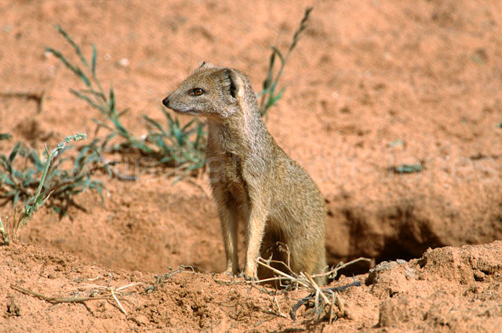
burrow

Slide 15
Exit Ticket: Point of View
This story is told from the 3rd Person Limited Point of View.
Find an example from the text so far that shows the point of view. Copy the sentence from the story.
Then explain why this is limited 3rd person. Why do you think the author chose to tell the story this way?
Make a prediction... Guess what will happen next in the story.

Slide 16
Tuesday
Copy the Agenda
Flashback: What point of view is the story “Rikki-Tikki-Tavi” told in?
Bell Ringer: How would the story be different if it was told in Omniscient 3rd person?

Slide 17
Learning Target
I can identify the role of conflict in a story.
RL 7.3

Slide 18
Page

Slide 19
Exit Ticket: Conflict
*Use complete sentences and restate!
Describe the main conflict or any complications in the story so far.
How do these conflicts move the plot forward?
What do you predict will happen next?
Find a quote from Nag. Write it on your paper.
What does Nag’s dialogue or way of speaking reveal about his character?

Slide 20
Wednesday
Copy the Agenda
Flashback: What are motives?
Bell Ringer:
What is Nag’s main motive?
What is one of Rikki’s motives?
How does this create conflict?

Slide 21
Learning Target
I can analyze the types of conflict in a story.
RL 7.1

Slide 22
Add to your Cornell NOTES
Types of Conflicts: https://www.youtube.com/watch?v=rM5cp_YL77k

Slide 23
Rikki-Tikki-Tavi Conflict Competition!
With your table, list as many conflicts in the story as you can think of.
Then label which type of conflict they are.
There will be an incentive for the largest, most accurate list! ☺

Slide 24
Thursday
Copy the Agenda
Flashback: What are 3 types of external conflicts?
Bell Ringer: In what ways has Rikki-Tikki’s new home and surrounding created conflict?

Slide 25
Learning Target
I can use text evidence to analyze how the setting impacts the plot.
RL 7.3, 7.1

Slide 26
Page

Slide 27
Active Reader Questions
Answer the questions within the text as we finish the story today.
These should go in your notes section of your binder.

Slide 28
Quote Analysis Assignment
Work silently on your quote analysis assignment.

Slide 30
Friday
LIBRARY DAY!

